Slide 1

Creating a Collective Approach to Address an Aging NH
NH Alliance for Healthy Aging
Quarterly Meeting
June 16, 2016

Slide 2

You may feel that your part is small and you may not even see your role yet. I am here to shout it out: Every person in the process is important. You are AWESOME! Together we will achieve our vision. Thank you for participating!

Slide 4
Alliance for Healthy Aging Action Steps
Implementation
June/ July 2016
Convene kickoff meeting for each strategic area.
Summer 2016
Finalizing 12 month approach for each strategic area including detailed plan as needed.
Define measurements
Fall 2016
Take action based on plans in each strategy area.
Alliance Quarterly meetings occur.
Winter 2017
Strategy areas update steering committee about progress on actions.
Action continues within each strategy area.
Alliance Quarterly meeting occurs
Spring/Summer 2017
Action continues within each strategy areas.
Alliance Quarterly meeting occurs.
Alliance reevaluates strategic priority areas.
Development
Notes:
Update for us.

Slide 5
The steering committee, actions areas & backbone functions all play pivotal roles in Collective Impact
Common Agenda and Shared Metrics
strategic guidance and support
partner-driven
action
= community partner (e.g., nonprofit, funder, business, public agency, parent)
Community partners working on strategies
Communications Committee
Community Partners
Enhance services and supports for informal, family caregivers
Identify and advocate for needed zoning changes in order to promote affordable, accessible housing options
Program team
Steering Committee
Improve the availability of quality healthcare and social service workforces
Convene a cross-disciplinary workgroup including medical, mental health, social service, community service, and oral health providers, in order to plan and coordinate efforts
Develop an advocacy infrastructure to enhance support for aging issues
Measurement Committee
Backbone
Support
Guides strategy
Supports aligned activities
Establishes shared measurement
Builds public will
Advances policy
Mobilizes resources
Assure that information on resources, services, transportation and housing is available, accessible, and coordinated
Improve care coordination for older adults involving medical, mental health, social, community, and oral health services
Increase transportation options, including an analysis of current efforts and funding issues
*Adapted from Listening to the stars: The Constellation Model of Collaborative Social Change by Tonya Surman and Mark Surman, 2008.
From “Collective Impact: Leading Change to Achieve Results,” Presentation at the NGA Talent Pipeline Policy Academy, October, 2014

Slide 6
NH Alliance for Healthy Aging: 2016 Strategic Groups
Workgroup Name | Kickoff Meeting | Location
Improve care coordination for older adults involving medical, mental health, social, community, and oral health services (practice). | Monday, June 13 1:00 - 3:00 | Concord IOD: PDC
Increase transportation options, including an analysis of current efforts and funding issues | Monday, June 13 9:00 - 11:00 | Concord IOD: Suncook
Convene a cross-disciplinary workgroup including medical, mental health, social service, community service, and oral health providers, in order to plan and coordinate efforts (public policy). | Tuesday, June 21 1:00 - 3:00 | Concord IOD: PDC
Enhance services and supports for informal, family caregivers. | Friday, June 24 9:00 - 11:00 | Concord IOD: Suncook
Develop an advocacy infrastructure to enhance support for aging issues. | Tuesday, June 28 9:00-11:00 | Concord IOD: PDC
Assure that information on resources, services, transportation, and housing is available, accessible, and coordinated. | Wednesday, June 29 1:00 - 3:00 | Concord IOD: Suncook
Improve the availability of quality healthcare and social service workforces. | Wednesday, June 29 9:00 - 11:00 | Concord IOD: Suncook
Identify and advocate for needed zoning changes in order to promote affordable, accessible housing options. | Friday, July 1 9:00 - 11:00 | Concord IOD: PDC

Slide 7
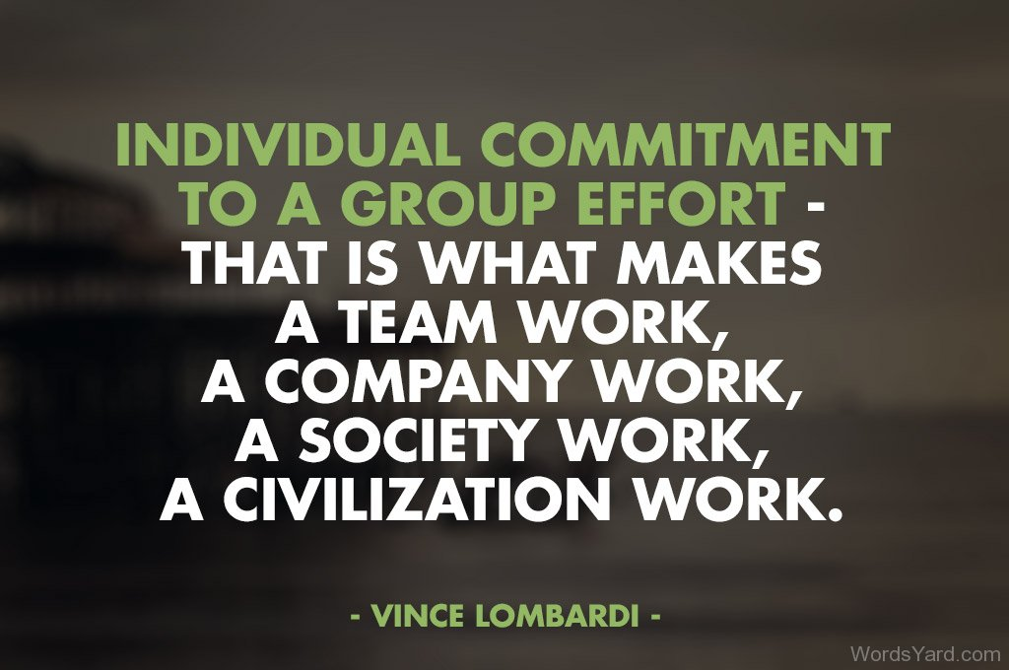

Slide 8
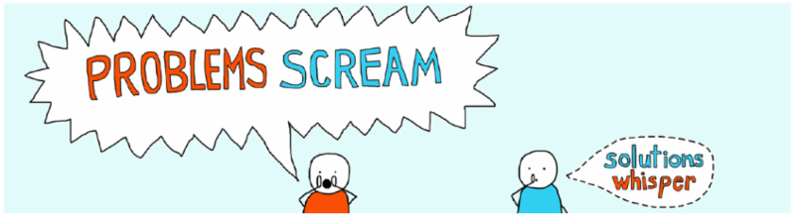
Raising Awareness of Aging Issues in NH

Slide 9


Systems Change for the News!

Slide 10
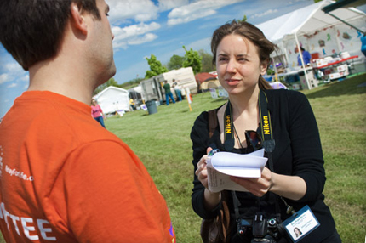
SoJo Gets Results. Readers Say:
Seemed different from typical news articles
Gained more knowledge about the issue in the article
Felt better informed about the issue
Increased their interest in the issue
Believe they could contribute to a solution
Believe that there are effective ways to address the issue
Influenced their opinion about the issue
Felt inspired and/or optimistic

Slide 11
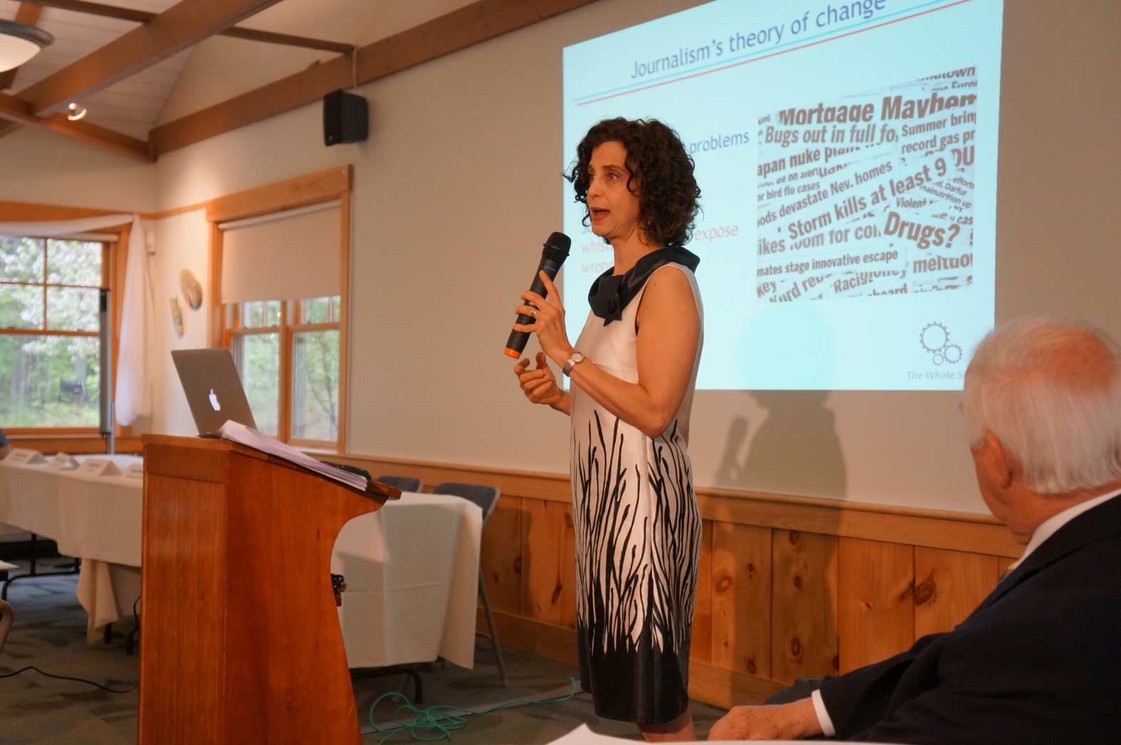
NYT Reporter Tina Rosenberg

Slide 12
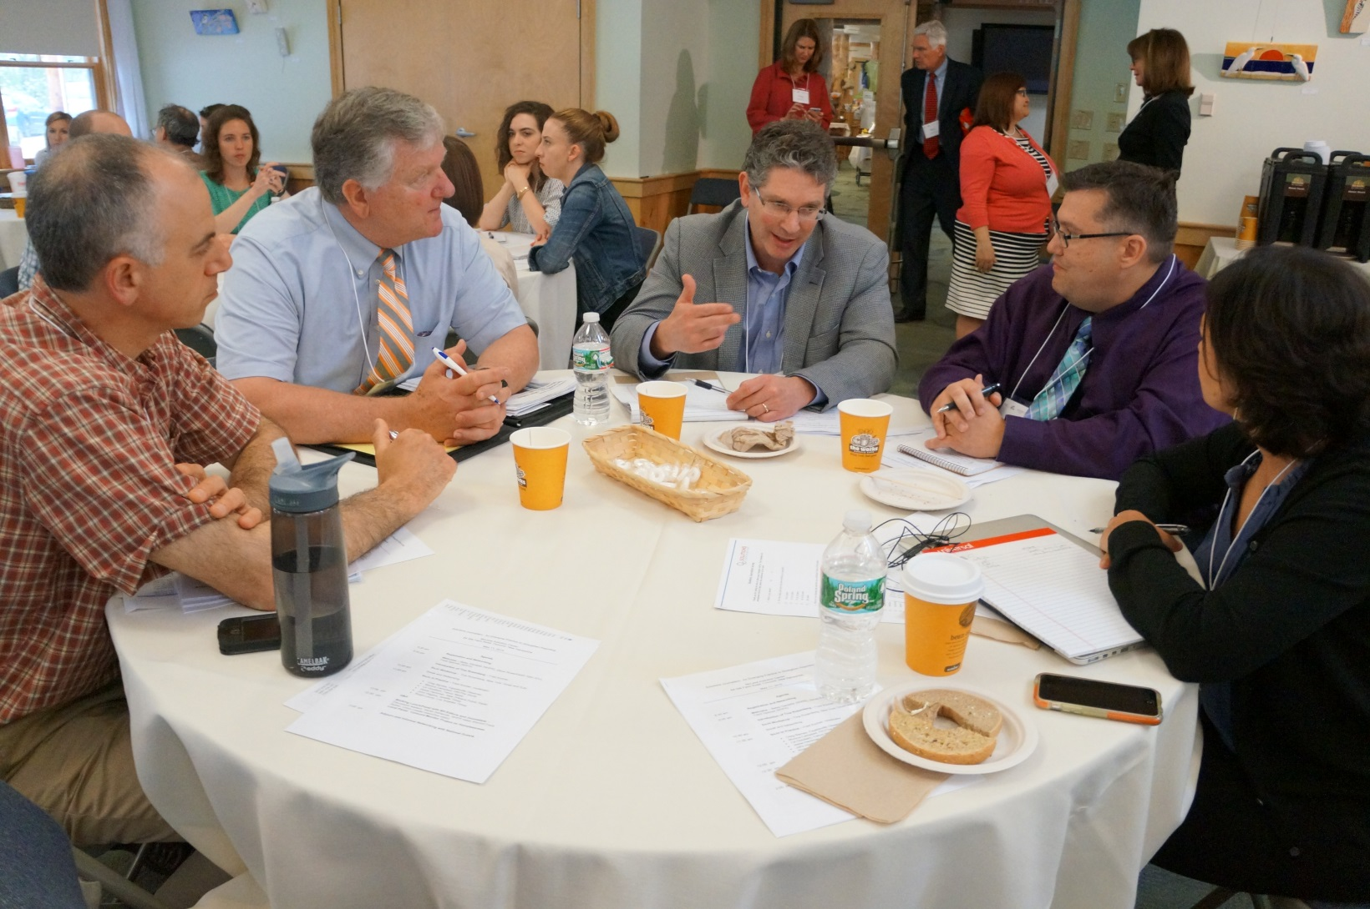

Slide 13
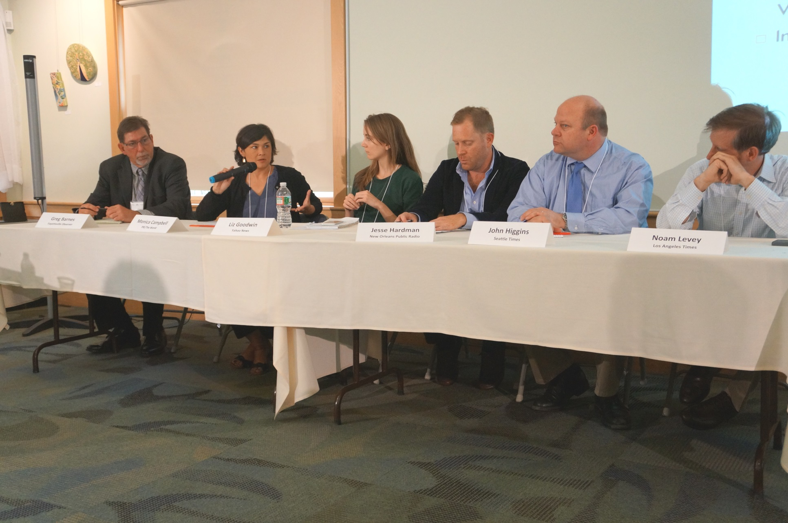

Slide 14
Our National SoJo Panel
Monica Campbell, Immigration Reporter, PRI The World
Jesse Hardman, Environmental Reporter, New Orleans Public Radio
Noam Levey, Health Correspondent, L.A. Times
John Higgins, Education Reporter, Seattle Times
Greg Barnes, Sunday Editor, Fayetteville Observer
Liz Goodwin, National Affairs Writer, Yahoo News

Slide 15

New SoJo Series
Union Leader year-long series on aging
Newsroom-wide training on sojo
Full-Time reporter to be hired
Technical assistance from SoJo Network
Web presence
Shared content with other news outlets
Culminates in a public forum on the issue

Slide 16

National and Local Framing

Slide 17
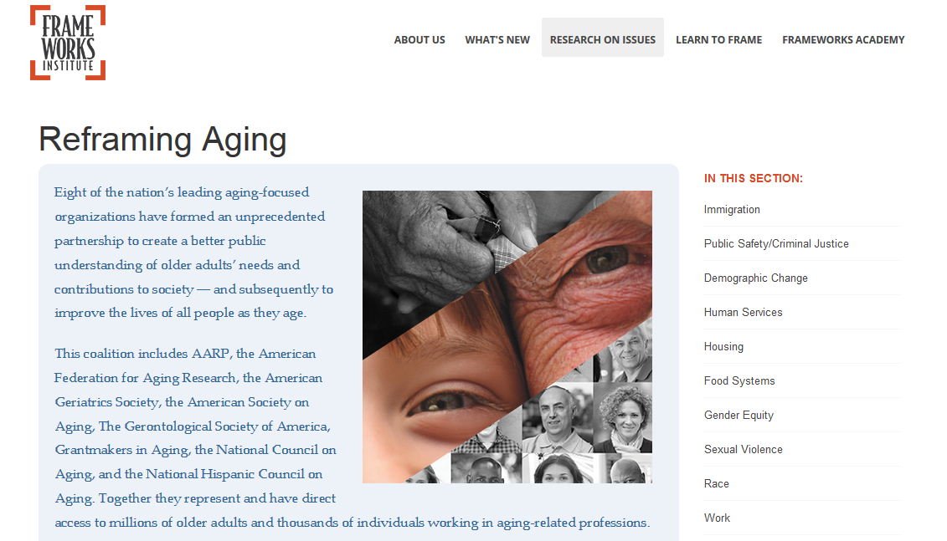
Reframing Aging

Slide 18
A Funding Scan for Age-Friendly Initiatives in NH: Illuminating Opportunities
Focus of the scan
  Starting point of mapping the vision of AHA by correlating opportunities with 2015 action planning strategies.
  For AHA members to find potential funding streams for groups seeking to take action steps
  To gather knowledge about the types and availability of funding
Scan Layout

Slide 19
Tufts Health Plan Foundation
Website: http://www.tuftshealthplanfoundation.org/index.php
Summary: The Tufts Health Plan Foundation aims to build communities that are responsive to the needs of older adults. The Foundation makes investments that promote: (1) moving communities towards achieving age-friendly policies and practices that are relevant; (2) focus on the most vulnerable; and (3) include older adults in the process. The Foundation has three focus areas outlined below, timing for applications varies for each focal area and is included in stated description.
Focal Areas (timing included):
Systems and Best Practices
Policy and Advocacy
James Roosevelt, Jr., Leadership Fund
Level of Opportunity: Community, statewide, or national impact.
Type of Opportunity: Research, direct practice, and capacity building.
Funding Amount: Not stated.
AHA Strategic Framework Area:

Slide 20
Funding Scan Spreadsheet
It encompasses all the grant opportunities outlined in the scan and offers the ability to sort and search for specific keywords related to each opportunity.
These two documents can be found on the Endowment For Health’s Website: endowmentforhealth.org
  Report URL:
  Spreadsheet URL:

Slide 21
Thank you for participating!
Please join us for lunch and screening of the film, Nine to Ninety following the meeting
For questions, or more information contact: jennifer.rabalais@unh.edu

