Slide 1

Creating a Collective Approach to Address an Aging NH
NH Alliance for Healthy Aging
Quarterly Meeting
December 15, 2016

Slide 2
Today’s Agenda
Welcome and introductions
New items and updates
Building an Aging Advocacy Network
Discussion on how we measure our progress including a small group activity
Winnipesaukee Public Health Council
Strategic Group Updates
Next steps/adjourn

Slide 3
What’s New? BOX!
Box is an online, cloud-based service and allows users to store, collaborate and share information.
AHA will be using Box so that all members will be able to view and share information.
These folders are updated periodically so check back for updates!
To access BOX click here: https://unh.box.com/s/euc2o9pu4zja2b5g4dfxs5agq0nan0pg

Slide 4
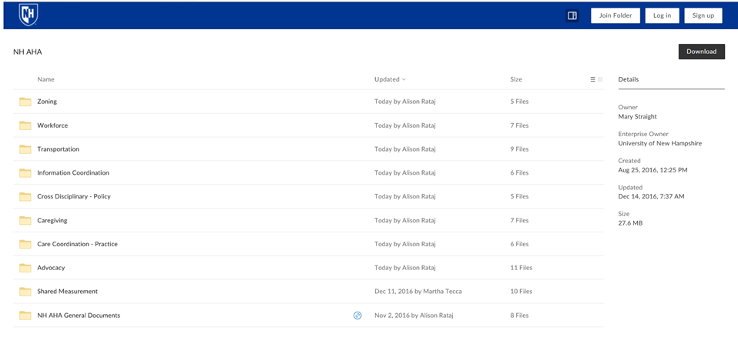

Slide 5
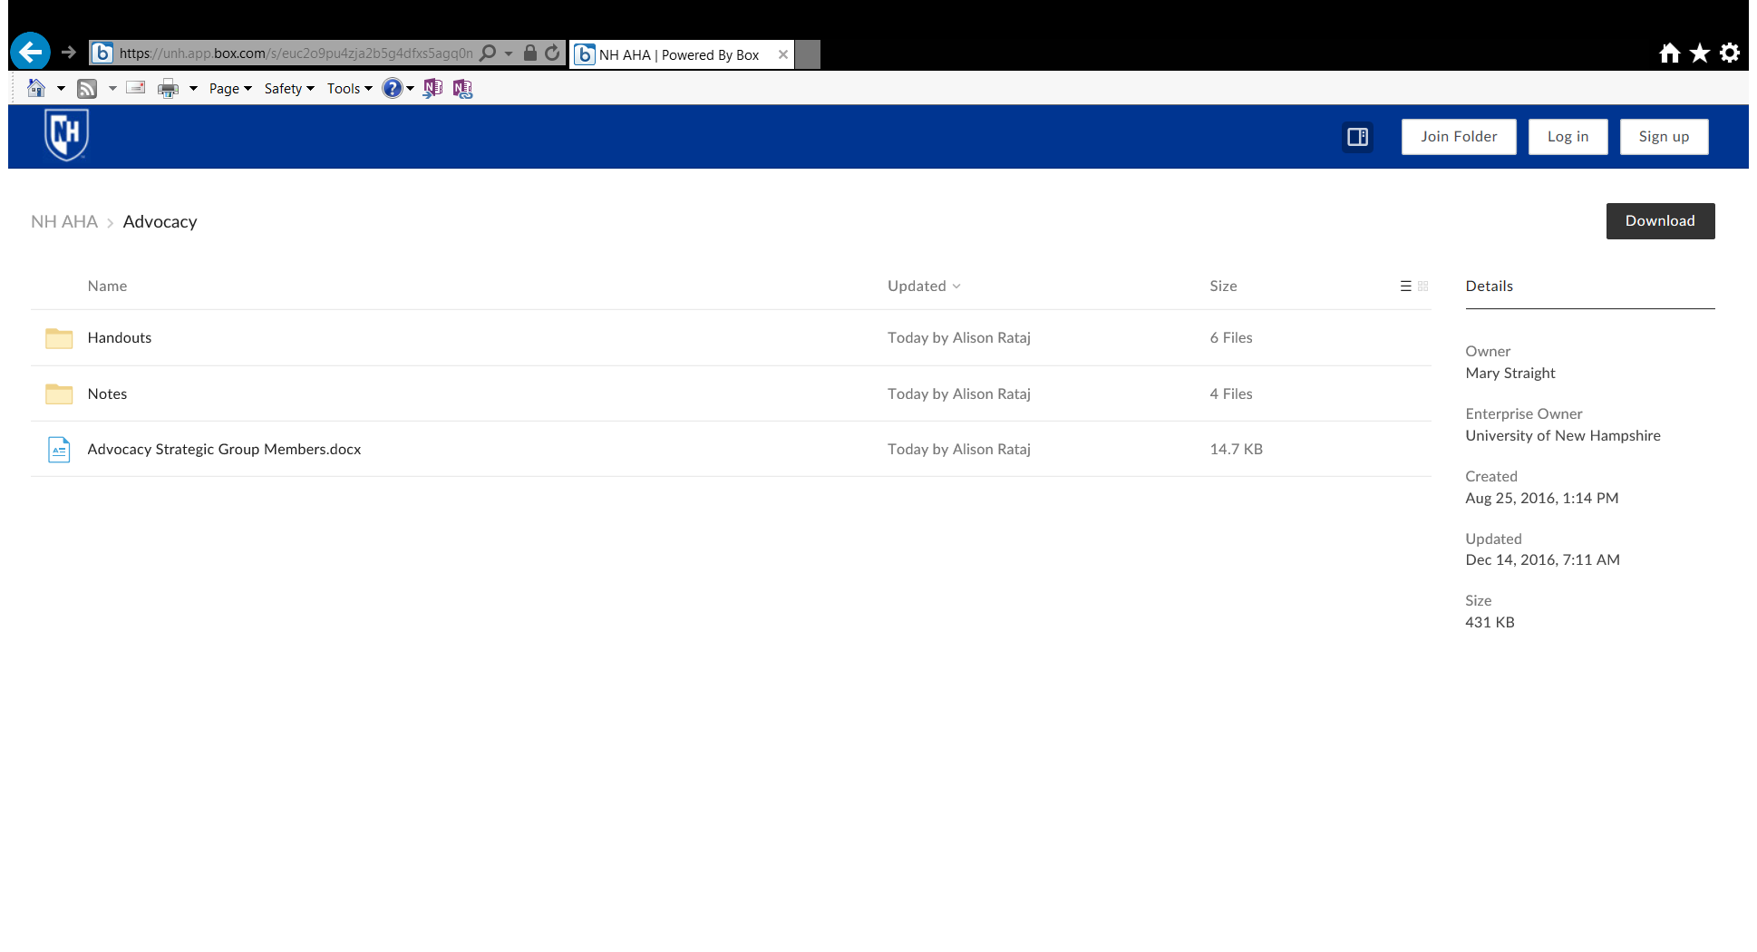

Slide 6
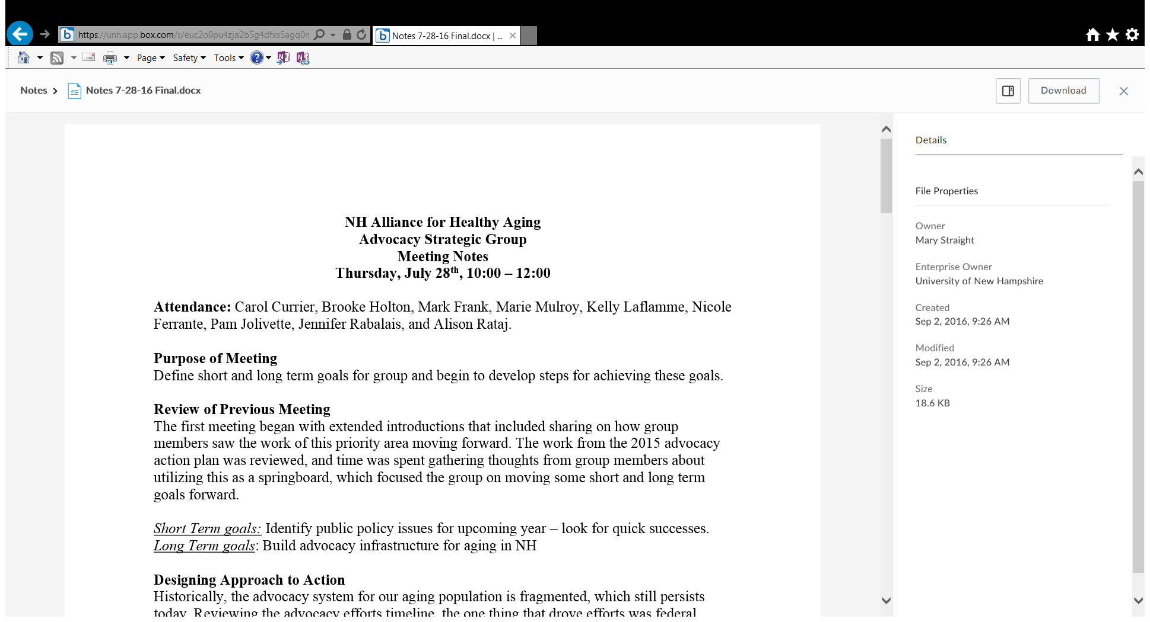

Slide 7
Issues with BOX?
Contact Alison Rataj at Alison.Rataj@unh.edu or at
(603) 862-5409

Slide 8
NH Alliance for Healthy Aging
The Legislative Process
Jim Monahan, Vice President
The Dupont Group
December 15, 2016

Slide 9
The Legislative Process
The NH General Court by the Numbers
How Do They Get Anything Done?
What Makes the Legislature Tick?
The Lobbying Process
Highlights and Predictions
Questions and Answers

Slide 10
The NH General Court by the Numbers
3rd largest legislative body in the English-speaking world
400 volunteer
member House
24 volunteer
member Senate
30% turnover every
2 years
1,000+ bills every year
$11 Billion budget
Every bill has a
public hearing
Every bill has a vote
on the floor
23 House policy committees
14 Senate policy committees (each Senator is on multiple)
400+ lobbyists

Slide 11
How Do They Get
Anything Done?
Rely on “advice”
  Committee recommendations
  Party leadership guidance
  Lobbyists’ advocacy
  Constituents’ calls
  Governor’s “advice”
  Meaningful role of state agencies
Most work gets done in (House) committees
Calendars and schedules
  Very tight deadlines
  But, more flexibility than is let on

Slide 12
What Makes the Legislature Tick?
Managing the process
  When are they voting?
  Who is asking?
  What are the consequences/rewards?
Inside vs. outside approach
  Some votes are impacted from outside the State House
Most votes are not major events
  There can be complicated dynamics
  when it matters
  5% of votes are controversial

Slide 13
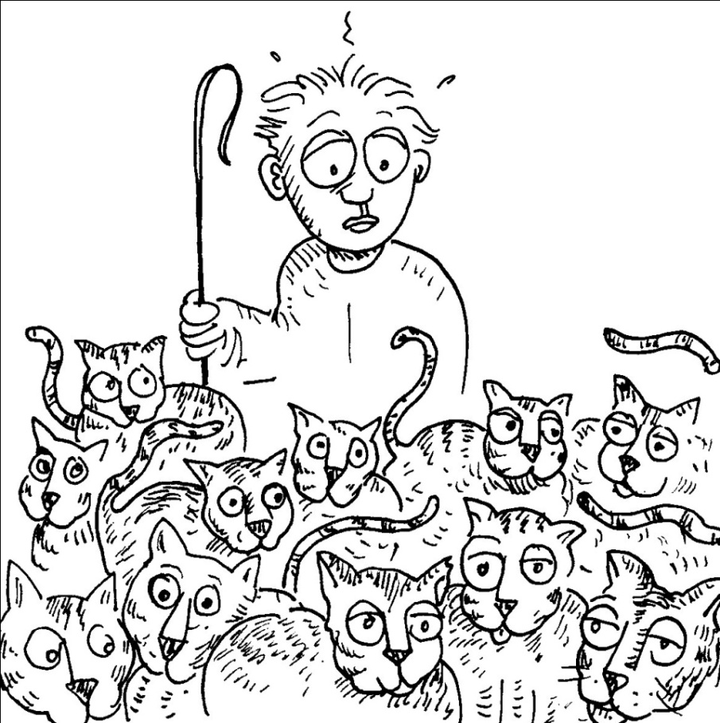
The Lobbying Process
Contract lobbyists
In-House
  Full time
  Part time
Knowing the rhythm, knowing the rules, and knowing the policy

Slide 14
Highlights and Predictions for 2017 at the State House
Highlights
  All Republican Control
  A new Governor
  Legislature: Some Stability
  Budget: Not so bad this time. Tax cuts will compete with workforce investments
  Crisis Politics: Mental health, then Heroin – what's next?
Predictions:
  New Governor will mainly focus on the budget;
  But, the budget might include some reorganization and new proposals.
  Slow walk on any change to Medicaid Expansion
  Managed Medicaid Phase II ???

Slide 15
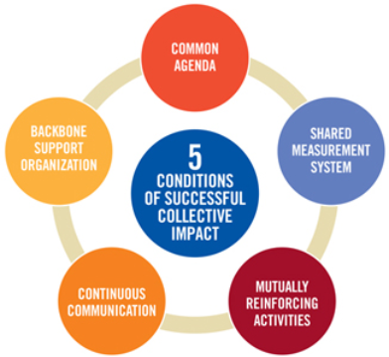
Measurement Team Update
AHA measurement goals and status
Measuring initiative impact
AHA indicators by domain
a work in process
Small group input
Next steps

Slide 16
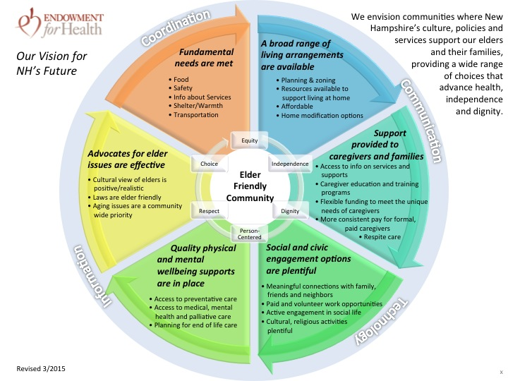
AHA Vision and “Domains”
Vision
Domains
Sub-categories

Slide 17
Measurement Priorities
Goals
Needs
Measure initiative impact
Evaluate work group impact
Track and evaluate work group progress and satisfaction with participation
Measures
Data capture capabilities
Data management systems
Metrics-driven improvement
methods
Notes:
Measure inventory
Advance measurement in all work groups
Backbone team led
Measurement team members working with Work Groups as appropriate
Facilitate development of SMART goals to clarify focus of work
Help select measures
Design data capture and management processes
Determine initiative level indicators

Slide 18
Measuring Impact
Vision
What will the world look like as a result of our efforts?
Indicators
What will demonstrate our success?
Measures
How, quantitatively, will we demonstrate our success?

Slide 19
AHA Domain-level Goals

Slide 20
Indicators of Impact
Example Domain with Sub-categories
DOMAIN Sub-categories | IMPACT INDICATORS
Fundamental Needs are Met | Living in poverty Demographically vulnerable Experiencing food insecurity With any unmet need
Food | Experiencing food insecurity In "food desert"
Safety | Crime Supporting State Health Improvement plan: - Emergency preparedness planning - Falls - consequential (injuries, hospitalizations, deaths) - Poisoning deaths
Information about Services* | In communication (accessible by phone, internet) Workgroup focus TBD
Shelter/Warmth | Homelessness Unable to pay mortgage, rent, utility
Transportation* | Ability to get where needed (Ride access; "Walkability") Workgroup focus TBD
* AHA Work Group in process

Slide 21
Domain-level Indicators
DOMAINS | IMPACT INDICATORS
Fundamental Needs are Met | Living in poverty Demographically vulnerable Experiencing food insecurity With any unmet need
Living Arrangements | Perception of availability of good, "affordable" housing
Caregiver and Family Support | Caregivers with unmet needs for support services Businesses support employee caregivers
Social and Civic Engagement Options | Self-reported social and emotional support
Physical and Mental Wellbeing supports | Recent routine checkup (physical, mental, dental) Delayed care (physical, mental, dental) Satisfaction with care received Someone to discuss health and care needs
Advocates for Elder Issues are Effective | Culture, laws, and community practices support aging

Slide 22
Small-Group Input
Instructions
Each table will address one domain
Quick assessment of suggested domain-level indicators for that domain
  If something jumps out as missing, what?
  For now, go around table and name – no discussion
Discuss and respond to specific question
  Responses will be posted
  Notes will be shared with Measurement Team
Facilitators
  A Steering Committee volunteer at each table
  Keep discussion on track
  Assign someone to record notes
  Summarize recommendations on large sticky pages
  Post completed sticky pages
  Give notes to Martha

Slide 23
Next Steps
Measurement team will compile notes and refine to domain indicator listing with group input.
Selecting domain measures will be a 2017 priority.
Work groups determine SMART goals for 2017 and beyond.
Initial broad inventory of indicators and measures to guide “aging” work will be available.
It will continue to grow and evolve in partnership with others doing this work across NH and nationally.

Slide 24
Measurement Team
Laura Davie, UNH CACL, AHA Backbone Team
Rebecca Harris, Transport New Hampshire
Karen Horsch, NH Endowment for Health
Rene Pepin, Dartmouth-Hitchcock
Martha Tecca, M&M Strategies
Would you like to join the team??

Slide 25


Slide 26

www.winniphc.org
The Aging and Disability Workgroup
Stace Dicker-Hendricks, Director, Wesley Woods
Marian Gill, Center Manager, ServiceLink Resource Center – Belknap County

Slide 27


Slide 28
PRIORITY AREA 1: Improve Access to Health Insurance and Consumer Navigation of the Health Care System
PRIORITY AREA 2: Improve Access to Behavioral Health Care Services.
PRIORITY AREA 3: Reduce Substance Misuse and Addiction through Prevention, Treatment and Recovery
PRIORITY AREA 4: Suicide Prevention
PRIORITY AREA 5: Improve the Health and Well-Being of Older Adults and Their Caregivers
PRIORITY AREA 6: Prevent Childhood Obesity through Healthy Eating and Active Living
PRIORITY AREA 7: Increase Public Health Emergency Preparedness
PRIORITY AREA 8: Improve Health through Increased Financial Stability of Individuals and Families

Slide 29
Regional Initiatives and Opportunities
The Aging and Disability Work Group is leading efforts to improve the health and well-being
of older adults and their caregivers through this Community Health Improvement Plan.
Existing resources and initiatives that can be built upon in this priority area include:
• ServiceLink Resource Center of Belknap County provides up-to-date information and assistance to help individuals and families make informed choices about health care and other services for older adults, people with disabilities and their families. • ServiceLink, LRGHealthcare and other community partners provide support to family caregivers through caregiver grants, support groups in local communities, caregiver website offering resources, “Powerful Tools for Caregivers”, and “Remembering When” and Chronic Disease Self-Management classes. • “Matter of Balance” training partners to promote falls prevention led by Community Action Program Belknap-Merrimack Counties with LRGHealthcare, Catholic Charities and Lakes Region VNA. • Multiple community partners working together on assessment of home environments for falls risks and reduction strategies including Municipal Fire Departments, Emergency Medical Services, Home Health providers and through support of Senior Safety Day.

Slide 30
Goals, Objectives and Strategic Approach
Goal 1 | Support aging in place by improving services and supports for unpaid caregivers and senior companions of older adults
Objective 1 (developmental) | Increase the proportion of older adult caregivers who perceive having sufficient caregiving skills and emotional support
Goal 2 | Prevent older adult injury, disability and death due to falls.
Objective 1 | Reduce emergency department visits and hospitalizations due to older adult falls by 10% by 2020.
Objective 2 (developmental) | Reduce the proportion of Emergency Medical Service run activity that is related to older adult falls by 10% by 2020.

Slide 31
Aging & Disability Workgroup Members
Genesis Behavioral Health
Lakes Region Community Services
ServiceLink Resource Center
Community Action Program
Belknap Merrimack Counties
Lakes Region VNA
Franklin VNA
Comfort Keepers
NH Veterans Home
Catholic Charities NH
Wesley Woods
Laconia Senior Center
State Committee on Aging
LRGHealthcare
Community Members
Taylor Community
Winn. Public Health Council

Slide 32
Aging & Disability Activities
Caregiver Supports
Falls Prevention
Powerful Tools for Caregivers
Caregiver survey
Caregiver Events
Matter of Balance Classes
Falls Prevention Cards

Slide 33

Powerful Tools for Caregivers provides a self-care education program for family caregivers. The Powerful Tools for Caregivers program will provide s the Caregiver with tools and strategies to better handle the unique caregiver challenges you face.
The 6-week scripted curriculum has been shown to improve:
Self-Care Behaviors: (e.g. increased exercise, relaxation and medical check-ups)
Management of Emotions: (reduced guilt, anger, and depression)
Self-Efficacy: (increased confidence in coping with caregiving demands)
Use of Community Resources: (increased utilization of local services)

Slide 34
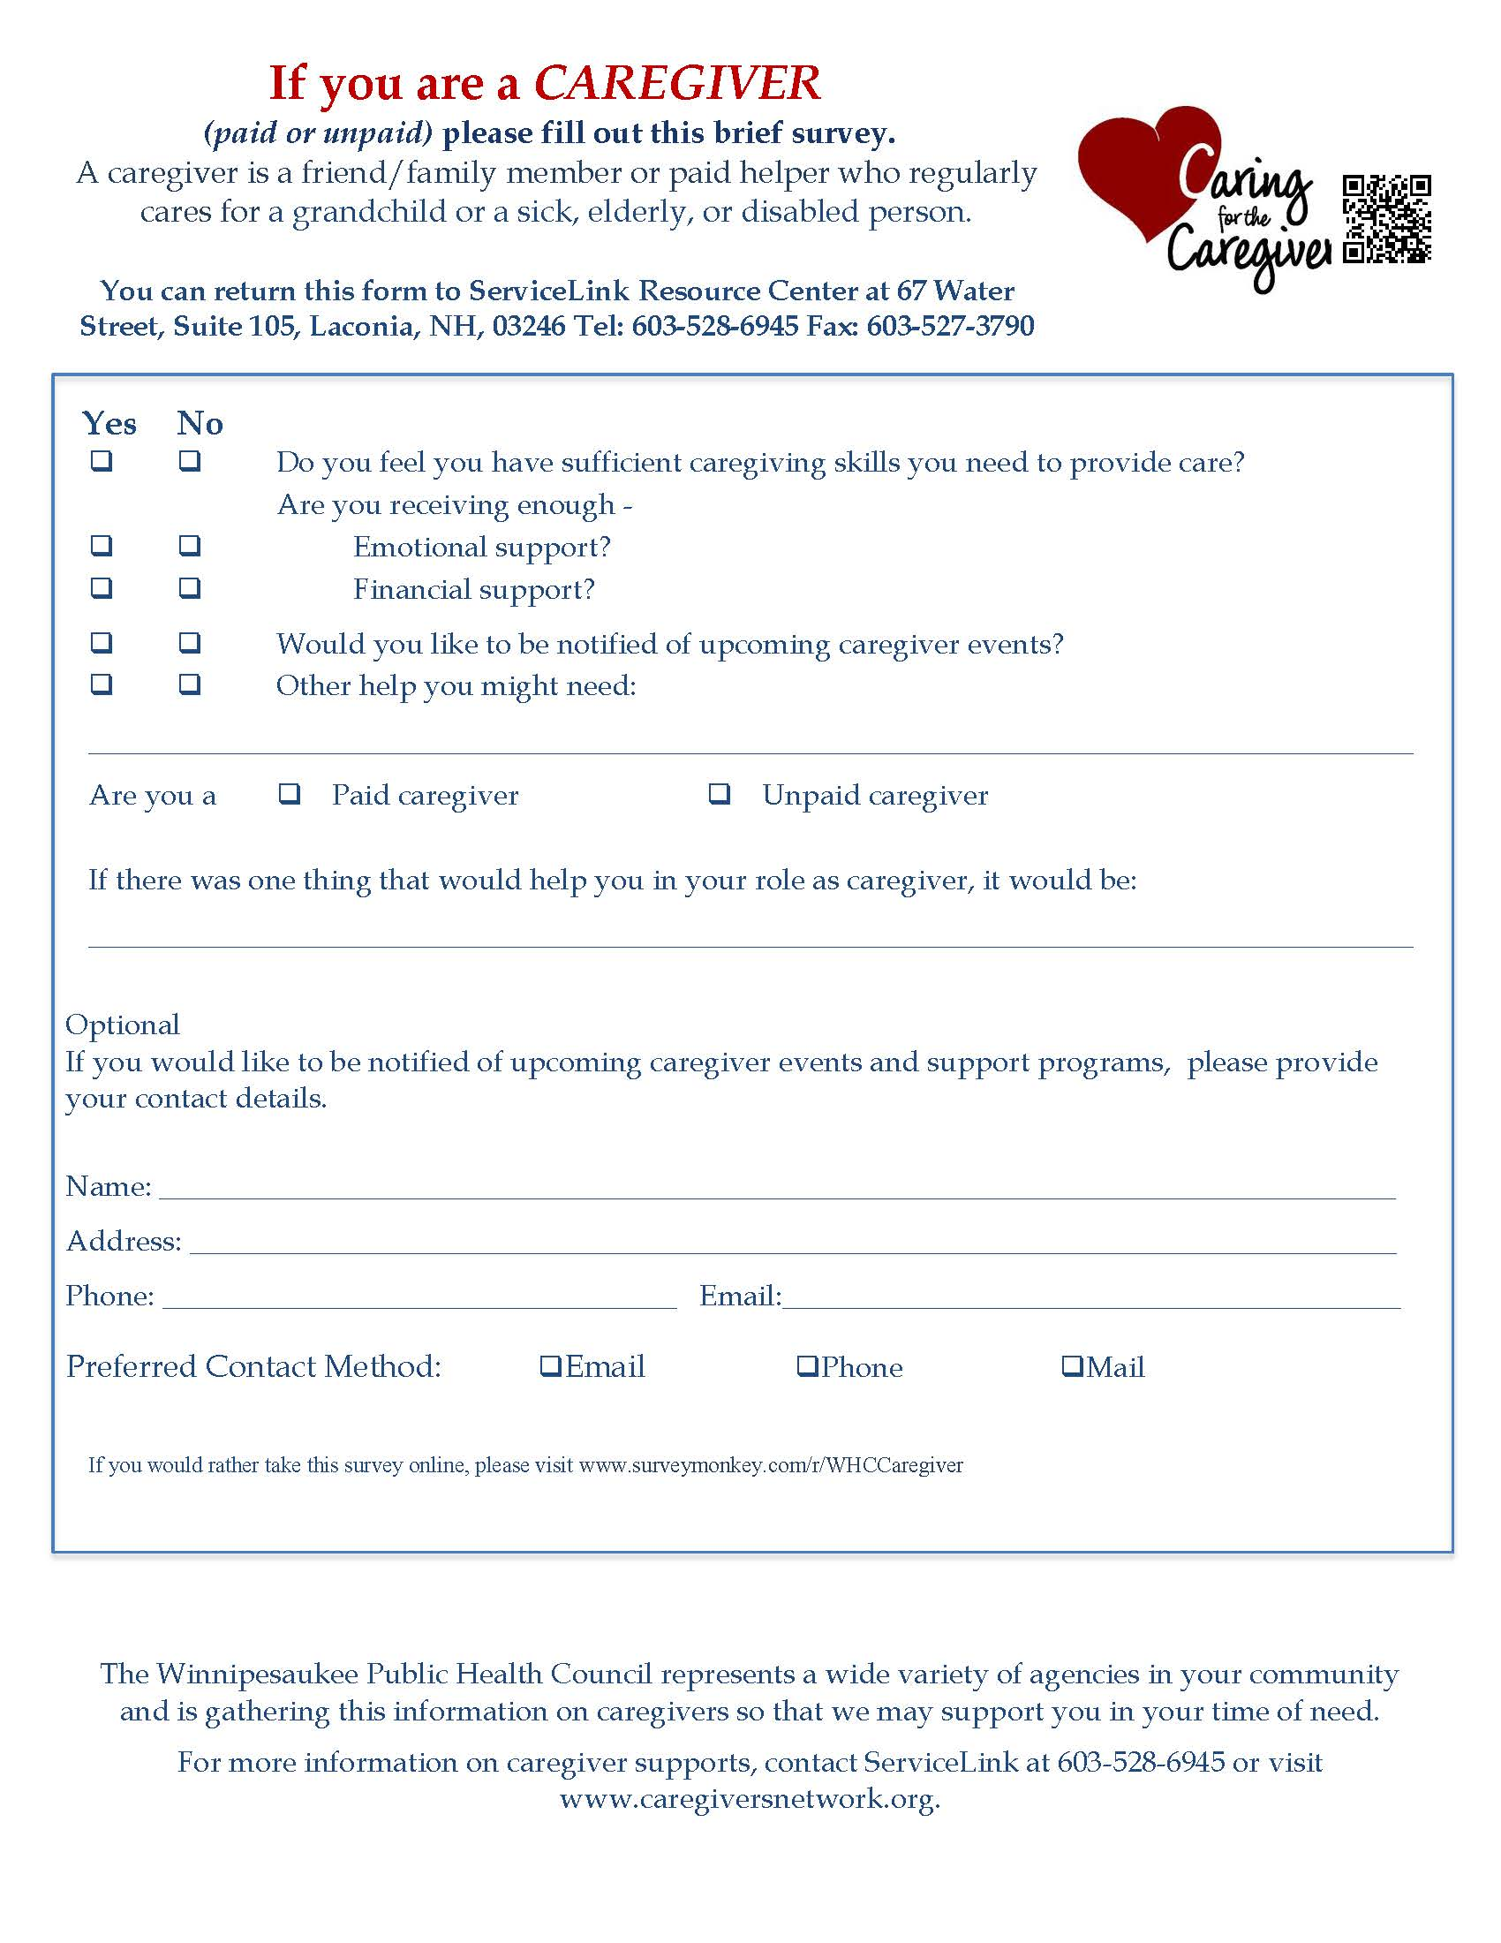

Slide 35

Matter of Balance Classes
11 Matter of Balance Classes from April 2015 to March 2017 hosted by three organizations under the CAP Belknap and Merrimack license.

Slide 36
CAPBMCI Master Trainer and Coach Trainer Schedule from
April 2015- March 2017 for WPHC grant
April 8th-May 27th 2015, CAPBMCI taught at the TRIP Center, 12 Rowell Drive, Franklin
August 4th- September 22nd, 2015 -Lakes Region VNA -Meredith
August 13th- October 1st, 2015 CAPBMCI Gilman Library, Alton
August 26th- October 14th, 2015, LRGHealthcare -The Pines Community Center, Northfield
March 9th- April 27th 2016, CAPBMCI taught Wesley Woods Community Center, Gilford
March 30th – May 18th, 2016 LRGH The Pines Community Center, Northfield
April 6 -May 25, 2016, Lakes Region VNA Meredith Community Center, Meredith
May 2nd-June 27th, 2016, CAPBMCI Tilton Senior Center, 11 Grange Road, Tilton
Sept 14th- November 2nd, 2016– LRGH The Pines Community Center in Northfield
October 5th- November 23, 2016 Lakes Region VNA Meredith Community Center, Meredith
January 12- March 9th, 2017 9 CAPBMCI Alton Senior Center, Alton

Slide 37

Some preliminary data suggest the following, after completion of a Matter of Balance (MOB) class:
95 % reported an overall reduced fear of falling.
94% reported after the class that they were sure or very sure they could get up after a fall (62% before class)
90% reported after the class that they were sure or very sure they could protect themselves if they fell ( as opposed to 33% before class)
95% reported they were more satisfied with their life.
62% reported they were more comfortable talking to a health care provider
62% reported they were more comfortable increasing activity and planned to continue exercising
The steps taken most frequently to reduce the chance of a fall were: Exercise at home (40%); Changes to the home (33%); Talked to a family member or friend (22%)

Slide 39
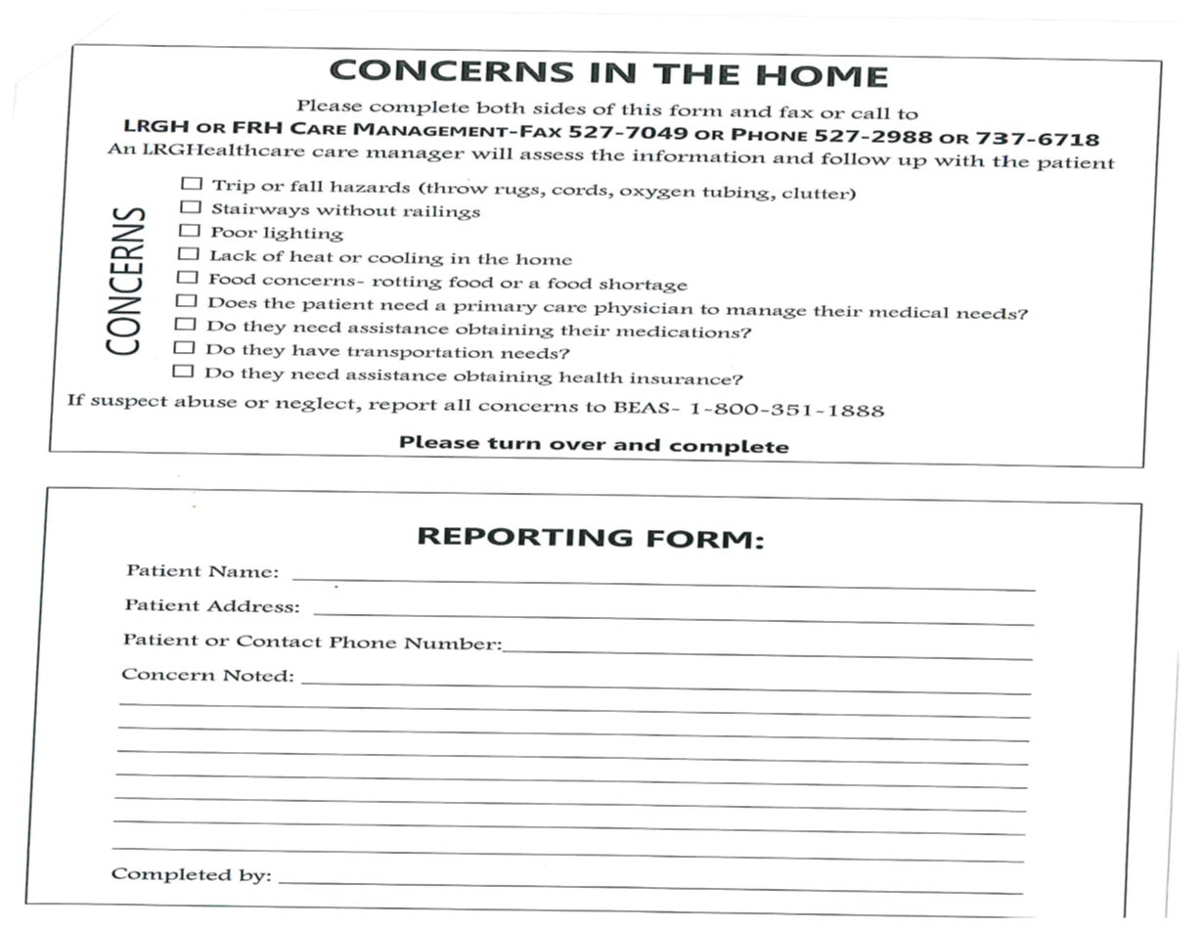

Slide 40
Aging & Disability Workgroup
Breadth - 16 organizations representing community services, individuals, medical, mental and behavioral health sectors that meet on a monthly basis.
Pulse – ability to keep informed on what organizations are doing in our community with regard to older adults and caregivers.
Commonality - commitment to fulfilling the CHIP priority to promote the health and well being of older adults and their caregivers.
Collaboration – ability to pool the groups expertise to host and promote events.

Slide 41
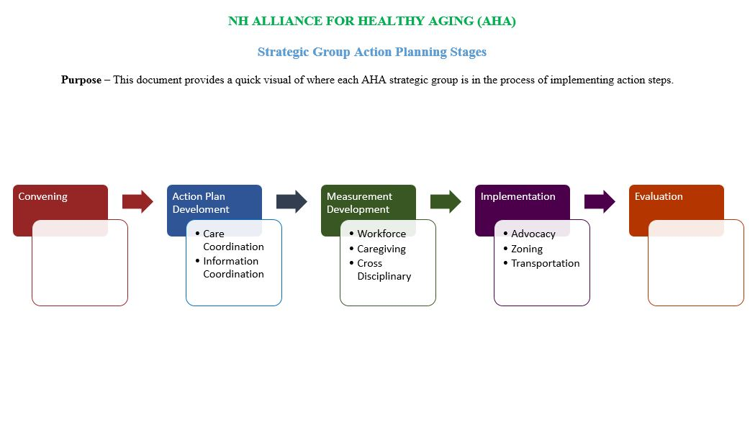
AHA Workgroup General Update

Slide 42
Thank you for participating!
For questions or additional information, contact:
Jennifer Rabalais
jennifer.rabalais@unh.edu
228-2084 x14

