Slide 1

Creating a Collective Approach to Address an Aging NH
NH Elder Health Coalition
Quarterly Meeting
March 16, 2016

Slide 2

Notes:
The changing and aging of NH is a complex social challenge for NH.
To face these challenges alone feels like this ---

Slide 3

What is Collective Impact?
Collective Impact occurs when organizations from different sectors agree to solve a specific social problem using a common agenda, aligning their efforts, and using common measures of success.
Notes:
What is Collective Impact?
There is an entire body of literature on Collective Impact, but the core concepts are
Collective Impact occurs when organizations from different sectors
agree to solve a specific social problem
using a common agenda (based a common understanding of the challenges and opportunities),
aligning their efforts, and
using common measures of success.

Slide 4

Why Collective Impact?
https://www.youtube.com/watch?v=pzmMk63ihNM&feature=youtu.be

Slide 5
The Five Conditions of Collective Impact
Common Agenda
All participants have a shared vision for change including a common understanding of the problem and a joint approach to solving it through agreed upon actions
Shared Measurement
Collecting data and measuring results consistently across all participants ensures efforts remain aligned and participants hold each other accountable
Mutually Reinforcing Activities
Participant activities must be differentiated while still being coordinated through a mutually reinforcing plan of action
Continuous Communication
Consistent and open communication is needed across the many players to build trust, assure mutual objectives, and appreciate common motivation
Creating and managing collective impact requires a dedicated staff and a specific set of skills to serve as the backbone for the entire initiative and coordinate participating organizations and agencies
Backbone Support
11
Source: FSG, Tamarack Institute
Notes:
There’s five conditions or elements to collective impact that are critical to the success of the model.
These are not anything new – it’s community building 101.
But what is relatively new is the recognition that this is a recipe for success in creating complex social change.
To do Collective Impact right, you need to
Agree to a common agenda – a shared vision for change based on a common understanding of the problem that includes agreed upon actions.
Then you need to identify shared measurement to track your progress and maintain accountability
You create space for all concerned by recognizing and coordinating mutually reinforcing activities (which I will say more about in a minute)
Critical to the success of Collective Impact is clear and continuous communication so that all those involved are kept in the loop
And finally, what FSG and Tamarack clearly identified is that successful collaboration and collective impact doesn’t just happen by good will and good intentions – but dedicated staff and resources are needed to provide backbone support.

Slide 6

Working across boundaries
Across regions
Across sectors
Across issues
Across party lines
Across generations
Notes:
It takes working across boundaries…
We have to find ways to work across culture – across geographic regions, across sectors, across the vast array of issues facing our communities, across political party lines and across generations. We can’t fall into the trap of an “us vs. them” mentality….it has to be all of us.

Slide 7
Creating a Collective Approach to Address an Aging NH:
A Shared
Vision for
Our Future
We envision communities where New Hampshire’s culture, policies and services support our elders and their families, providing a wide range of choices that advance health, independence and dignity.
Coordination Communication Technology Information
A broad range of living arrangements are available
Fundamental needs are met
• Food
• Safety
• Info about Services
• Shelter/Warmth
• Transportation
• Planning & zoning
• Resources available to support living at home
• Affordable
• Home modification options
Support
provided to
caregivers and families
Equity
Independence
Dignity
Person-Centered
Respect
Choice
Advocates for elder issues are effective
• Access to info on services and
supports
• Caregiver education and training programs
• Flexible funding to meet the unique needs of caregivers
• More consistent pay for formal,
paid caregivers
• Respite care
• Cultural view of elders is positive/realistic
• Laws are elder friendly
• Aging issues are a community wide priority
AGE
Friendly Community
Quality physical and mental wellbeing supports are in place
Social and civic engagement options are plentiful
• Meaningful connections with family, friends and neighbors
• Paid and volunteer work opportunities
• Active engagement in social life
• Cultural, religious activities
plentiful
• Access to preventative care
• Access to medical, mental health and palliative care
• Planning for end of life care
Supported by
Revised 3/2016
Notes:
And that is what our vision is all about.
It was created during 2014 with the input of more than 40 stakeholders, the input of more than 100 elders who participated in focus groups across the state, and with interviews of 10 cross sector business leaders in NH.
This wheel was used to capture the key themes that we heard in our planning conversations, our focus groups and interviews.
This vision recognizes that the health and well-being of our elders requires a comprehensive approach..
Fundamental Needs of food, shelter, and safety need to be met.
A broad range of living options are needed to support us at every stage of the aging process
Our families and caregivers need support in order to support us through our aging and dying processes
Social and civic engagement options need to be plentiful and appropriate for being of all stages of aging and all cultures
Quality physical and mental wellbeing supports need to be in place – to promote healthy aging and prevent decline, to address health issues that occur as we age and to support elders and their families through the end of life.
And finally – we need a strong and effective capacity to advocate on behalf of elders and their families.
Those of you familiar with AARP’s work to create Age Friendly Communities or the World Health Organization’s work or other age friendly communities work will notice that this vision is very similar to their models. For example, the World Health Organization breaks their model out into 8 areas – but we combined some of their domains and added a special emphasis on both advocacy and caregiving.
You might be surprised that NH’s largest health foundation is supporting and leading such a broad and comprehensive vision and that what you might traditionally think of the EH’s work is only the green wedge – but the Endowment for Health has a comprehensive and inclusive view of health.
Realizing this vision isn’t going to be easy. And that is why a collective impact approach is what we think is the best way to work.

Slide 8


Slide 9
Launching the Elder Health Coalition
Led by Endowment for Health
Led by UNH Center on Aging and Community Living
Implementation
Planning
2014 Created Shared Vision
Summer & Fall 2015
Identified priorities for 2 to 3 year Action Plan –
Fall 2015 Identified a core team to lead the Coalition
Early 2016
Establish Steering Committee
Spring 2016
Identify partners to lead strategies and engage additional members
Supported by Endowment for Health
Notes:
So how will we do this?
We have contracted with the Center on Aging and Community Living to lead us all through an action planning process. Over the next several months, under the facilitation of staff from CACL – we will convene workgroups to co-create an action plan for the next 2-3 years. This will set targets and shared measures that are doable with a stretch over this time frame and recognize that there are longer term goals and targets that we’ll focus on in the future.
Developing leadership, a Steering Committee, to guide this plan and monitor the implementation of the plan once it is created, is an important step for the next several months. We’ll start by working with those who served in a core advisory capacity to the Endowment’s work thus far, to help create the guiding principles and role description for steering committee members.
Our vision is that the Steering Committee won’t just lead the planning, it will launch and lead a Statewide Coalition…focused on a collective impact approach to advance healthy aging and age-friendly communities in NH.
It will take more than the Steering Committee – we will need to identify partners to lead the strategies selected in the planning process and to engage more members to support this work.
The EH is committed to providing the backbone support to undergird this effort during this formative time – like an incubator for the coalition – with the intention of it being a free-standing coalition in the future.

Slide 10
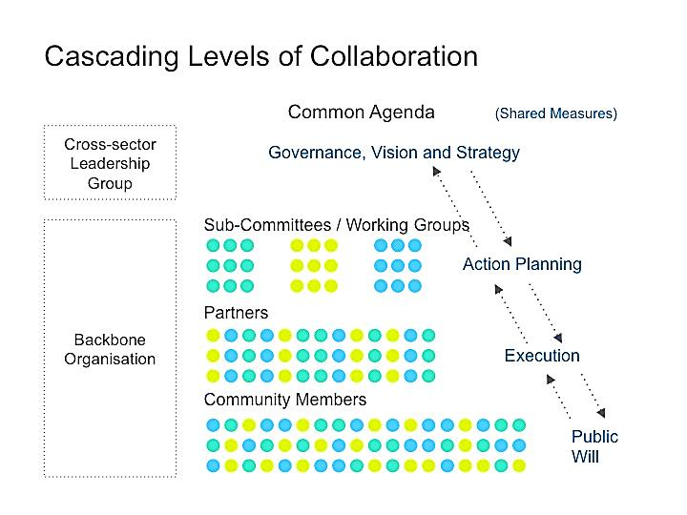

Steering Committee
Center on Aging & Community Living
Source: http://www.collaborationforimpact.com/wp-content/uploads/2014/02/Cascading-collaboration.jpg
Notes:
This is a visual of what the collective impact approach will look like as it develops…it isn’t linear…notice the arrows going up and down the levels of collaboration.
Right now we have our Vision and we’re working with partners to turn the vision into a common agenda with strategy and measures.
We are working to establish the cross-sector leadership group.
We’ve convened working groups and launched the action planning phase.
And the Endowment has volunteered to provide backbone support until we identify or create a separate backbone organization in the future.

Slide 11

Center on Aging & Community Living
From “Collective Impact: Leading Change to Achieve Results,” Presentation at the NGA Talent Pipeline Policy Academy, October 2014

Slide 12
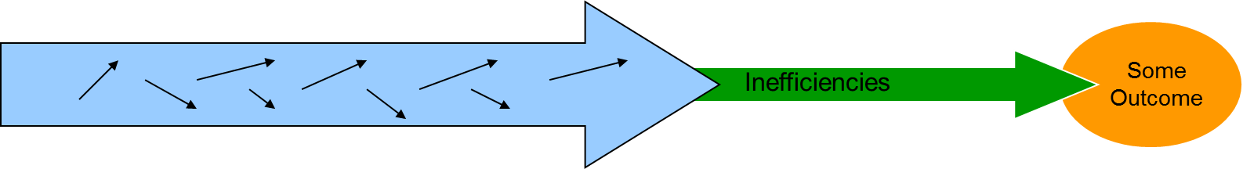
Creating Alignment
Mutually Reinforcing Activities
Working in isolation = Isolated Impact
Working together = Collective Impact
Policy Environment
Academic
Providers Non-profits Media Civic Groups
Enhanced Outcomes for Elders
Government Businesses Public Health Faith-based
Adapted from : Paul Epstein, Results that Matter Team
Notes:
But let’s be honest, working together in unison isn’t easy. And it isn’t the normal way of doing things.
When we try to create social change and create better outcomes for people we care about without the intentionality of a collective impact approach, it looks like the first arrow…we sort of all aiming in the same direction – but a lot gets lost along the way through inefficiencies and missed targets.
But when we align our efforts – recognize that we all have an important and differentiated role – we have an integrated system – with mutually reinforcing activities which leads to a greater chance of hitting the targets and enhancing outcomes for elders. Put another way – it’s not about giving up our work or even our turf – but it’s about being clear in what our work accomplishes and acknowledging that we can’t do it alone.

Slide 13

Questions?

Slide 14

Are YOU a Member?
FREE membership for service providers, local officials, advocates, caregivers and older adults from Maine, New Hampshire and Vermont.
Simply go online to register:
http://agefriendly.community/
Notes:
You are all eligible to participate for free in a Tri-State Learning Collaborative on Aging.
The Learning Collaborative is offering free webinars, peer to peer learning opportunities and an annual conference.

Slide 15
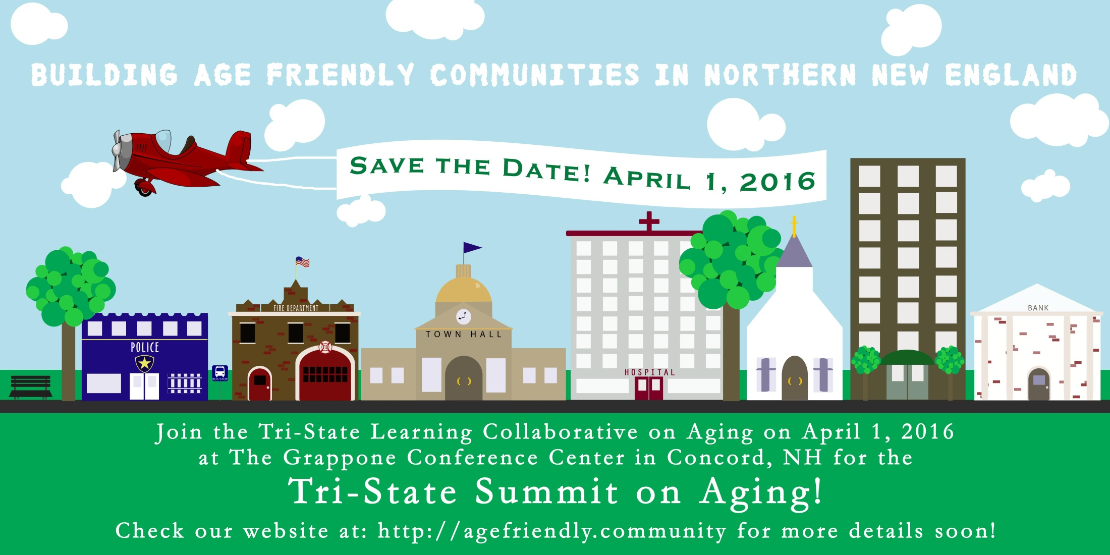

Slide 16

Upcoming Opportunity
Community Leaders Forum
An interactive forum for Age Friendly Community leaders
4th Tuesday of every month via webinar
March 22, 2016
Notes:
There are two upcoming webinars planned – you can register now.
And others will be planned at least monthly, if not more.
Community Leaders Forum
February 8, 2016 | 0 Comments
Fourth Tuesday of Every Month via Webinar – 12:00pm – 1:30pm We’re excited to announce our new Community Leaders Forum – an interactive forum for leaders working on age friendly community initiatives to share ideas, get advice and build collective expertise. An “age friendly community” (AFC) is one that actively engages older adults in planning

Slide 17
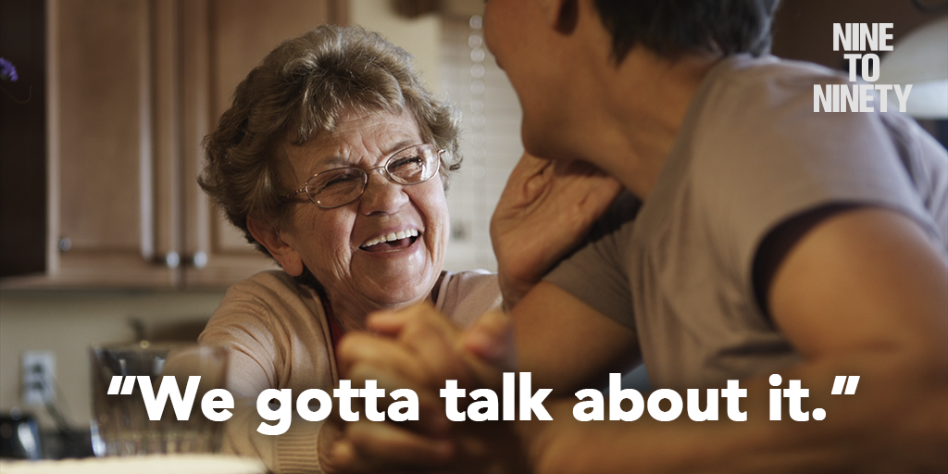
Coming soon…to a theater near you!
April 13th at Dartmouth College, Hanover
April 14th at Red River Theater, Concord
Register online!!

