Slide 1

Creating a Collective Approach to Address an Aging NH
NH Alliance for Healthy Aging
Quarterly Meeting
April 17, 2017

Slide 2
AGENDA
Welcome and Introductions
What’s Happening: AHA Update
Governor’s Commission on Health Care and Community Support Workforce Strategic
TSLCA Update on Cross Border Conversations on Caregiving
Collective Impact Video and Discussion
Bright Spot: Southern NH Planning Commission
Community Announcements
Strategic Group Update: Workforce & Advocacy
Wrap up/Next Steps

Slide 3

AHA UPDATE
Outreach and Engagement
Conferences/Presentations
American Society on Aging: A Collective Impact Approach to Creating Age Friendly Communities
Tufts Age-Friendly Communities: Collective Impact for Age-Friendly Communities 201
Collective Impact Forum- A Collaborative Approach to Creating Age Friendly Communities in New Hampshire
Notes:
Outreach and engagement- growing numbers/stats; who is at the table- talking with orgs not yet involved and want to align work; we are presenting at about the work you do at conferences and have tables at events
Survey this summer

Slide 4
AHA UPDATE
8 AHA Strategic Workgroups
Change Policy:
Advocacy: Develop an advocacy infrastructure to enhance support for aging issues.
Cross Disciplinary: Convene a cross-disciplinary workgroup including medical, mental health, social service, community service, and oral health providers, in order to plan and coordinate efforts.
Zoning: Identify and advocate for needed zoning changes in order to promote affordable, accessible housing options.
Change Practice:
Caregiving: Enhance services and supports of informal, family caregivers.
Transportation: Increase transportation options, including an analysis of current efforts and funding issues.
Information Coordinated: Assure that information on resources and services (e.g. transportation, nutrition, and housing) is available, accessible, and coordinated.
Care Coordination: Improve care coordination for older adults involving medical, mental health, social,, community, and oral health services.
Workforce: Improve the availability of quality healthcare and social service workforces.
Box
Common Measurement
Communications
Notes:
Workgroups- how to engage
Groups moving at different paces- all developing strategies for implement
Endowment for Health Annual Meeting- thanks so much to caregiver
Hear later about Workforce and Ad
We “heart” box- engage- stay connected
Workgroups- insert slide with all workgroup titles
Common measurement- thanks for your work at the last Q Meeting- we took your feedback regarding ….; bringing to next SC; then to full meeting….
Common Measurement
Communications- committee that completed its communications plan and will hear more in coming meetings. Welcome more voices both with expertise on communications and aging.
Resources- after the meeting- will include Frameworks Institutes- new tool kit.

Slide 5
Governor’s Commission on Healthcare and Community Support Workforce
May – December 2016

Slide 6
Commission Members
Susan Huard, Manchester Community College
Kathy Bizarro-Thunberg, NH Hospital Association
Lisa DiMartino, Parent of child receiving long term care services
Jon Eriquezzo, Crotched Mountain Foundation
Todd Fahey, AARP
Mike Ferrara, UNH College of Health and Human Services
Margaret Franckhauser, Central NH VNA and Hospice
Yvonne Goldsberry, Endowment for Health
Brenda Howard, Maplewood Nursing Home

Slide 7
Commission Members Cont.
Judith Joy, NH Nurses’ Association
Joelle Martin, Council for Youths with Chronic Conditions
Stephanie Pagliuca, Bi-State Recruitment Center
Dennis Powers, Community Crossroads
Susan Reeves, Colby-Sawyer College, School of Health Professions
Deborah Scheetz, NH DHHS

Slide 8
Charge:
Project healthcare workforce needs
Examine + recommend expansion of workforce + training needs
Examine barriers to education + employment
Examine pay rates/structures of healthcare workers
Identify regulatory barriers + recommend improvements
Examine NH loan repayment programs

Slide 9
Data Collection
Need – cannot identify workers in many fields of healthcare
Consistency – some segments collect data; others do not
Expansion of data collection
Uses

Slide 10
Licensure + Certification
Barriers
Delays in time to licensure
Limited reciprocity for out of state workers
Limitations on processing criminal background checks
Inability to issue licenses between professional board meetings
No vehicles for counting community experience toward licensure

Slide 11
Direct Support Professionals
No database for families or agencies to access for recruitment
Low wages
Low reimbursement rates
Varied formal training for workers

Slide 12
Financial Concerns
Medicare/Medicaid reimbursement rates
Lack of state reimbursement programs/low interest loans
Limited funding of State Loan Repayment Program
Limitations on Medicaid reimbursement for supportive technology

Slide 13
More to Think about…
Future workforce needs in an integrated care network
Use of older workers as paid and volunteer workforce
Role of housing for workers
Behavioral healthcare needs

Slide 14


Tri-State Learning Collaborative on Aging
http://agefriendly.community/crossborderconversations/
http://agefriendly.community/2017/03/gray-is-the-new-green/

Slide 15

BREAK

Slide 16


COLLECTIVE IMPACT VIDEO AND DISCUSSION
Notes:
Jennifer
https://www.youtube.com/watch?v=pzmMk63ihNM&feature=youtu.be

Slide 17
Table Discussion
As an individual: review 5 conditions handout
As a group: Pick a scribe (write scribes name for further clarification later).
Strength
Challenge
Wish
Post your post-its
Will bring back at Next Q meeting (June 15th)
Notes:
Set up and video- 5 minutes total
5 conditions handout
As a group- come up with a strength, challenge, and wish– have wish and challenge on big sticky.
Have one person to be the lead- name we can follow up with if we have questions.
We will bring what we learned back to you all in June

Slide 18



SNHPC Becoming Age-Friendly
Funded by: Tufts Health Foundation
Contributions and Support: AARP & Manchester Health Dept.
Southern New Hampshire Planning Commission

Slide 19
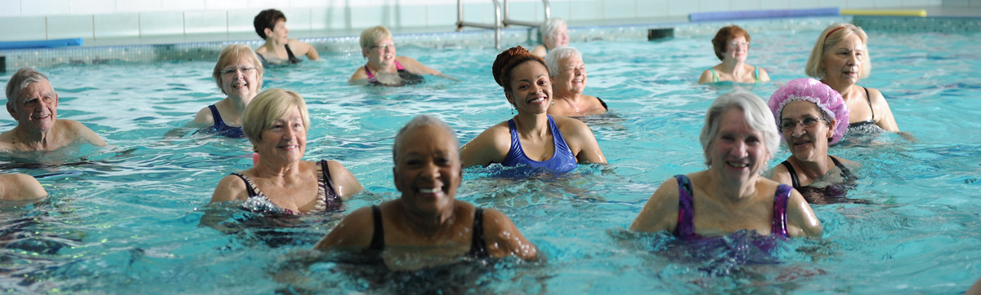
SNHPC Becoming Age-Friendly Project Considerations
How are our communities preparing to serve the needs for the growing senior population?
Southern New Hampshire Planning Commission

Slide 20

SNHPC Becoming Age-Friendly Project Considerations
How can our region attract young adults?
Southern New Hampshire Planning Commission

Slide 21
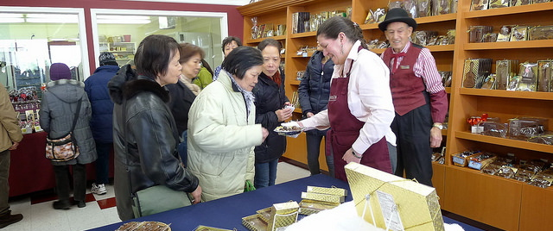
SNHPC Becoming Age-Friendly Project Considerations
Do resident seniors/millennials realize the programs, services, and age-friendly businesses within their community and their region?
Southern New Hampshire Planning Commission

Slide 22
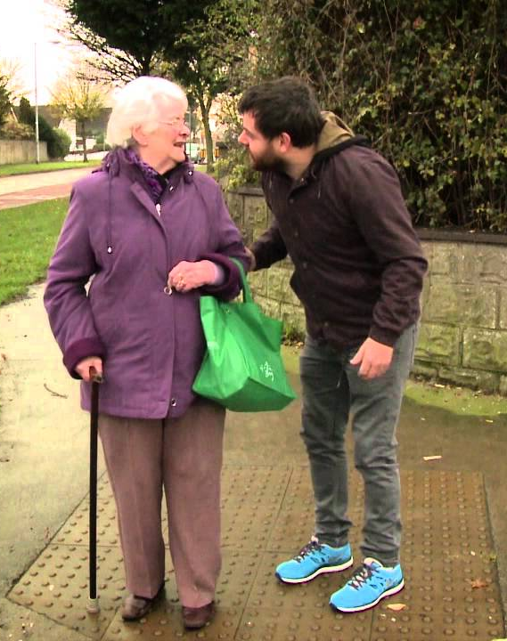
SNHPC Becoming Age-Friendly Project Considerations
Are there synergies and opportunities between these two populations?
Southern New Hampshire Planning Commission

Slide 23
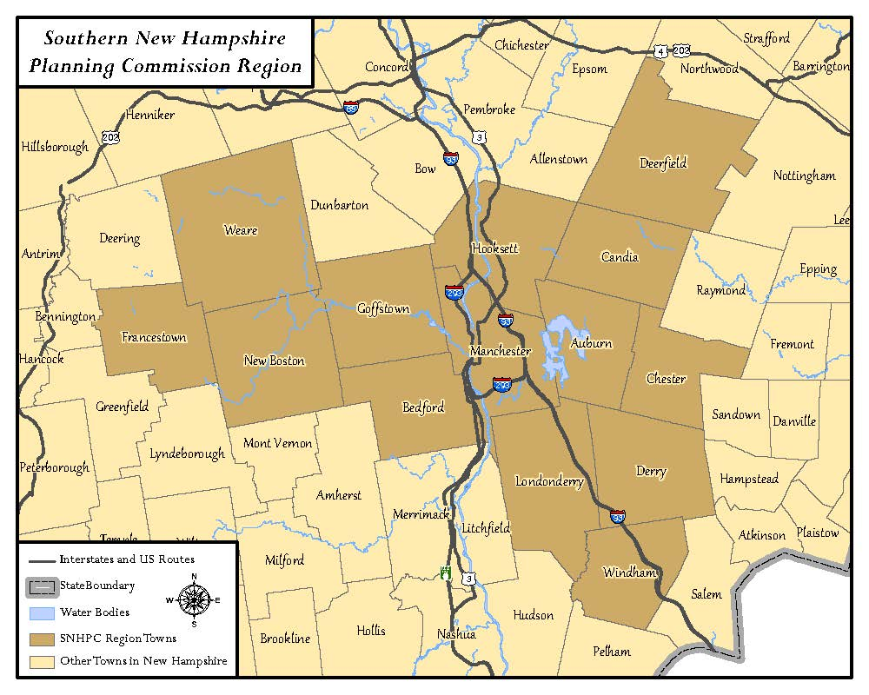
SNHPC Becoming Age-Friendly Project Considerations
How can our region better unite to create collective solutions?
Southern New Hampshire Planning Commission

Slide 24

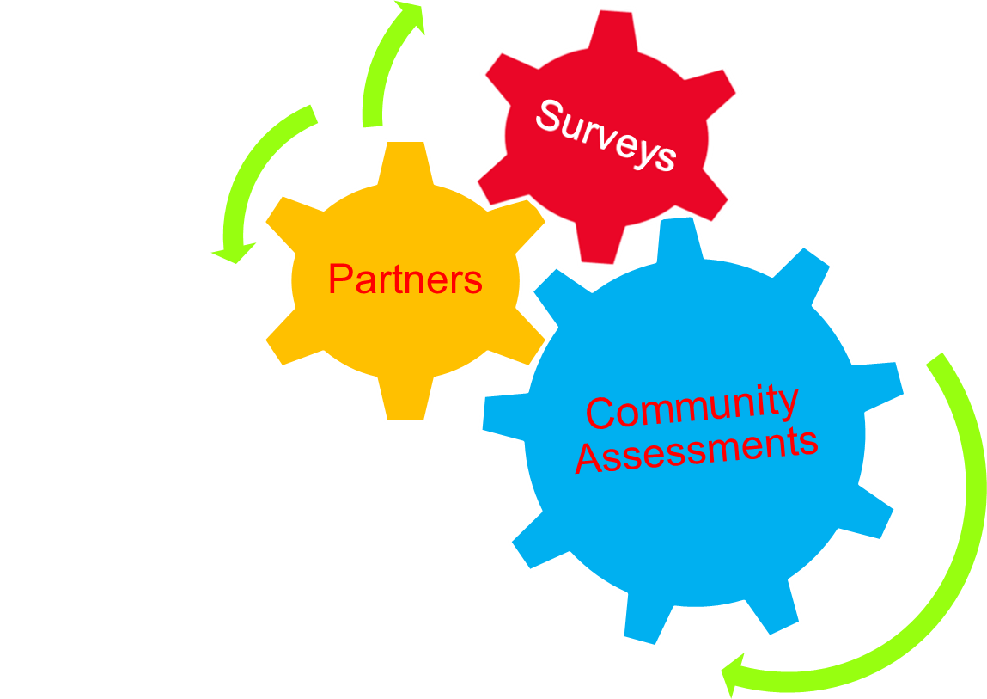

SNHPC Becoming Age-Friendly Project Tasks
Public Forum
Research
Southern New Hampshire Planning Commission
Notes:
Create stakeholder team from interested communities and agencies
Work with Manchester’s Health Department to form a Resident Advisory Committee (dove-tailed with MRACOA)
Research case studies in New Hampshire, Massachusetts, Maine, and Vermont
Complete Community Assessments incl. local land use regulatory allowances and road blocks for all of our communities
Survey SNHPC’s community residents
Organize an Age-Friendly Public Forum

Slide 25




SNHPC Becoming Age-Friendly
Involvement
Communities, town departments
Agency partners
Existing Committees
Southern New Hampshire Planning Commission
Notes:
AARP and SNHPC with input from Manchester Reg’l Area Committee on Aging

Slide 26
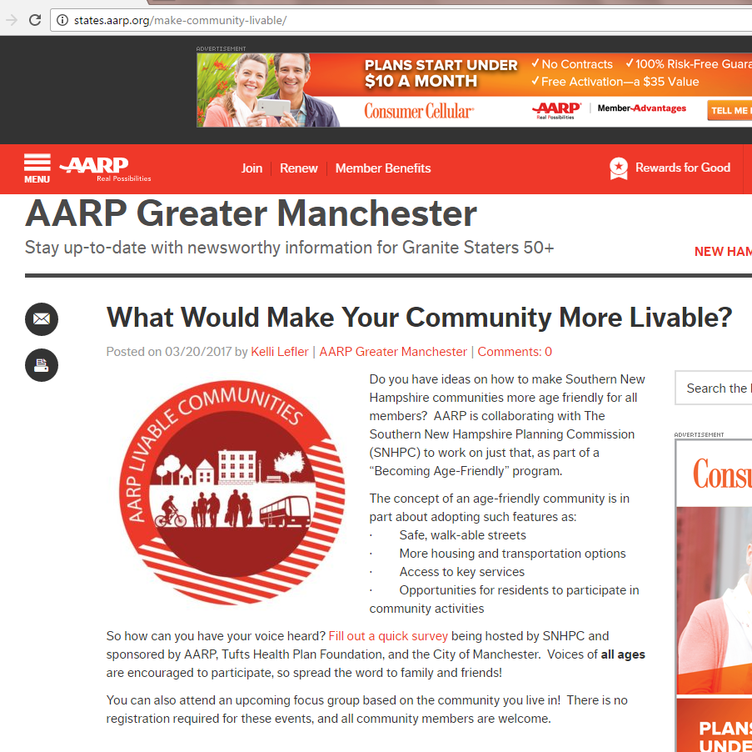
SNHPC Becoming Age-Friendly
Getting the Word Out
Dovetailing with Partners
Manchester Public TV
Local Community Links
Postcard Distributions
Meetings and Talking it Up
Facebook
Web-Site Links
Phone Calls
Local Heroes
Southern New Hampshire Planning Commission
Notes:
AARP multiple venues from email blasts to going to their Movies for Adults event and being the preshow infomercial, handing out postcard with survey monkey site and project background, and SNHPC with input from Manchester Reg’l Area Committee on Aging,NH Planners Association

Slide 27
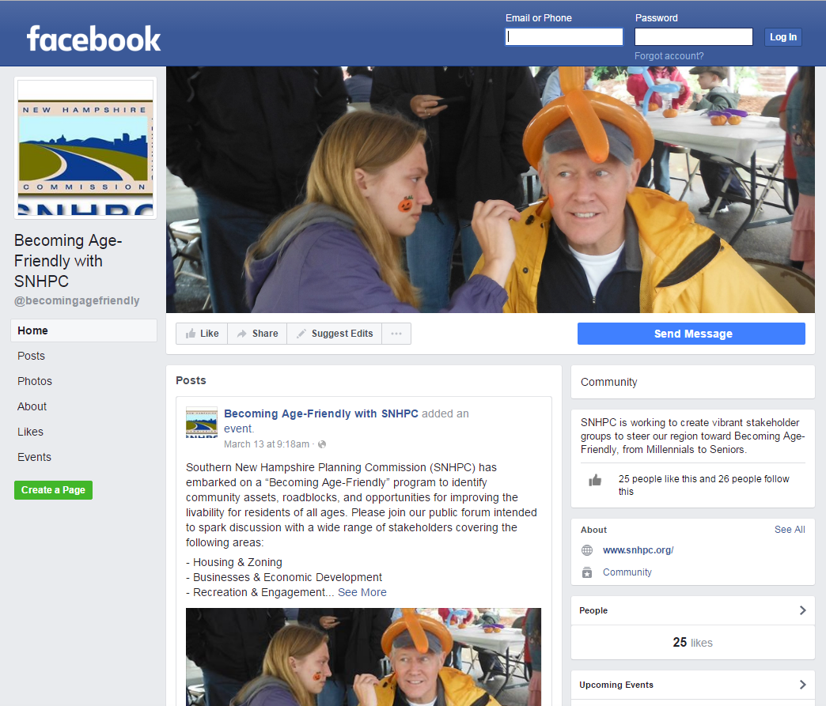
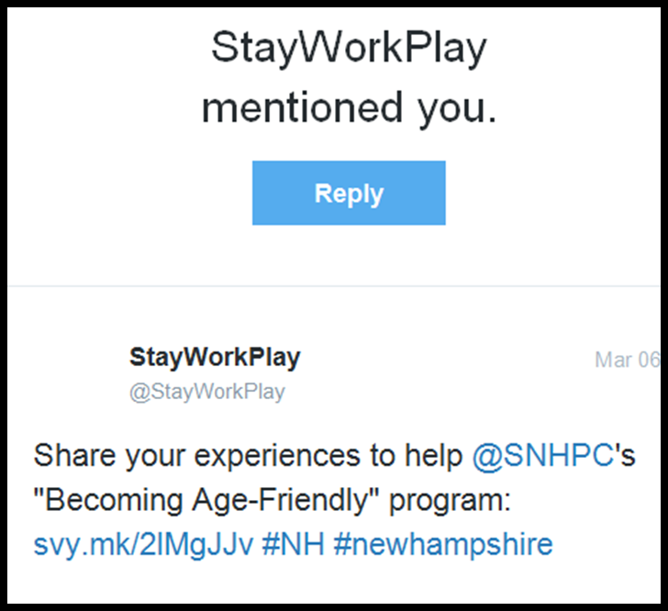
SNHPC Becoming Age-Friendly Millennial Stakeholder Involvement
Southern New Hampshire Planning Commission
Notes:
Business Associations – StayWorkPlay, twitter account and connection to our resident survey
Colleges – SNHU
(business survey)

Slide 28
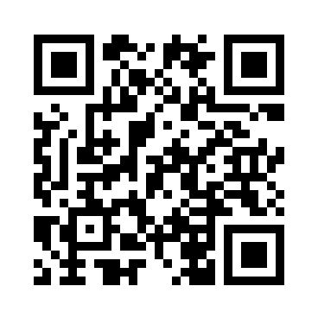
SNHPC Becoming Age-Friendly Survey Distribution
Please visit www.surveymonkey.com/r/BecomingAgeFriendly
to take a 10-minute survey.
WE WANT TO HEAR FROM YOU!
***YOU COULD win $50!
Notes:
QR code

Slide 29

SNHPC Becoming Age-Friendly
Community Assessments and Surveys
Community Assessments
Resident Surveys – Online and Hard copy
Library Assessments (partner with MRACOA)
Home-Building Industry Online Survey (partner with AHA)
Business Surveys (partner with SNHU and local business organization – Chamber and InTown)
Southern New Hampshire Planning Commission
Notes:
o

Slide 30



SNHPC Becoming Age-Friendly Scheduling 14 Community Assessments
Southern New Hampshire Planning Commission

Slide 31

SNHPC Becoming Age-Friendly Incentives
Southern New Hampshire Planning Commission
Notes:
“This sounds like a great event to have to maybe coax residents into voicing their ideas and concerns. I like that it is involving the migration of young adults as well. I do feel this is a problem and it would be great to get some younger perspectives and possibly innovative ideas.” Chester resident From Dave Pierce of Goffstown, Planning Board and Commissioner, “I distributed invite letters to: each town dept (+ planning, zoning, code), SAU, 2 senior housing groups, 5 churches, 2 athletic groups, Main St, 2 youth groups, and 2 medical providers.”

Slide 32

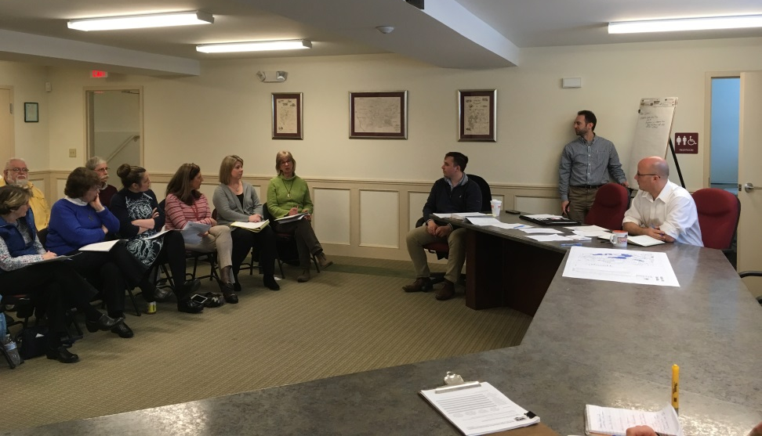
SNHPC Becoming Age-Friendly Community Assessments
Library, Police & Fire Dept,. Church, Historic Soc., Parks, Planning, Town Admin., Church, Civic, Senior/Com. Center, YMCA, Volunteers, Residents, etc.
Southern New Hampshire Planning Commission
Notes:
Housing, (Trends, Needs, Diversity, and Zoning)
Transportation, Accessibility, & Connections
Recreation & Engagement
Age-Friendly Businesses/Economic Development
the purpose of the age-friendly assessment is to raise the awareness and examine assets, opportunities, and roadblocks on many aspects of quality of life issues for both seniors and young adults. We want to know how the community is dealing with the growing aging population, but also if they are recognizing the out migration of young adults, and if so if anything is being done about it.
We hope that invitees include representatives from town departments including the local library, land-use boards, school offices, senior organizations, youth groups, churches, health providers, civic organizations, and recreational organizations.
“Auburn’s single biggest issue is lack of affordable housing for seniors and millennials.” –Bill Herman
▪ Land is too expensive, so builders end up building bigger homes on it to make up their investment

Slide 33
SNHPC Becoming Age-Friendly
Community Assessments and Surveys
Community Assessments
Resident Surveys – Online and Hard copy
Library Assessments (partner with MRACOA)
Home-Building Industry Online Survey (partner with AHA)
Business Surveys (partner with SNHU and local business organization – Chamber and InTown)
Southern New Hampshire Planning Commission
Notes:
o

Slide 34


SNHPC Becoming Age-Friendly
Resident Survey
Southern New Hampshire Planning Commission
Notes:
AARP and SNHPC with input from Manchester Reg’l Area Committee on Aging, Background info (age, where do you live, etc.)
Thoughts on aging in their community
Transportation
Housing
Recreation & engagement
Accessibility and communication

Slide 35
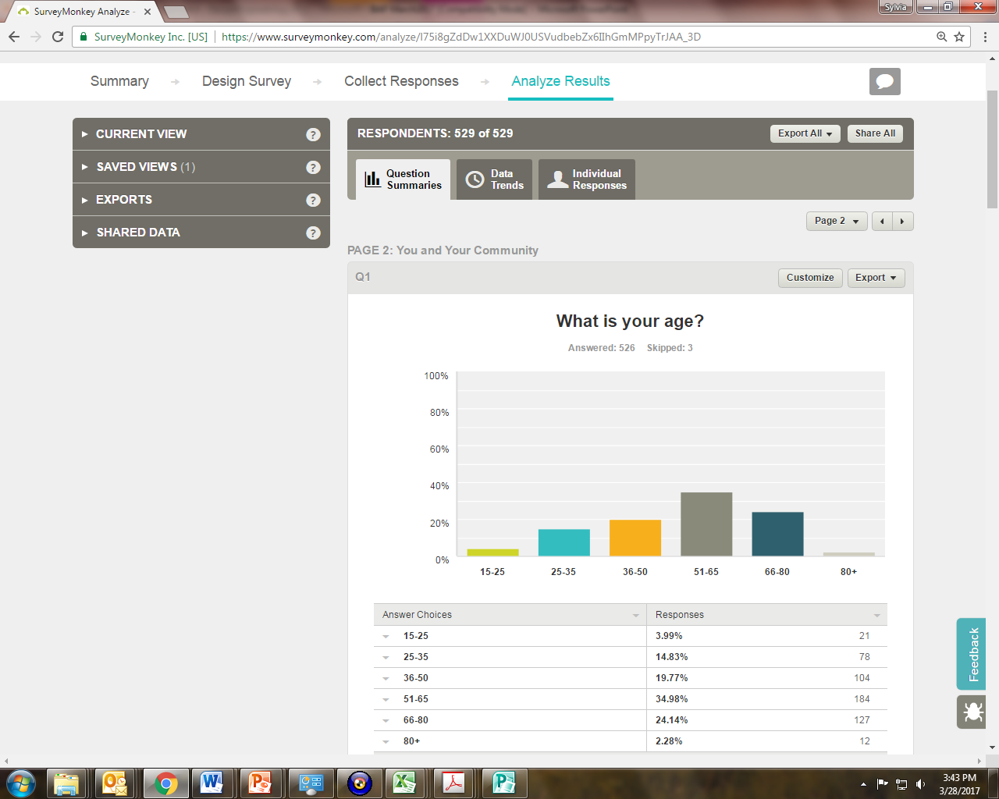
SNHPC Becoming Age-Friendly Background Info.
What is your age?
Southern New Hampshire Planning Commission
Notes:
15-25 6% 35
25-35 14% 91
36-50 19% 122
51-65 34% 216
66-80 24% 154
80+ 2% 14
Total 526
Employed 52%
Employed pt 13%
Veterans 3%
Unemployed 3%
Student 4%
Retired 25%
Other category – stay at home moms 10%

Slide 36
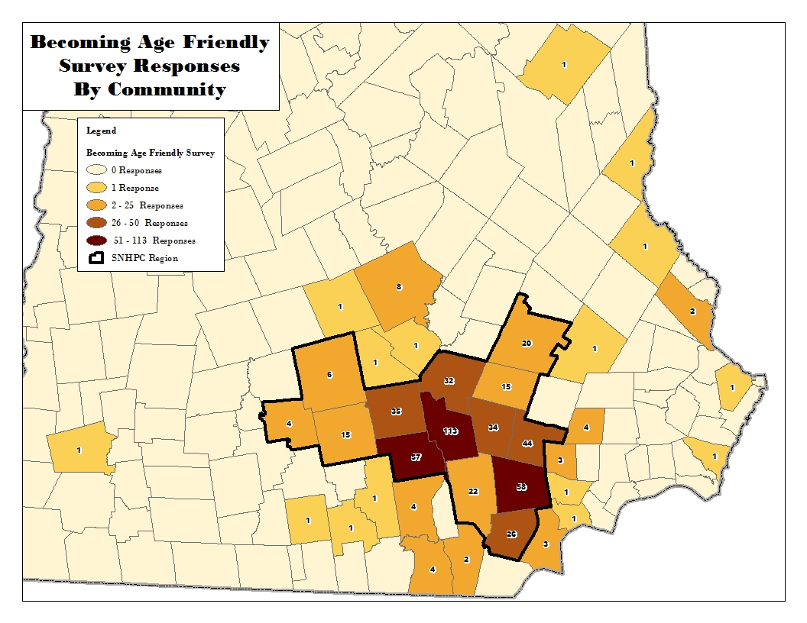
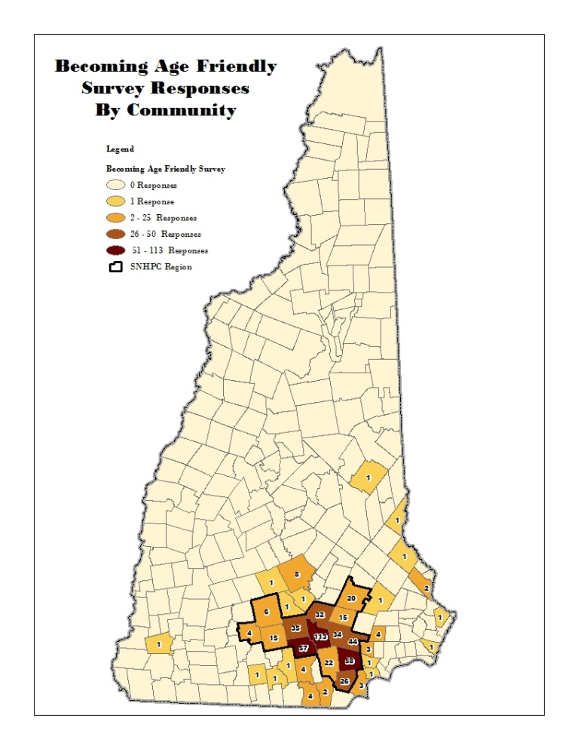
SNHPC Becoming Age-Friendly Background Info.
Where do you live?
Southern New Hampshire Planning Commission
Notes:
Manchester (136), Derry (60), Bedford (59)
Chester (47), Goffstown (35), Auburn (34), Hooksett (35), Windham (52)
Londonderry (24), Deerfield (27), Candia (16), New Boston (26), Weare (13), Francestown (4), Concord (8)
Fremont (4), Nashua(4), Dover (2), Hudson,(2), Salem(2), Sandown (2)
Other (50)
Atkinson, Amherst, Bow, Concord, Dunbarton, Fremont, Hampton, Hampstead, Hopkinton, Hudson, Keene, Salem, Merrimack(4)
Milford, Milton, Nottingham, Penacook, Portsmouth, Rochester, Salem, Sandown, Sanbornton, Temple, Wilton, Wolfeboro NH

Slide 37
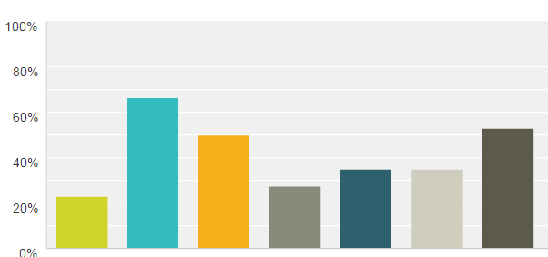
SNHPC Becoming Age-Friendly
What concerns you the most about aging in your community?
T
H
R
F
S
M
J
Southern New Hampshire Planning Commission
Notes:
Finding jobs nearby, Having Transportation Options, Housing options, family nearby, accessible services, medical service nearby, recreation and social engagement, Other Comments: no options, need for more bus stops and later routes, need more options than CART, unsure since it’s not on my radar

Slide 38

SNHPC Becoming Age-Friendly
What is the single most important change that would enable you to stay in your home/community?
Lower Taxes (16%)
Transportation (15%)
More Diverse Housing (15%)
Accessibility to Services, Housing, Health Care, Shopping (10%)
Mobility, Walking, Biking (7%)
Employment (6%)
Southern New Hampshire Planning Commission
Notes:
Comments incl.More transportation options, accessible services, and housing options; Better public transportation; Access to transportation and medical services; the lack of transportation and services that causes many to leave Deerfield and move into assisted living options in Concord, Manchester and surrounding areas. Having access to needed care when that time comes. Mobility, Making sure I have easily accessible employment opportunities.; Better public transportation, Walkable streets; More bike access, Walkability - sidewalks (that are plowed during the winter), train/frequent bus or other public transit options to get around town/NH/into Boston; walkablity access to good housing that does not cost a fourtune; on-call transportation options

Slide 39
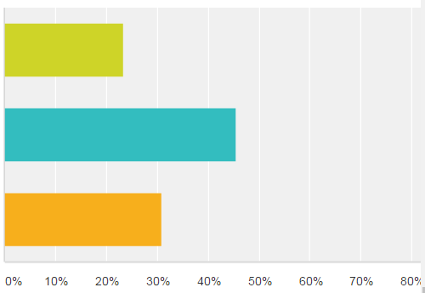
SNHPC Becoming Age-Friendly
Whether you wanted to move into your first home/unit or move into a smaller home/unit, does your community offer appealing alternatives ?
Yes
No
Unsure
Southern New Hampshire Planning Commission
Notes:
Yes – 23%
No – 46%
Not sure – 31%

Slide 40
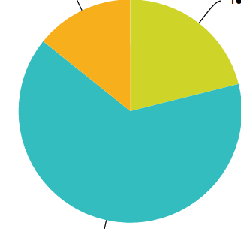
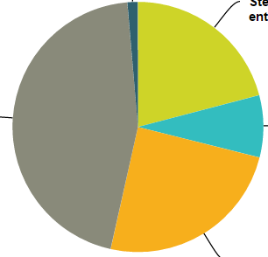
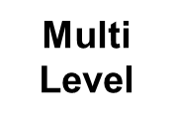
SNHPC Becoming Age-Friendly
If your home has multiple levels or outdoor entry steps, have you considered modifying your home so that you could “age in place”?
Not sure
Yes
Elev.
Steps outside
No
single Level
Two level
Southern New Hampshire Planning Commission
Notes:
Worst the older you get past 60, Distance from everything, requires ability to drive, walking the roads is not the safest undertaking. Good support from community and friends when in need. Access to woods and nearby lakes a plus. Church, community events bring old friends together.no services, no drug store, no decent grocery store, now walking that isn’t dangerous, transportation services
Steps at outdoor entry:20.90%, 125
Single level: 8.03%, 48
Two-levels with stairs to upper floor:24.58%, 147
Multiple levels including basement with multiple stair cases:45.15%, 270
Elevator: 1.34%, 8
Total598

Slide 41
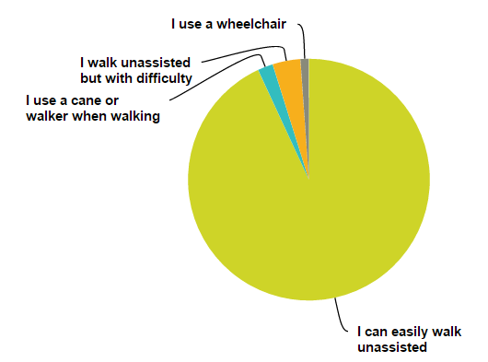
SNHPC Becoming Age-Friendly Transportation
How would you describe your level of mobility
“Many things I do now at 68, I will not be able to do safely as I age.”
Southern New Hampshire Planning Commission
Notes:
Walk unassisted 93 %
Cane – wheelchair 7 %
How do you usuallly travel, 96% have their own vehicle
8 % have their friends or family drive them
26% walk
Less than 1 % use volunteer driver program
Under 2 % use public transportation

Slide 42
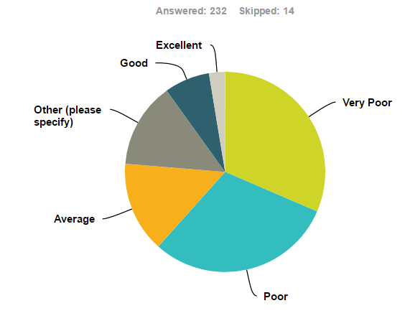
SNHPC Becoming Age-Friendly Transportation
How would you rate your community’s trans-portation options if you were unable to drive?
Concerns:
“MTA does the best they can with very limited resources; Outside the Queen City, options range from very poor to nonexistent; the state should be ashamed for failing to invest in transportation infrastructure for the increasing number of individuals unable to drive.”
Southern New Hampshire Planning Commission
Notes:
Other comments included: Worst the older you get past 60, Distance from everything, requires ability to drive, walking the roads is not the safest undertaking. Good support from community and friends when in need. Access to woods and nearby lakes a plus. Church, community events bring old friends together.no services, no drug store, no decent grocery store, now walking that isn’t dangerous, transportation services

Slide 43
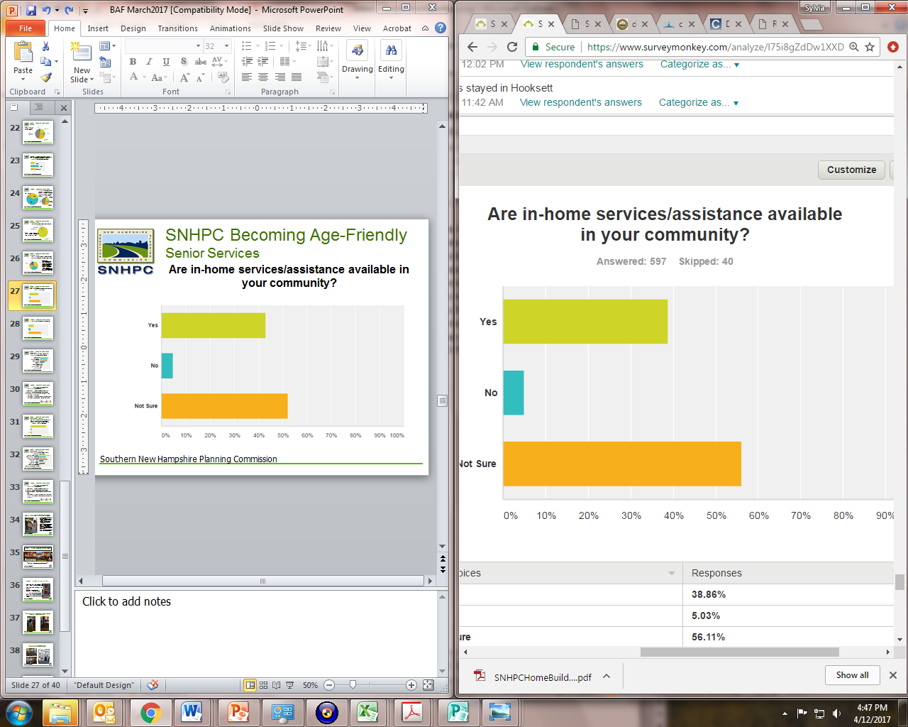
SNHPC Becoming Age-Friendly Senior Services
Are in-home services/assistance available in your community?
Southern New Hampshire Planning Commission

Slide 44
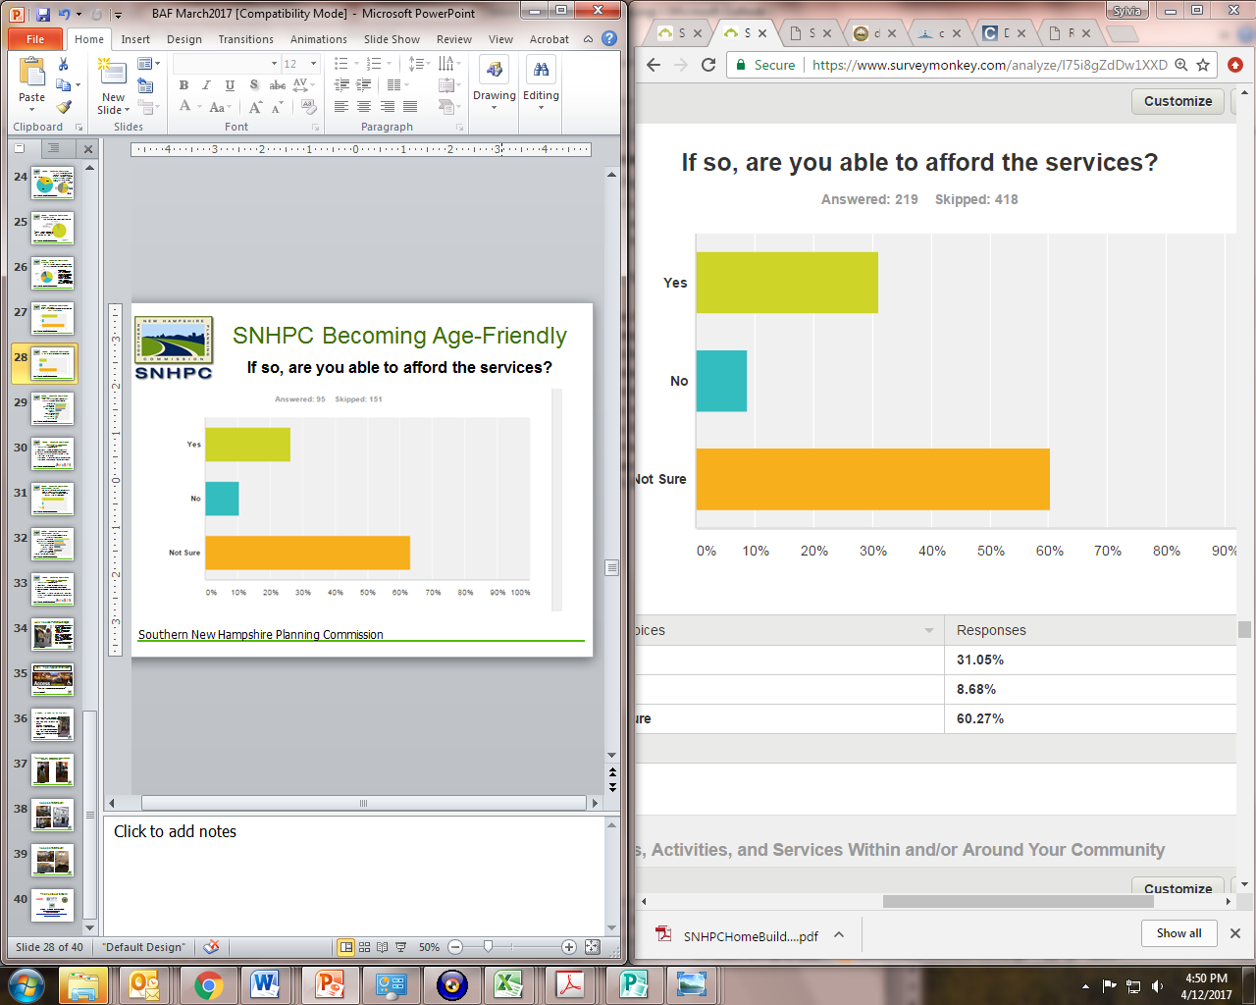
SNHPC Becoming Age-Friendly
If so, are you able to afford the services?
Southern New Hampshire Planning Commission

Slide 45
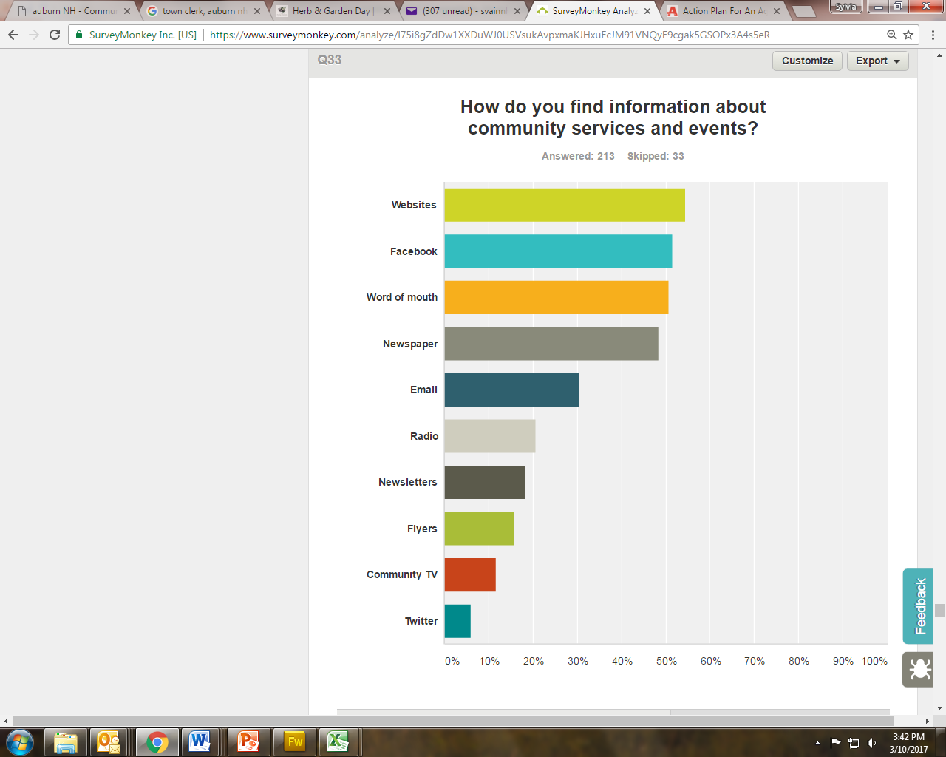
SNHPC Becoming Age-Friendly Accessibility
How do you find information about community services and events?
Website
Facebook
Word of Mouth
Newspaper
Email
Radio
Newsletters
Flyers
Community TV
Twitter
Southern New Hampshire Planning Commission

Slide 46
SNHPC Becoming Age-Friendly
Community Assessments and Surveys
Community Assessments
Resident Surveys – Online and Hard copy
Library Assessments (partner with MRACOA)
Home-Building Industry Online Survey (partner with AHA)
Business Surveys (partner with SNHU and local business organization – Chamber and InTown)
Southern New Hampshire Planning Commission
Notes:
o

Slide 47
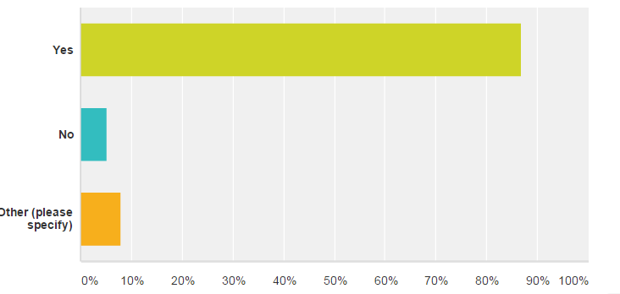
SNHPC Becoming Age-Friendly Home-Builder Survey
As NH’s demographics change, do you see a need to build more diverse housing (smaller homes for seniors, rental units for millennials)
Southern New Hampshire Planning Commission

Slide 48
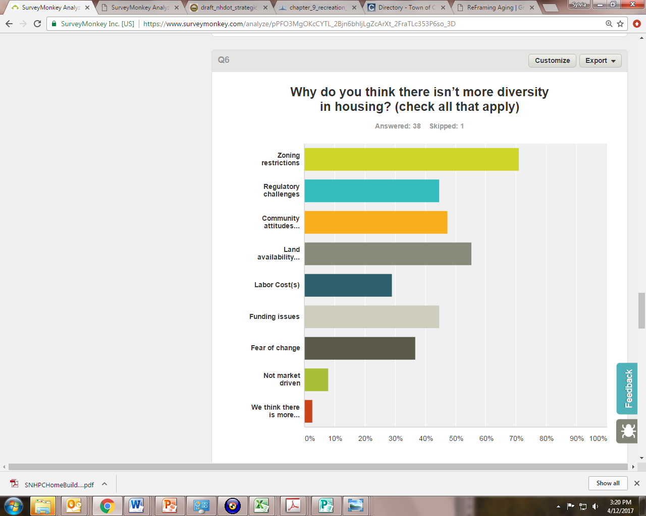
SNHPC Becoming Age-Friendly Home-Builder Survey
Why do you think there isn’t more diversity in housing?
Zoning Restrictions
Regulatory Challenges
Community Attitudes
Land Availability
Labor Costs
Funding Issues
Fear of Change
Not market driven
There is diversity in housing
Southern New Hampshire Planning Commission

Slide 49
SNHPC Becoming Age-Friendly
Community Assessments and Surveys
Community Assessments
Resident Surveys – Online and Hard copy
Library Assessments (partner with MRACOA)
Home-Building Industry Online Survey (partner with AHA)
Business Surveys (partner with SNHU and local business organization – Chamber and InTown)
Southern New Hampshire Planning Commission

Slide 50
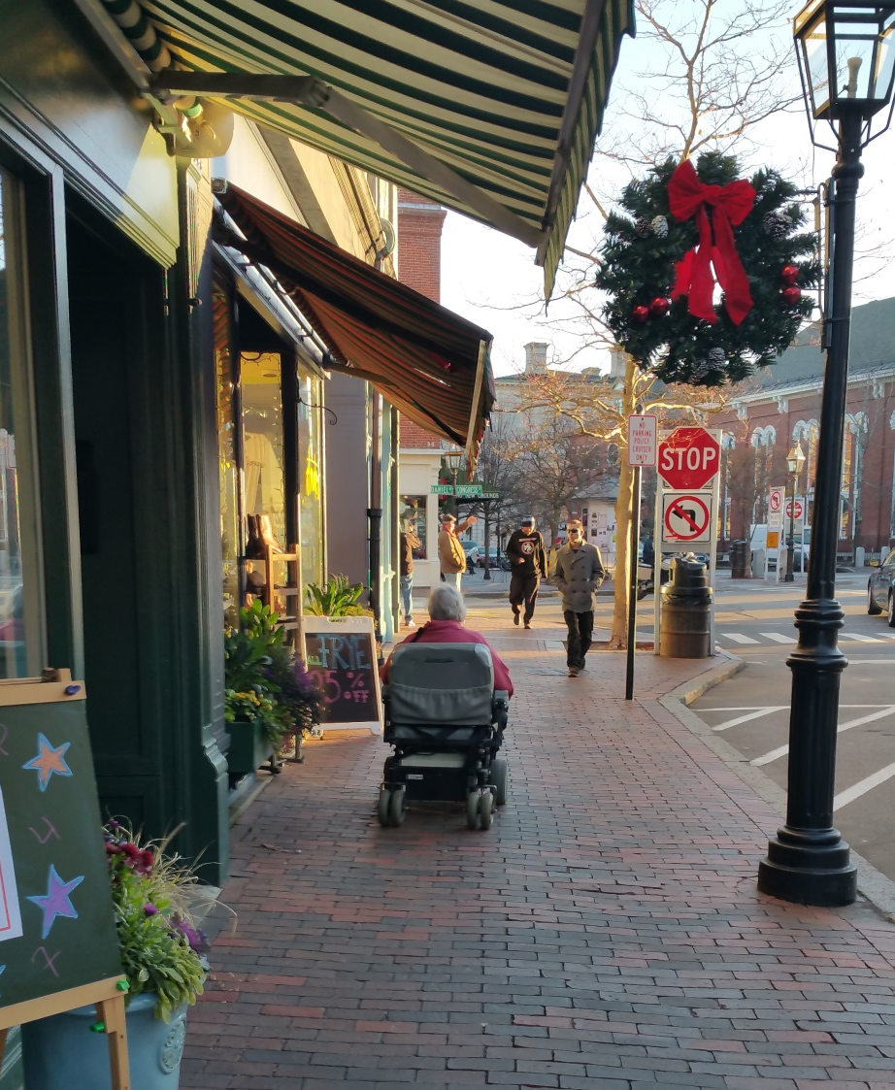
How Access Portsmouth Began
Launched in November 2016 by JSA, Inc.
Todd Hanson, Accessibility Guru and Chief Crash Test Dummy
Anne Weidman, Creative Director and Inspector General
Todd has lived in Downtown Portsmouth for 25 years and loves the atmosphere; however, he lost mobility function 9 years ago and now gets around in a motorized wheelchair.
This changed his perspective and was his call to action.
Access Portsmouth

Slide 51
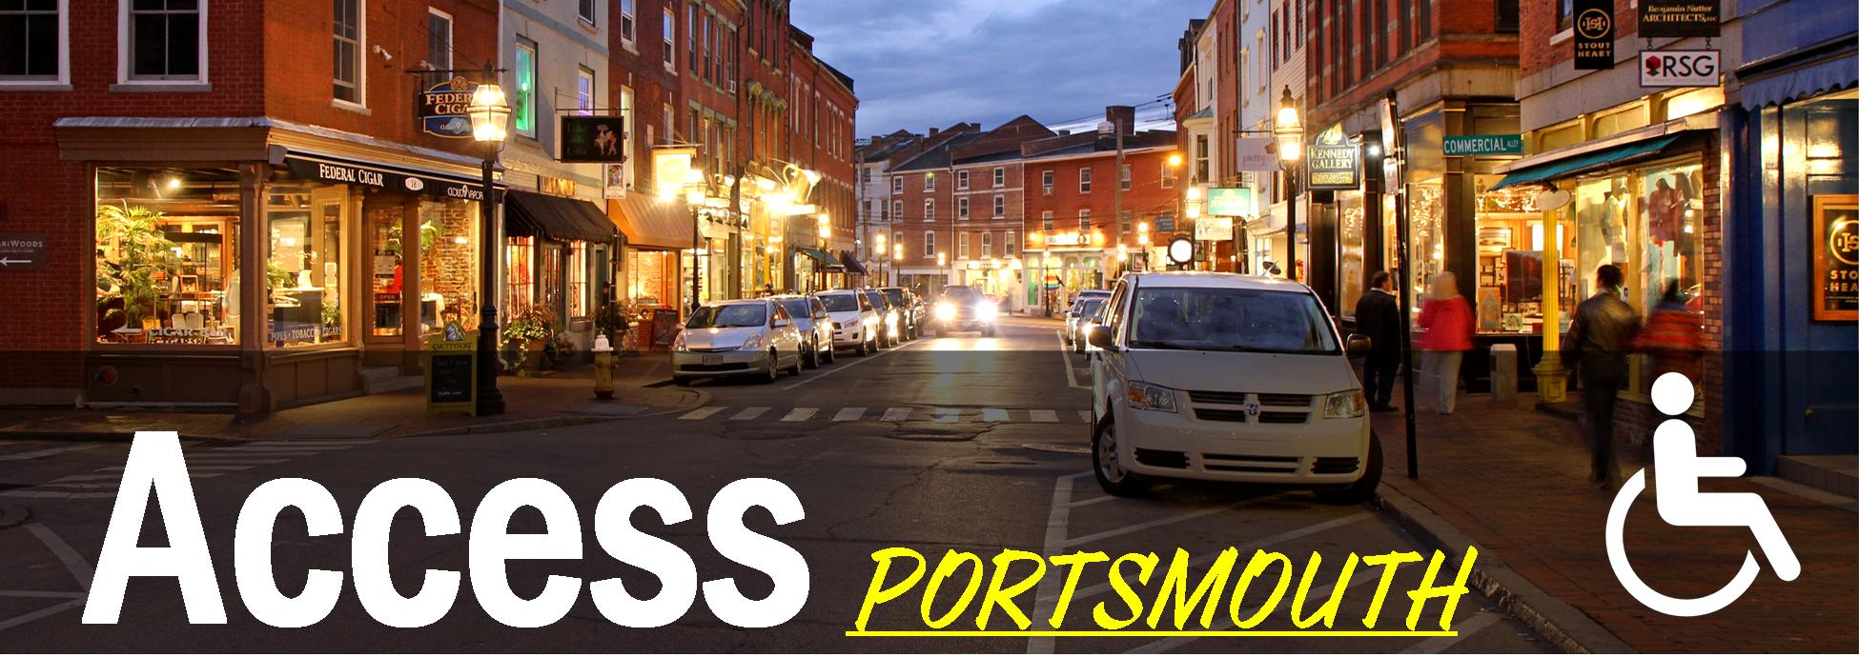
JSA, Inc.’s Access Portsmouth
“Taking the mystery out of accessibility”
Access Portsmouth

Slide 52
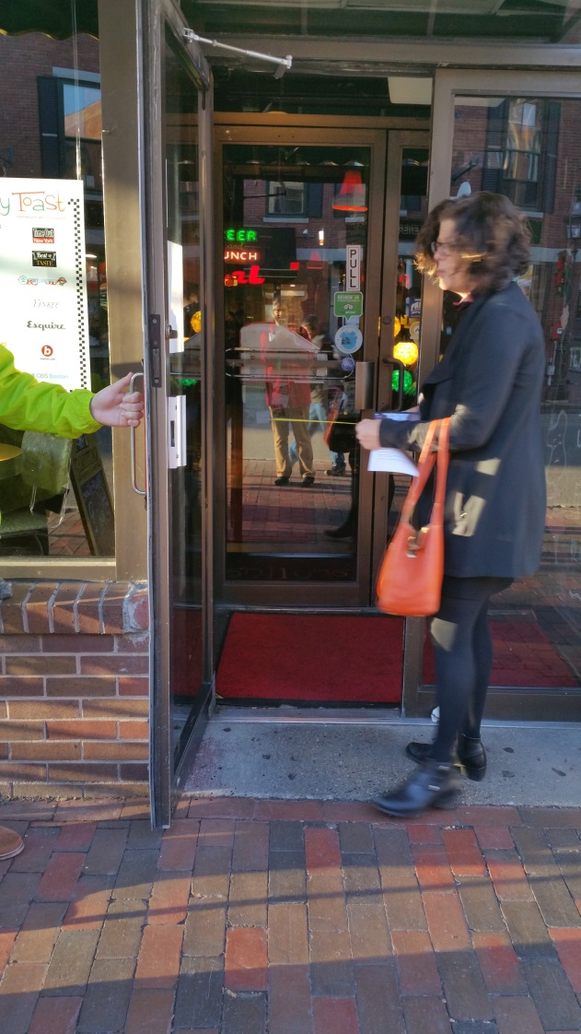
3 Things to Look for on Site Visits
Can you get into the door?
32” wide, has flat surface or ramp
Can you use the facility with ease?
Tables spaced apart
Paths free of obstructions
Is the bathroom accessible?
Flat entrance, sufficient area
Elevator-accessible if on different level
Access Portsmouth

Slide 53
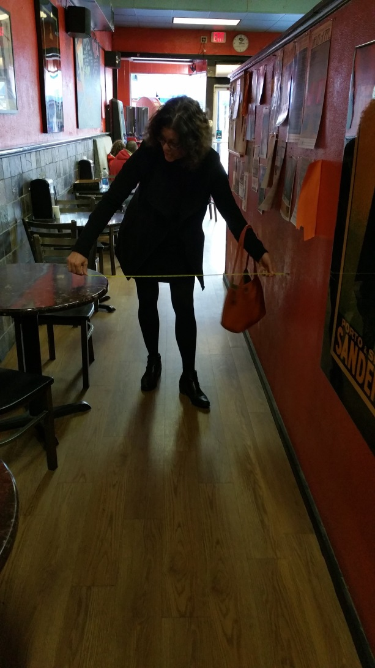
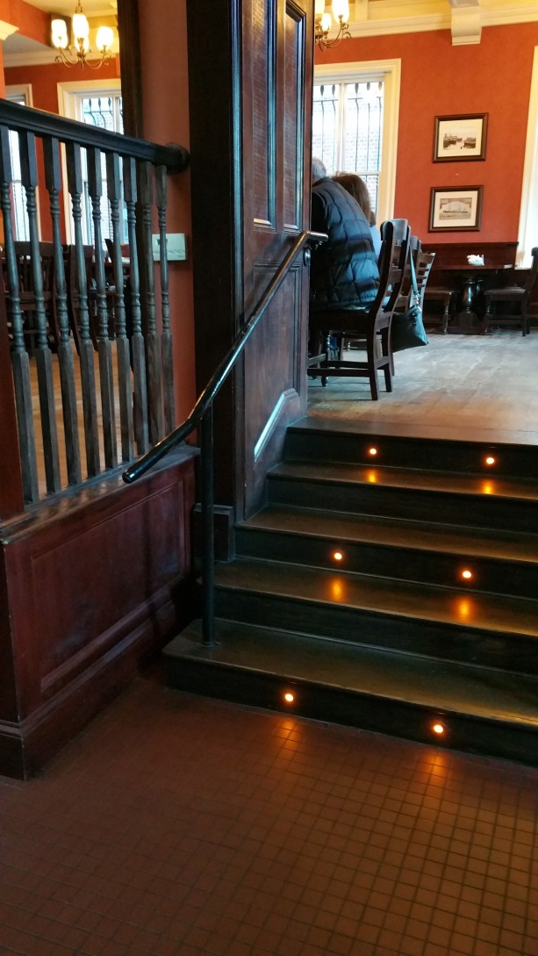
“Accessibility not only benefits the less mobile—it benefits businesses, too.”
Access Portsmouth

Slide 54
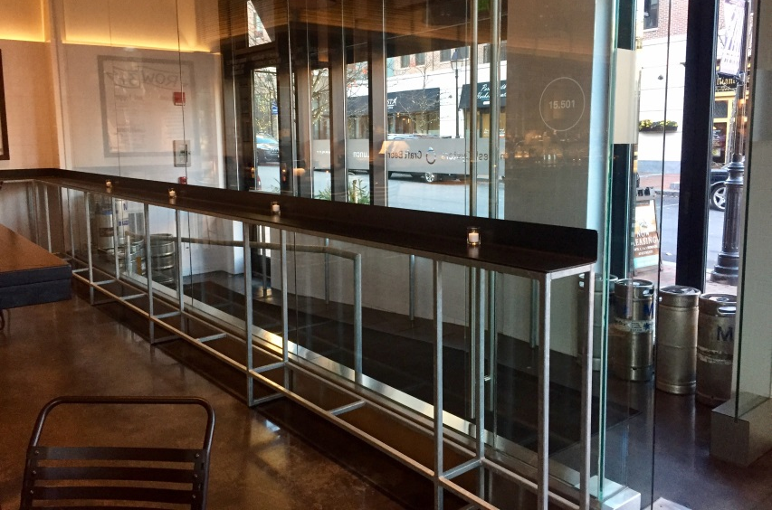
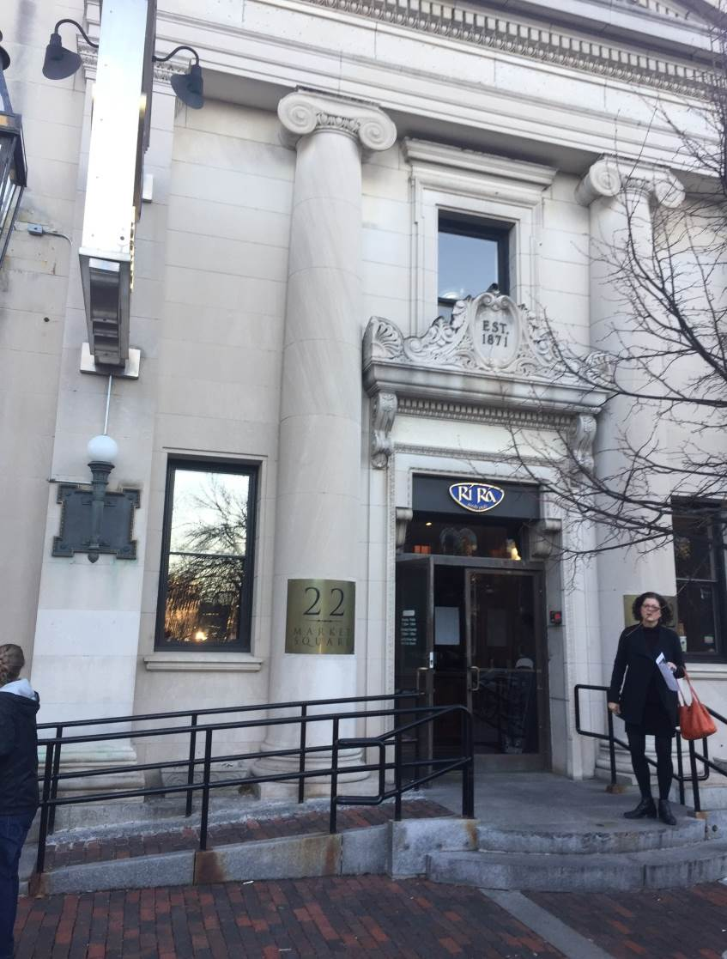
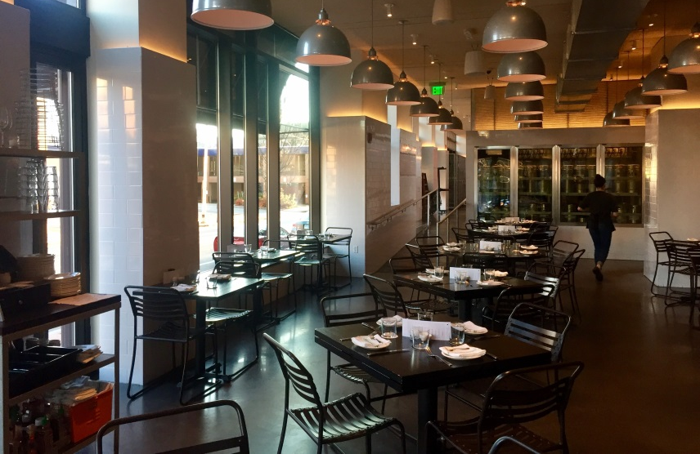
Access Portsmouth
Access Portsmouth

Slide 55
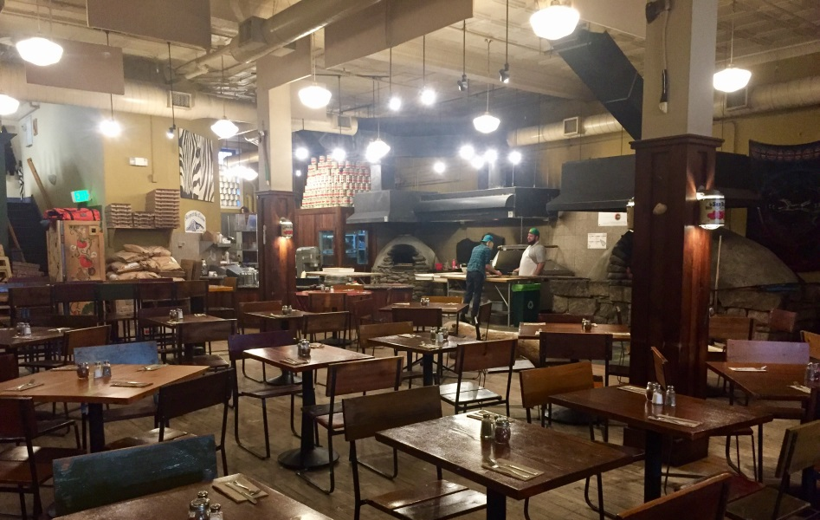
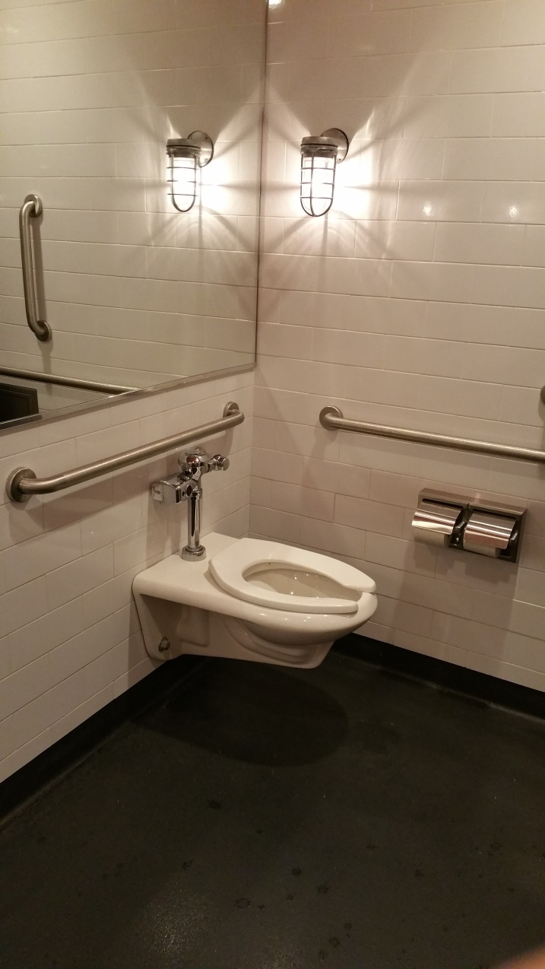
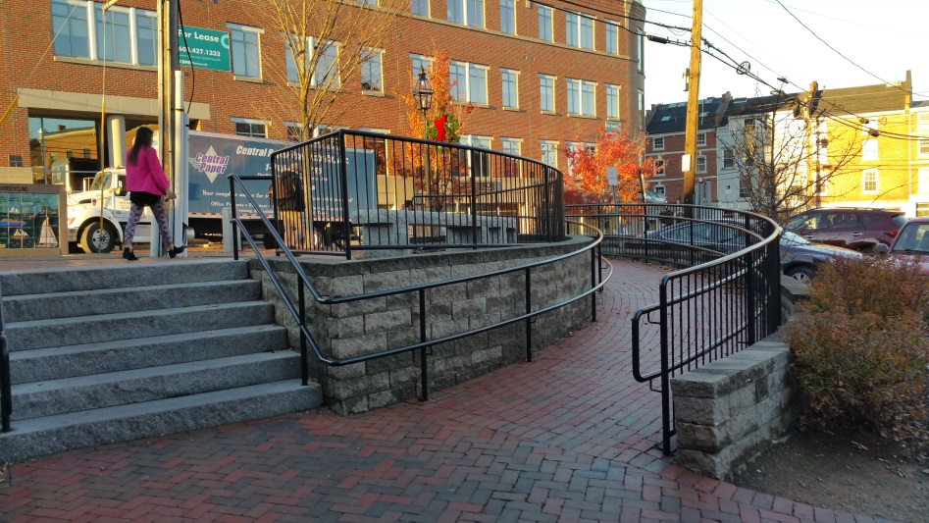
Access Portsmouth
Access Portsmouth

Slide 56



Thanks to our funders!
Project Manager: Sylvia von Aulock, svonaulock@snhpc.org
603-669-4664
http://www.facebook.com/becomingagefriendly
http://www.snhpc.org/

Slide 57


Slide 58

COMMUNITY ANNOUNCEMENTS

Slide 59
STRATEGIC GROUP UPDATES
WORKFORCE: Improve the availability of quality healthcare and social service workforces.
ADVOCACY: Develop an advocacy infrastructure to enhance support for aging issues.
Notes:
Do something with this one….
Advocacy: Develop an advocacy infrastructure to enhance support for aging issues.
Cross Disciplinary: Convene a cross-disciplinary workgroup including medical, mental health, social service, community service, and oral health providers, in order to plan and coordinate efforts.
Zoning: Identify and advocate for needed zoning changes in order to promote affordable, accessible housing options.
Change Practice:
Caregiving: Enhance services and supports of informal, family caregivers.
Transportation: Increase transportation options, including an analysis of current efforts and funding issues.
Information Coordinated: Assure that information on resources and services (e.g. transportation, nutrition, and housing) is available, accessible, and coordinated.
Care Coordination: Improve care coordination for older adults involving medical, mental health, social,, community, and oral health services.
Workforce: Improve the availability of quality healthcare and social service workforces.

Slide 60

You may feel that your part is small and you may not even see your role yet. I am here to shout it out: Every person in the process is important. You are AWESOME! Together we will achieve our vision. Thank you for participating!

Slide 61
Thank you for participating!
For questions or additional information, contact:
Jennifer Rabalais
jennifer.rabalais@unh.edu
228-2084 x14

