Slide 1

Creating a Collective Approach to Address an Aging NH
NH Alliance for Healthy Aging
Quarterly Meeting
June 15, 2017

Slide 2
AGENDA
Welcome and Introductions
What’s Happening: AHA Update
How AARP is supporting and engaging older workers
Community Announcements
NH HB219: Establishing a demographic study committee
Strategic Group Updates: Caregiving & Advocacy
Group networking activity
Bright Spots:
Osher Lifelong Learning Institute
Oral Health Coalition
Wrap up/Next Steps
Notes:
Just place holders for now

Slide 3
AHA UPDATE
AHA Communication Update
Elevator Speech
Logo
Feedback on 5 Conditions of collective impact

Slide 4
Condition 1: Common Agenda
Strengths
Inclusion
Bringing new stakeholders to work together
Consistent message of success
Challenges
Difficult for new members to get involved
Limited awareness of mission
AHA participants should be more diversified
Wishes
Regular reinforcement of vision
Ease of access to information

Slide 5
Condition 2: Shared Measurement
Strengths
Strategy/measurements under development
Challenges
Full understanding of measurements
Access to information on progress
Wishes
Dashboard for measurement updates
Access to resources

Slide 6
Condition 3: Mutually Reinforcing Activities
Strengths
Collaboration
Challenges
Communication across work groups
Broadness
Wishes
Tool kits for sustained work

Slide 7
Condition 4: Continuous Communication
Strengths
Communication keeps everyone on track
Challenges
Continuous participation
A lot of information to keep track of
Wishes
Increased communication across groups

Slide 8
Condition 5: Backbone Support
Strengths
Working together to make a difference
Challenges
Confidence in work completed and results of efforts
Wishes
More funding
Higher numbers of dedicated AHA members

Slide 9
AHA UPDATE
Survey
8 AHA Strategic Workgroups
Change Policy:
Advocacy: Develop an advocacy infrastructure to enhance support for aging issues.
Cross Disciplinary: Convene a cross-disciplinary workgroup including medical, mental health, social service, community service, and oral health providers, in order to plan and coordinate efforts.
Zoning: Identify and advocate for needed zoning changes in order to promote affordable, accessible housing options.
Change Practice:
Caregiving: Enhance services and supports of informal, family caregivers.
Transportation: Increase transportation options, including an analysis of current efforts and funding issues.
Information Coordinated: Assure that information on resources and services (e.g. transportation, nutrition, and housing) is available, accessible, and coordinated.
Care Coordination: Improve care coordination for older adults involving medical, mental health, social,, community, and oral health services.
Workforce: Improve the availability of quality healthcare and social service workforces.
Notes:
Workgroups- how to engage
Groups moving at different paces- all developing strategies for implement
Endowment for Health Annual Meeting- thanks so much to caregiver
Hear later about Workforce and Ad
We “heart” box- engage- stay connected
Workgroups- insert slide with all workgroup titles
Common measurement- thanks for your work at the last Q Meeting- we took your feedback regarding ….; bringing to next SC; then to full meeting….
Common Measurement
Communications- committee that completed its communications plan and will hear more in coming meetings. Welcome more voices both with expertise on communications and aging.
Resources- after the meeting- will include Frameworks Institutes- new tool kit.

Slide 10

How AARP is Supporting and Engaging Older Adult Workers and Volunteers
Todd Fahey, AARP State Director

Slide 11

COMMUNITY ANNOUNCEMENTS

Slide 12


Slide 13
NH HB219: Establishing a Demographic Study Committee
Steve Norton

Slide 14
STRATEGIC GROUP UPDATES
ADVOCACY: Develop an advocacy infrastructure to enhance support for aging issues.
Workgroup update: NH Legal Assistance
AHA long term public policy planning: Ellen Koenig
CAREGIVING: Enhance services and supports for informal, family caregivers
Kelly Laflamme
Notes:
Do something with this one….
Advocacy: Develop an advocacy infrastructure to enhance support for aging issues.
Cross Disciplinary: Convene a cross-disciplinary workgroup including medical, mental health, social service, community service, and oral health providers, in order to plan and coordinate efforts.
Zoning: Identify and advocate for needed zoning changes in order to promote affordable, accessible housing options.
Change Practice:
Caregiving: Enhance services and supports of informal, family caregivers.
Transportation: Increase transportation options, including an analysis of current efforts and funding issues.
Information Coordinated: Assure that information on resources and services (e.g. transportation, nutrition, and housing) is available, accessible, and coordinated.
Care Coordination: Improve care coordination for older adults involving medical, mental health, social,, community, and oral health services.
Workforce: Improve the availability of quality healthcare and social service workforces.

Slide 16
Networking Activity
In thinking about your work:
What is worrying you?
What opportunities do you see?
Turn to a neighbor and take turns discussing these questions for 10 minutes.
Switch to a new person and repeat.

Slide 17
Osher Lifelong Learning Institute (OLLI)at Granite State College
Jane Fletcher, MSW
Program Director

Slide 18
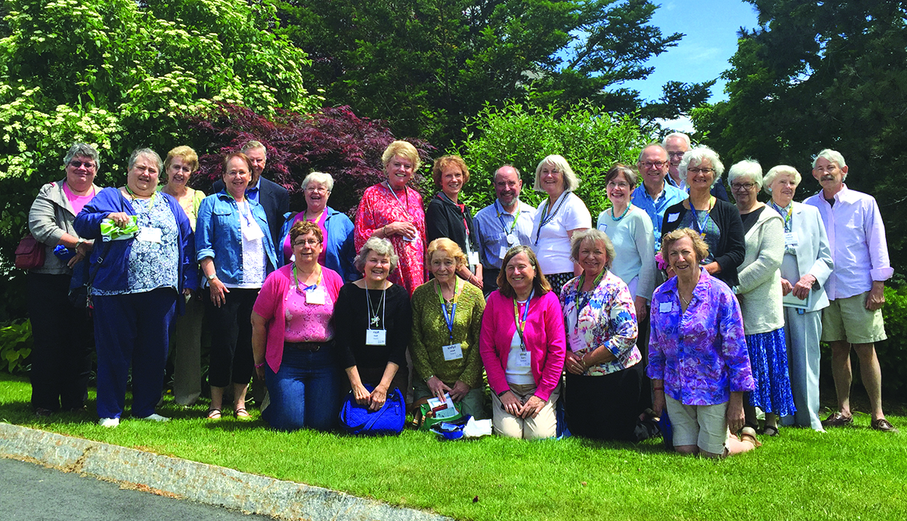
A Bright Spot

Slide 19
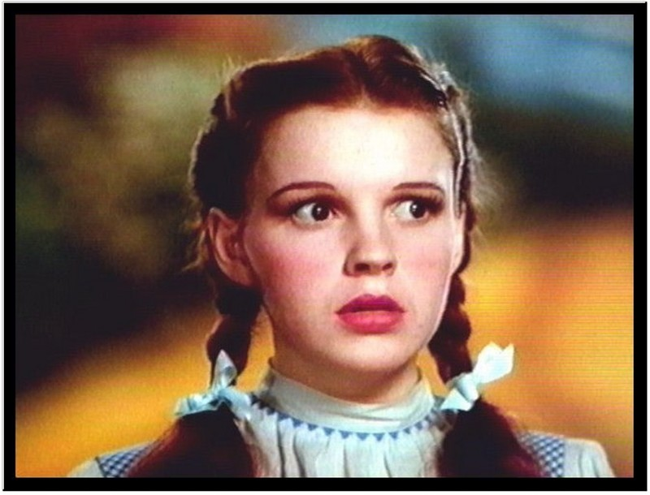
Am I in the land of OZ?

Slide 20
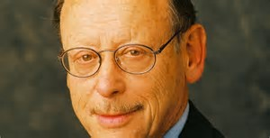
Bernard Osher

Slide 21
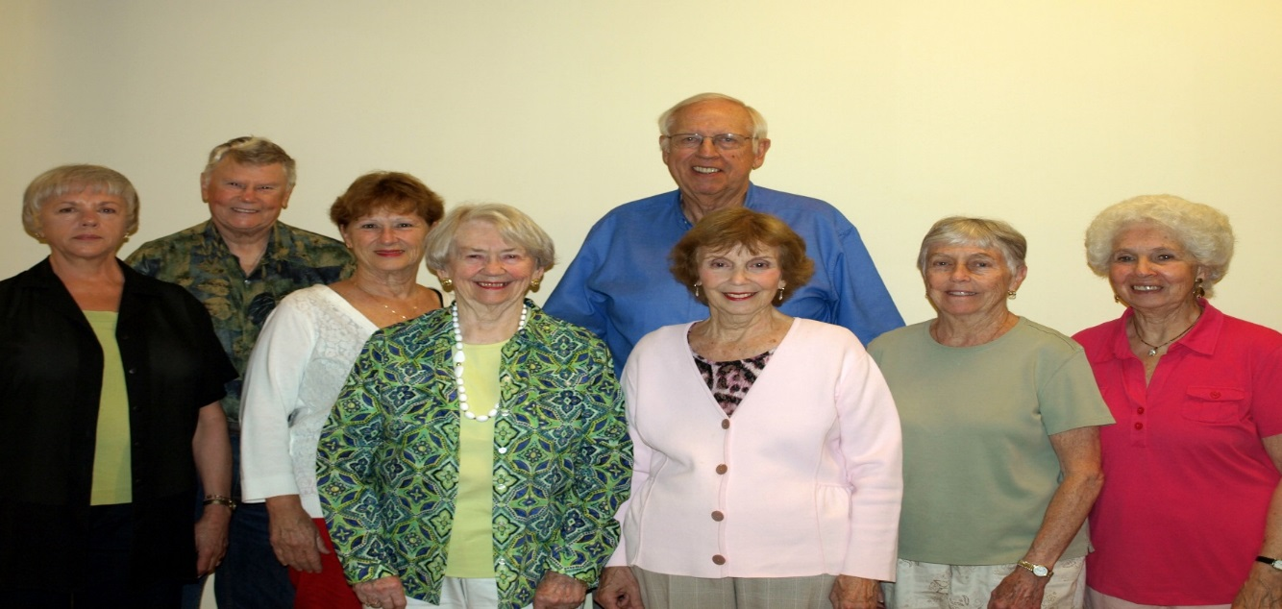
One of the Eight Criteria for an Effective OLLI
Significant Opportunities for Volunteer Engagement and Leadership

Slide 22
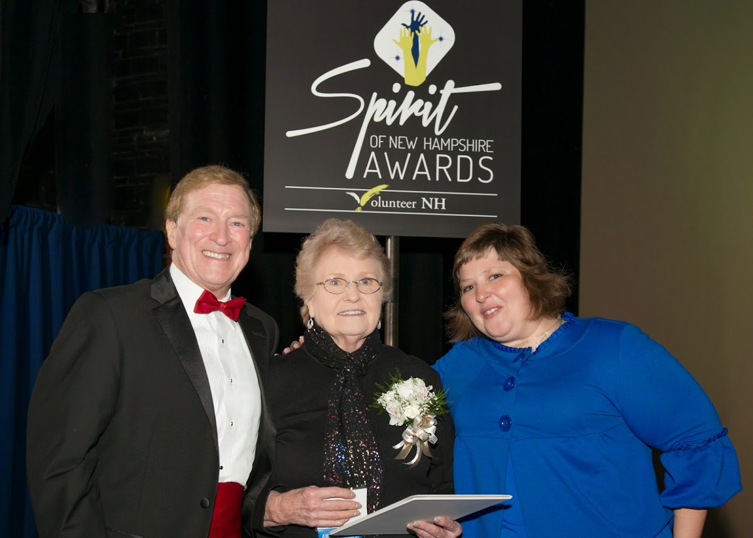
“Dignity and Purposefulness”

Slide 23
Four learning sites:
Greater Concord area
Greater Manchester area
Greater Conway area
Seacoast area: Portsmouth and Rochester area

Slide 24
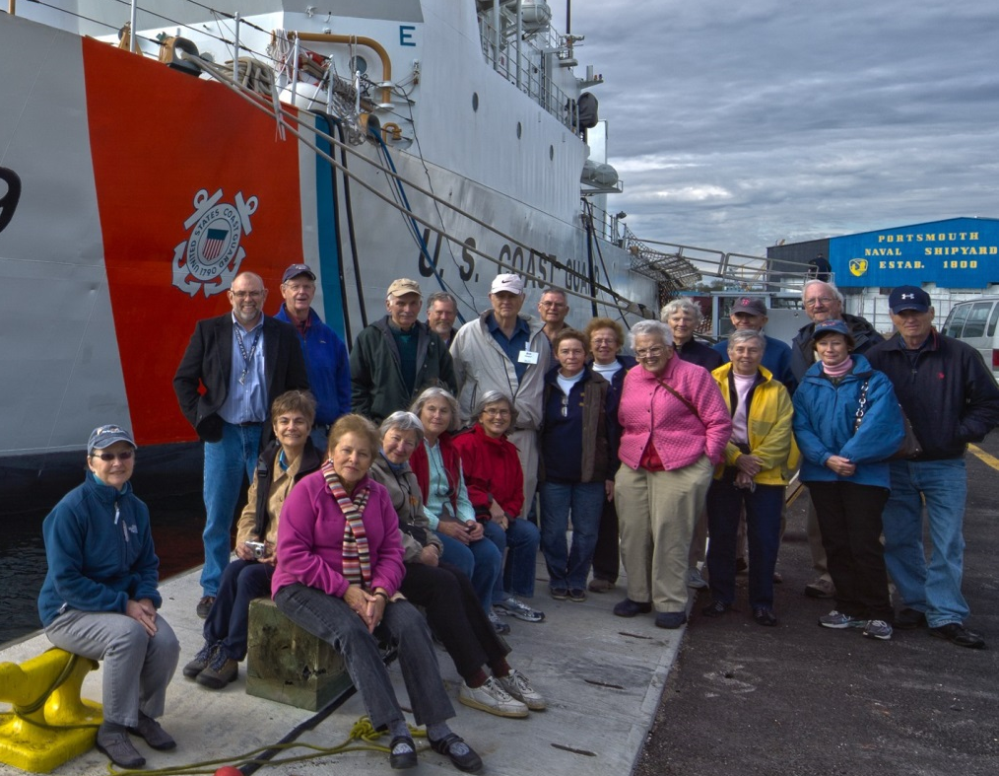
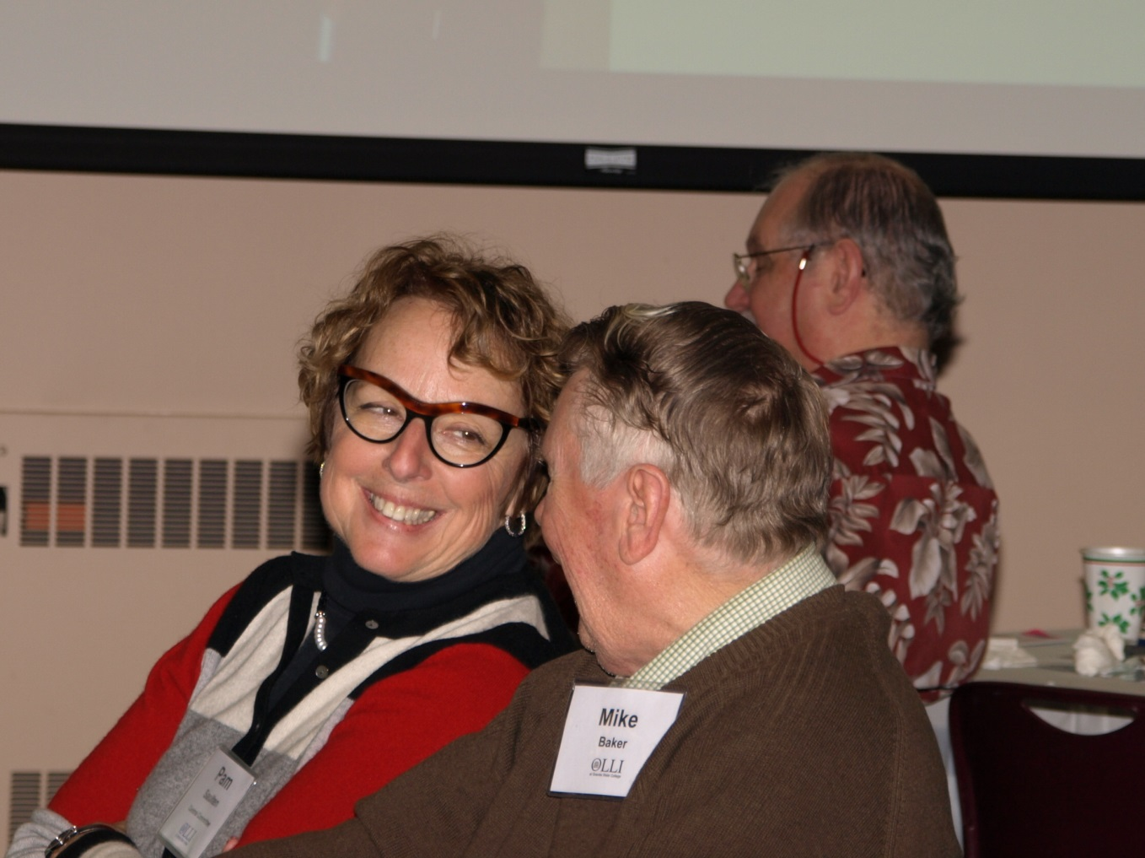
OLLI – Learning For the Fun of It. Come for the classes. Stay for the friends!

Slide 25
What is OLLI at GSC?
A membership organization dedicated to offering intellectually and socially stimulating programs, trips and social events for interested individuals age 50+
Granite State College hosts OLLI
GSC is part of the University System of NH
OLLI at GSC initiated in 2004
One of 120 OLLIs across U.S.A.
Notes:
Click for O L L I

Slide 26
The Bernard Osher Foundation
Supports a network of OLLIs across U.S.A.
Intended for seasoned adults aged 50+ seeking
the love of learning
personal fulfillment
social interaction, and
volunteer opportunities
Supports the OLLI National Resource Center provides support and connects the network
Osher
Lifelong
Learning
Institute

Slide 27
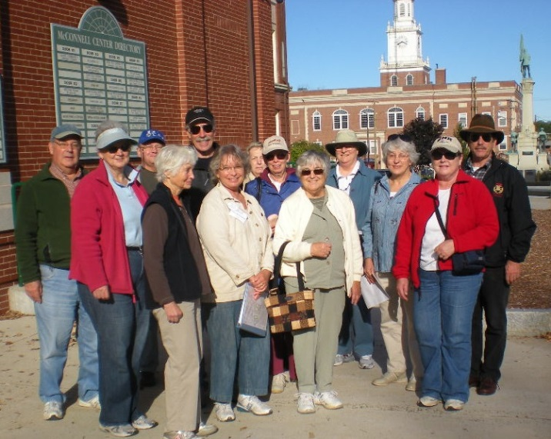
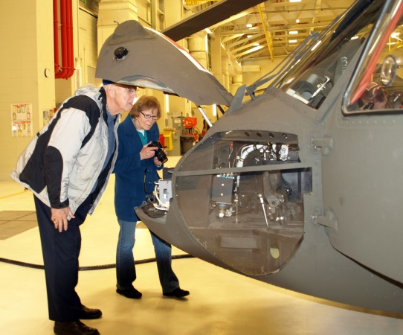
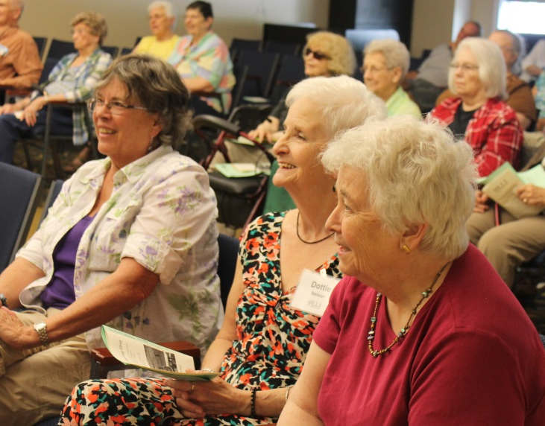
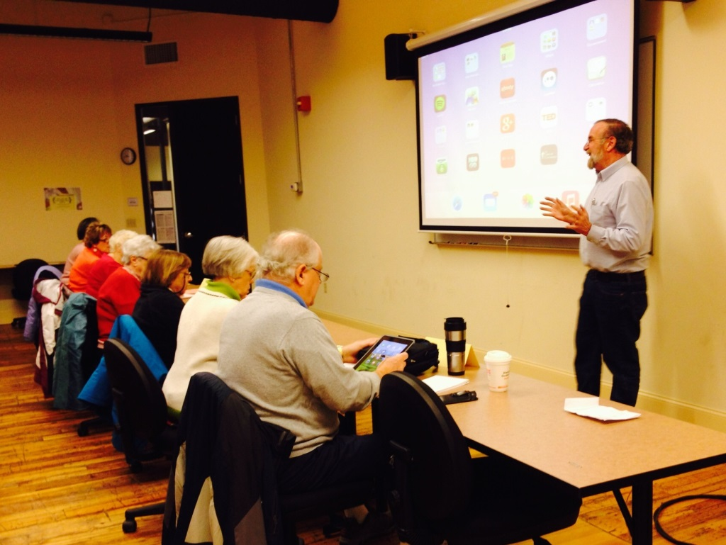
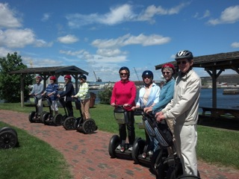
OLLI at GSC-Operations

Slide 28

Funding Sources
Bernard Osher Foundation
Awarded start-up funds, gifts and grants
Awarded $1,000,000 endowment in June 2008, and $950,000 endowment in 2015
Managed/invested through USNH. Generates interest income.
Donations and Sponsorships
Class & Membership Fees
In-Kind donations Granite State College:
Classroom, meeting and office space, parking
Departmental Support: Information Technology, Marketing, Finance and Accounting, Human Resources, Facilities
In-Kind contributions from community organizations

Slide 29
Opportunities to Volunteer OLLI is Operated and Governed by Member-Volunteers.
Members may choose to serve in one of the following roles:
Class Presenter (including non-member opportunities)
Class Assistant
Newsletter Contributor
OLLI Ambassador presenter
Social Event Planner
Members may volunteer to serve on a local organizational committee:
Central
Curriculum
Communications - Publicity
Membership
Volunteer

Slide 30
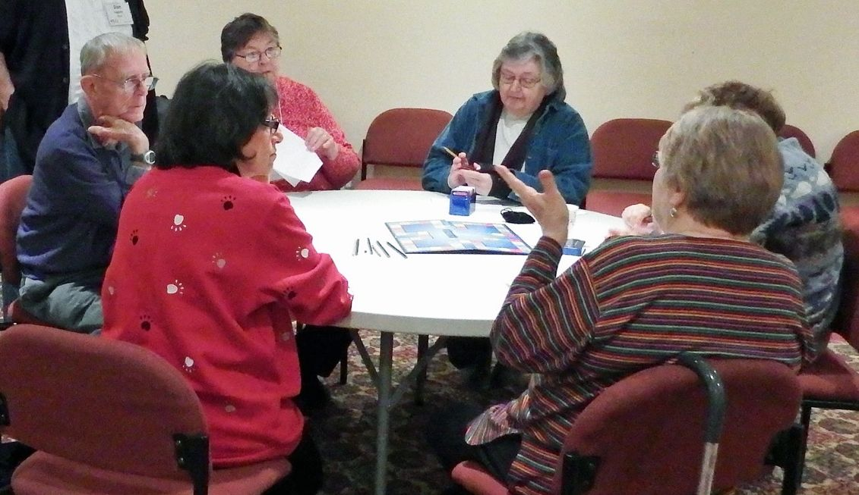
State-wide Committees
Steering
Membership
Development
Travel

Slide 31
STAFFING OLLI is Managed by Staff
3 Full Time & 1Part Time
Director (FT)
Manager (FT)
Program Support Person (FT)
Volunteer Support Person (PT)
Administration & Program Development
Curriculum & Office Management
Registration & Accounts Receivable
Locality Development

Slide 32
OLLI at GSC by the Numbers
Membership 2017: 1200
Annual Membership Fee: $40.00
Class fees: $20. for single session class and $5 for each additional session
Over 380 classes to choose from annually
4 OLLI Learning Sites (Members may take classes at any of them)

Slide 33
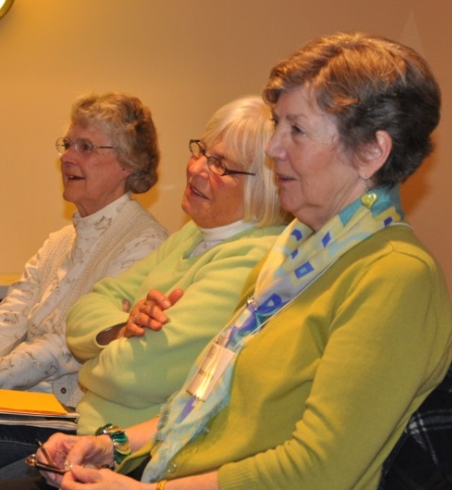
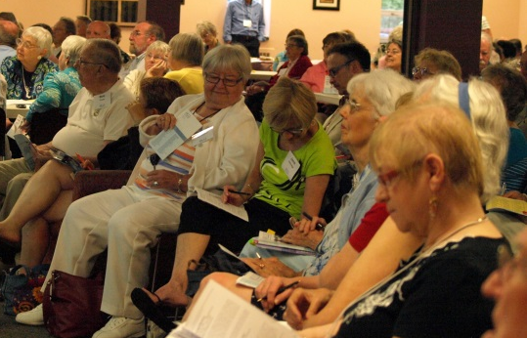

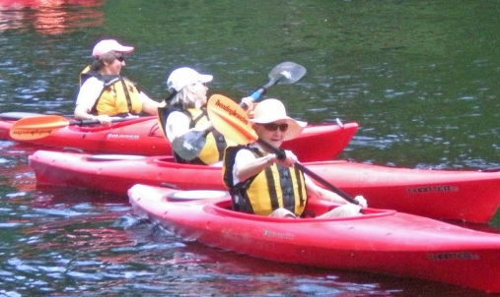
Class Topics Include:
Literature Science History
Languages Art
Computers and Technology
Health Films Social Media
Outdoor Adventures
Cooking Games
Music Philosophy World Religions
Current Events and World Affairs Coins

Slide 34
Above all, OLLI is about Learning for the Love of It!
Watercolors With A Splash!
10536 | Class Size: Min: 2 Max: 10 | Member Class Fee: $25
3 Tuesdays: 10/7, 10/21-10/28 | 9:30-11:30 AM
Granite State College, 53 Technology Lane, Conway
In this fun and laid back atmosphere, learn the basic techniques of painting with watercolors and color mixing. With hands-on exercises, examine the different ways this fluid medium can be used. Watercolors can be challenging, but learning the basics will allow you to experiment and find your own style. At the completion of this class participants will have an understanding of how this medium works, as well as a completed project to take home. A list of supplies will be provided.
Jessica Fligg is an award winning artist working in oils and watercolors. Jessica studied at the New Hampshire Institute of Art in Manchester. She works from her private studio in Ashland, NH and extensively en plein air. Jessica is passionate about art and enjoys sharing her knowledge of the arts.
Fort McClary Hike
10457 | Class Size: Min: 5 Max: 20 | Member Class Fee: $15
1 Friday: 9/26 | 10:30 AM-Noon
Fort McClary, Route 103, Kittery, ME
Walk the grounds of Fort McClary, discussing the historical remains at the site. Let your mind wander back through time while you hear the military timeline of events including personalities of the people involved, local historical happenings and military technologies. Emphasis on the geological and ecological attributes and how they impacted the history of the Fort. Please dress for the weather and wear sturdy hiking/walking shoes. Be prepared to
walk for extended periods of time throughout the class over uneven terrain. Participants are invited to Kittery Point restaurant for lunch (pay on yourown) after the class.
Wesley Ham is an Environmental Steward with the Maine State Parks system. He has a BS in Earth Science from Southern Maine. He enjoys leading nature walks and workshops on a variety of geological and ecological topics.
Mark Twain
10490 | Class Size: Min: 8 Max: 30 | Member Class Fee: $40
6 Mondays: 11/10-12/15 | 3:00-4:30 PM
Granite State College, 195 McGregor Street, Manchester
Ernest Hemingway said “All fiction begins and ends with “Huckleberry Finn.” In addition to discussing this major work, the class will explore and discuss the versatility of Twain as short story writer, literary critic, humorist and travel writer. Participants should read the first 50 pages of “The Adventures of Huckleberry Finn” for the first class. Text: “The Adventures of Huckleberry Finn” Dover Publications (Thrift Edition) ISBN 978-0-486-57584-4. Kindle edition is also available.
Mike Baker served as headmaster of Tilton School and president of Maryknoll School in Hawaii. He was the Chairman of the Humanities Division at Tilton School and taught English and American literature at both the high school and college levels.
Great Decisions 2014
10463 | Class Size: Min: 8 Max: 16 | Member Class Fee: $55 includes book
4 Wednesdays: 11/12-11/19, 12/3-12/10 | 10:00-11:30 AM
Granite State College, 51 International Drive, Portsmouth
Have an opinion about everything? Here is your opportunity to engage in thought-provoking discussions around current and world affairs. Using well-researched material from the Foreign Policy Association (videos, web-links and short reading assignments) we will participate in dynamic conversations on issues such as Food Security and Climate Change, the Islamic Awakening, Foreign Policy in China, Turkey and Energy Independence in the U. S. Learn about relevant global issues, reflect on your own perspective and consider the implications of great decisions that make a difference.
Tessa McDonnell retired from Granite State College in January but continues working for OLLI assisting the efforts of Seacoast and Conway volunteers. A skillful moderator, Tessa will facilitate discussion for Great Decisions deliberations.
Benedictine Monasticism
10418 | Class Size: Min: 8 Max: 20 | Member Class Fee: $20
2 Thursdays: 11/6-11/13 | 11:00 AM-Noon
Granite State College, 195 McGregor Street, Manchester
Established in the 5th century, the Benedictine Order has had a profound influence on Western civilization and culture. Learn more about the Benedictine order from two lectures: the first on monasticism and the monastic life and the second on the Rule of St. Benedict which not only helped standardize monastic practices, but also replaced severity with moderation.
Abbot Mark Cooper OSB graduated Saint Anselm College in 1971 and was ordained 1976. He received an MSA from Notre Dame in 1979. He has been the CFO at Saint Anselm College for 30 years. He was elected Abbot of Saint Anselm Abbey in 2012.
Films: Happy Holidays - Hollywood Style!
10449 | Class Size: Min: 14 Max: 27 | Member Class Fee: $30
4 Fridays: 11/14-11/21, 12/5-12/12 | 10:00 AM-Noon Granite State College, 25 Hall Street, Concord
Hollywood has always had a unique way of presenting the holidays on film and we’ll take a look at some of those examples from the 1940s through the ‘80s. While “Holiday Inn” may be instantly familiar, some of the other titles such as “Remember the Night” and “One Magic Christmas” may be less well known but certainly deserve a look. Start the holidays early with some
delightful gems.
For bio of Paul Brogan, see “Films: Dynamic Duos – It Takes Teamwork.”

Slide 35
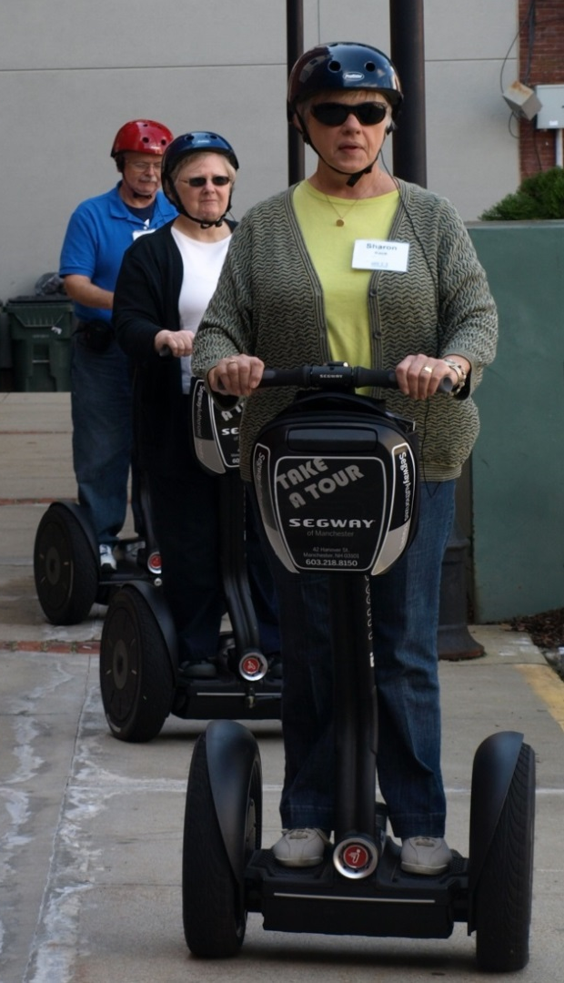
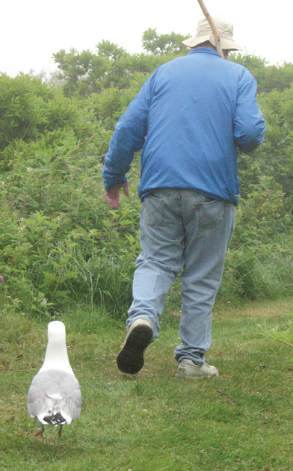
Follow us to OLLI at GSC!

Slide 36


Establishing the Base: Identifying NH’s Non-Traditional Oral Health Settings
AHA Quarterly Meeting
June 15, 2017
Notes:
The New Hampshire Oral Health Coalition is a diverse group of organizations, agencies, and individuals, concerned about the impact of oral health issues facing New Hampshire. This group is broadly representative of those involved in oral health provision, planning, policy-making and funding including the dental and medical communities, the legislature, educational programs, advocacy groups, insurance providers, state agency leaders, and private funders.
Our mission is working toward optimal oral health for the residents of New Hampshire.

Slide 37
Establishing the Base
Why – Where do we start?
Where are the programs?
Who do they serve?
What do they do?
Who does it?
How is it paid?
Are there gaps?
Notes:
Types of services available
Population served
Staffing patterns
Reimbursement resources
Gaps in services or obstacles to access
including those related to geography and subpopulations
MOST JARRING GAP LACK OF SERVICES AVAILABLE TO LOW-INCOME ADULTS
NO SYSTEMATIC - FULLY AND SUSTAINABLY FUNDED – STATEWIDE WAY TO ACCESS
CMS = NO MINIMUM REQUIEMENTS FOR MEDICAID ADULT DENTAL COVERAGE – LESS THAN HALF OF STATES PROVIDE COMPREHENSIVE
NH ONE OF 13 WITH EMERGENCY ONLY COVERAGE
TREATMENT OF PAIN AND INFECTION - EXTRACTION AND PHARMACEUTICALS
NO DENTURES
MEDICARE COVERING 266,000 NH CITIZENS (2009) PROVIDES NO DENTAL BENEFIT

Slide 38
Cutting the data:
35 of the entities provide OH services in 58 programs e.g. nursing homes, school-based programs, mobile vans etc.
By far, the most services are provided in schools and dental operatories**.
** For the purpose of this study and report: One operatory is a single/or multi-chair set-up with a dentist-based model.
Notes:
Programs have sprung up to meet the needs of these adults in ways that make sense
for their populations and using available resources

Slide 39
Program Types and Numbers
Program Types Identified | Number
Child Day Care | 1
Dental Operatory | 17
Head Start | 7
Medical Office | 168
Mobile Dental | 6
Nursing Home and Long-Term Care | 4
Other/Undesignated | 1
School Oral Health | 21
Senior Center – Adult Day Program | 1
Voucher Paid Dental Referral | 6
Women Infants and Children (WIC) | 6
Notes:
Conducted interviews at 58 programs
Approximately 29 provide services to meet some of the needs of low income adults

Slide 40
Model Frames
Dental Operatories affiliated with Federally-qualified Health Centers, community health centers, etc
School-based and school-linked programs, WIC and Head Start
Nursing homes and seniors, portable contract services
Medical offices; and medical offices plus hygienist
Notes:
We took the 58 programs and sorted them into 4 buckets
Roughly
Dental operatories providing care to all ages
children’s programs pre-K – 12
Services to adults in institutions and senior centers
Primary Care Medical offices serving children

Slide 41
Emerging Workforce Models
Hygienist-Centric models
Dentist-Centric models
School-Based Programs
Head Start
WIC
Child Care
Mobile
Hospital-Based Operatories
Community-Based Clinics
Nursing Homes
Contract Services
Notes:
Children v adults
Staffing differences
Differences in reimbursement
Differences in services
Portable v bricks and mortar

Slide 42
Pathways to Oral Health Access: A Fork in the Road
Pathways to Dental Access: Medicaid-covered, low-income, and underinsured adults.
Community-based Oral health and Dental Program, e.g. schools, nursing homes, sr. centers, mobile or community-based operatories, van, etc.
Programs vary by cost, location, accessibility, financial models, subsidies, and support services.
Private Dental Offices
"Go to the Dentist"
Case by case re: cost, location, accessiblity, financial models/sliding fee/payment play, pro bono.
Emergency Department (Urgent)
Traditional or diversion program.
Vary significantly re: availability of dental providers on site or referral, willingness to provide pain managment ongoing or repeatedly, f/u referral network, etc.
Notes:
NH Medicaid one of 13 states with emergency only dental benefits for adults
Pain & infection
Extraction, antibiotics, pain meds

Slide 43
Ages Served by Community-Based Dental Operatory Programs N=17.
Notes:
Dental operatories have a broad mission and scope of service including restorative care for all ages
Along with private practice dentists who accept Medicaid are the main source of oral health care for low-income adults outside of the Emergency Department
Interviewed 17 15 serve adults and of those 14 serve adults beyond age 65
Most are bricks and mortar so the patient has to be able to get to them
More likely than other community programs to bill Medicaid, private insurance and offer a sliding fee schedule
All expect the patient to pay a co-pay or minimal fee but if not able, most write off the expense.
Full range of services preventive – restorative and rehabilitative up to the budget limits – REMEMBER NH EMERGENCY ONLY MEDICAID POLICY –
Programs get creative trying to provide services to adults
EXTRACTION OK DENTURES????
DENTURE RAFFLE STORY

Slide 44
Services in Senior Centers and Institutional Care
Nursing homes that participate in the Medicare or Medicaid in NH, must provide for emergency dental care and any routine dental care defined within the Medicaid state plan.
Nursing homes that participate in the Medicare or Medicaid in NH,
must provide for emergency dental care and any routine dental care
defined within the Medicaid state plan.
4 interviews with nursing home providers representing 50+ facilities
All are portable
Range of services are based on contract between the provider and the facility
Services: screening, exam, prophy, FV, ITR, some restorative, some denture repair
Options beyond the contract are the responsibility of the patient or family
Changing demographic and health status
Notes:
Interviewed 4 nursing home oral health providers Provide services in 50+ facilities
contracts provider dentist and the facility negotiated, set number of hours per month at a set rate.
limited number of dentists who currently service NH nursing homes - mobile or stationary equipment.
Full range of services covered is identified in the contracts but all offer screening, oral exam, prophy, FV, acute/non-acute restorative series, rehab services including some fixing and relining of dentures
Need referral for new dentures, oral surgery or other PROBLEM
Patient or family must pay and even if can touch to find a private provider
The demographiic has changed over time from the “rest home” model where people went to just live out their lives. Residents now seem to be older and sicker unless there are at the care center for short-term rehabilitative treatment. nursing home stays are on average shorter than in the past. residents now tend to have more natural teeth, dentures, and even implants. More behavioral issues and chronic conditions are more medically compromised and have complex lists of medications, some of which negatively impact oral health.

Slide 45

.
1 interview with senior center providers serving 5 sites
Services: screening, exam, prophy, FV, X-ray, ITR, some
restorative, some denture repair
At no cost to qualified patients
Notes:
Contracted, portable
Dentist
Grant funded program
Gaps: geographically
limited number of programs
limited financial resources

Slide 46
Other adult oral health models
Voucher Programs
Voucher programs present few common attributes, but are designed and funded to fill a gap in the local oral health delivery system including given rural areas of Strafford, Coos and Monadnock counties
Emergency Department Diversion
Pre-Surgery oral health evaluations
Hospital based clinic Dental Director working with hospitalists
Mothers in some WIC programs receiving dental care and education
Oral health services for special populations e.g. residents of low income housing, those in unstable housing situations, food pantry clients
Hygienist services in a medical practice
Oral health services provided in correctional settings
Notes:
Vouchers 6 interviews 3 programs for adults
Limits
dollar amount
only specific services covered
referral network adequacy
waiting lists usually for adults
accept only patients of the umbrella entity
income eligibility requirements
most have adequate referral network but becoming harder as reimbursement is low

Slide 47
Cross cutting sustainability factors
Reimbursement resources and levels
Robust referral networks
Workforce allocation

Slide 48

Applying the Data in Your Community
How might dental disease impact your target population?
What public or private oral health resources are available to meet
the demands of your target population?
How can you provide support services for your clientele to mitigate the consequences of the social determinants of health, such as lack of transportation, provider availability, childcare, etc?
Find the Coalition Baseline Survey Report and GIS Map at
www.nhoralhealth.org

Slide 49

How to Contact Us
NH Oral Health Coalition
4 Park St Suite 212
Concord NH 03301
603-415-5550
www.nhoralhealth.org
Gail T Brown JD, MSW
Director
gbrown@nhoralhealth.org
Regina Blaney
Administrative and Data Coordinator
rblaney@nhoralhealth.org
Judith L Nicholson MEd
Survey Coordinator
jnicholson@nhoralhealth.org

Slide 50

You may feel that your part is small and you may not even see your role yet. I am here to shout it out: Every person in the process is important. You are AWESOME! Together we will achieve our vision. Thank you for participating!

Slide 51
Thank you for participating!
For questions or additional information, contact:
Jennifer Rabalais
jennifer.rabalais@unh.edu
228-2084 x14

