Slide 1

Creating a Collective Approach to Address an Aging NH
NH Alliance for Healthy Aging
Quarterly Meeting
September 14, 2016

Slide 2
Today’s Agenda
Welcome
An Introduction to Equity and Diversity in NH by Melina Hill Walker and Nathalie Ahyi
Update on the Tri-State Learning Collaborative
Presentation on Planning for the Upcoming Legislative Year by Doug McNutt
Solution Journalism Update
Strategic group updates

Slide 3
Icebreaker: How do you define your culture?
On the index card in front of you please do the following:
Write your first and last name.
Take 2 to 3 minutes and write three words to describe your cultural identity
(there is no wrong answer).
You will share this information as part of your introduction.

Slide 4

An Introduction to Diversity and Equity in NH

Slide 5
Our Goals Today
Present NH’s changing diversity.
Improve understanding of the social, cultural and community factors that contribute to health.
Discuss health disparities and the barriers that currently exist for some communities.
Recommend solutions that will open pathways to health across communities.

Slide 6

How do we define diversity in NH?

Slide 7

Diversity of “Languages Spoken at Home” Other than English by County
Percentage of population 5 years and over speaking Languages other than English at home.
Spoken language (other than English) with the highest percentage.
Percent of Population from (B) that is 65 and older.

Slide 8
Diversity of “Languages Spoken at Home” Other than English by County
Coos County
13.1%
89% - Other Indo-European
46%

Slide 9
Diversity of “Languages Spoken at Home” Other than English by County
Hillsborough County
12.9 %
47% - Other Indo-European
26.9%

Slide 10
Diversity of “Languages Spoken at Home” Other than English by County
Grafton County
7.0%
39% - Other Indo-European
31% - Asian and Pacific lsland
C. 21.2%
1.7%

Slide 11
Diversity of “Languages Spoken at Home” Other than English by County
Carroll County
2.7%
56% other Indo-European
46%

Slide 12
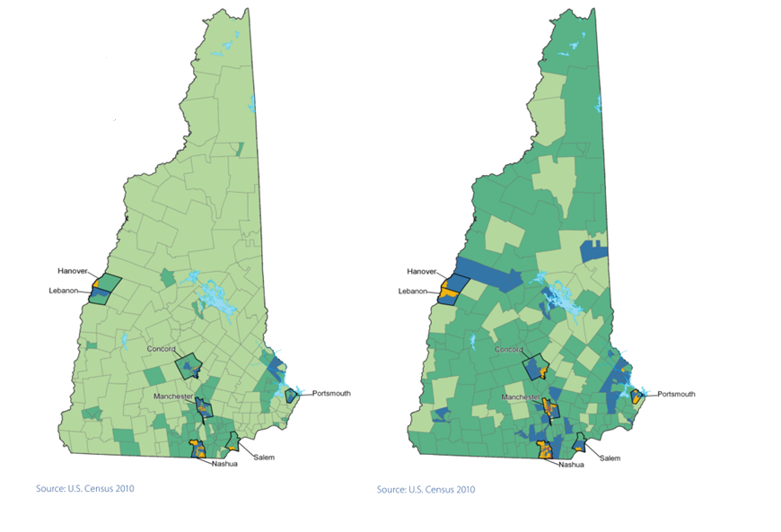

NH’s Growing Diversity
Percent Minority by Census Tract, 2010
Percent Minority Under 18 by Census Tract, 2010
Under 5%
5 to 10%
10 to 20%
20 to 40%
40% and greater

Slide 13


Opening Pathways to Health in New Hampshire

Slide 14


Slide 15

What Impacts Our Health

Slide 16
Specially…
Social and Economic Factors
Physical Environment
Education
Employment
Income
Family & Social Support
Community Safety
Environmental Quality
Built Environment
Clinical Care
Access to Care
Quality of Care
Health Behaviors
Tobacco use
Diet & Exercise
Alcohol Use
Sexual Activity
Adaptation of
County Health Rankings Model
© University of Wisconsin
Population Health Institute

Slide 17
Health Disparities
The
Issue
“A health disparity is a particular type of health difference that is closely linked with social, economic, and/or environmental disadvantage. Health disparities adversely affect groups of people who have systematically experienced greater obstacles to health based on their racial and/or ethnic group; religion; socioeconomic status; gender; age; mental health; cognitive, sensory, or physical disability; sexual orientation or gender identity; geographic location; or other characteristics historically linked to discrimination or exclusion.”
-National Stakeholder Strategy, Healthy People 2020 and Health and Human Services (HHS) Plan

Slide 18
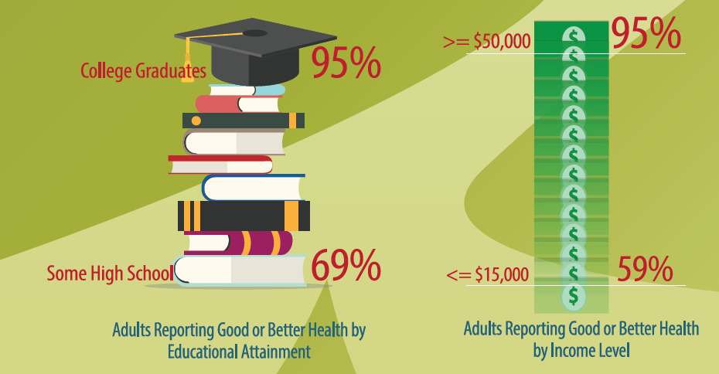
Examples of Inequities in NH

Slide 19
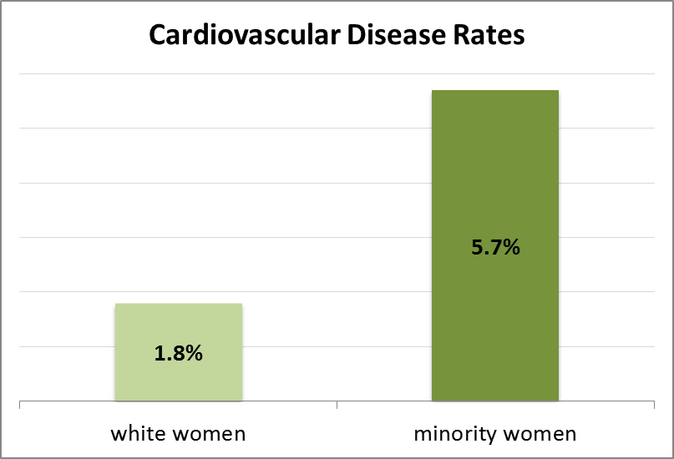
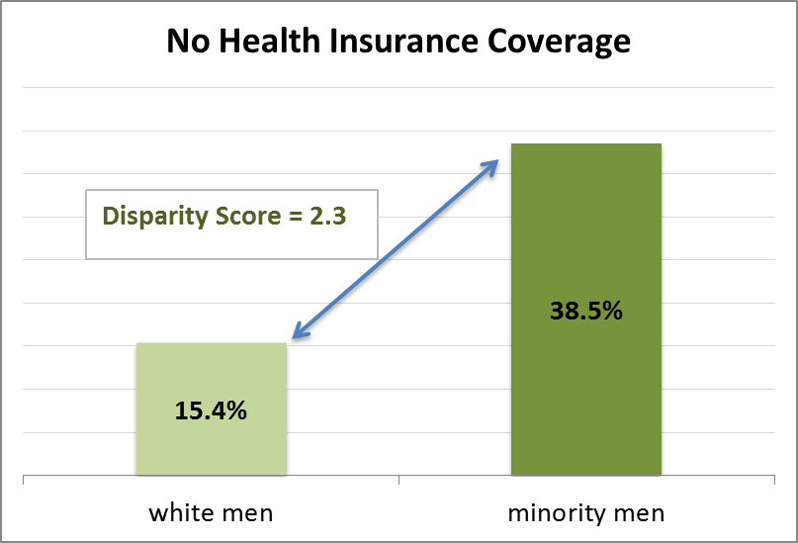
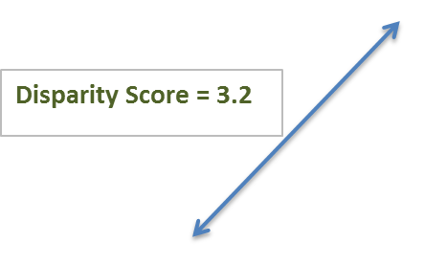
Examples of Inequities in NH
From: Health and Equity in NH, 2013 Report Card

Slide 20

Why do we need to solve this?
The US economy will gain an estimated $309 billion by addressing the issue of health disparity.
Ending health disparities can lead to a healthier and wealthier New Hampshire.

Slide 21
Solutions…
Raise community awareness and educate the public about health equity
Use an ‘Equity Frame’ when considering policies, systems, and environments
Use inclusive community engagement strategies (importance of having the representation of diverse elders at the table)
Importance of Cultural Effectiveness of Organizations to support the diverse workforce needed, in particular the workforce for aging healthcare services.

Slide 22
What Can You Do?
Always ask yourself:
Which elders are not thriving in our community?
Who else should be included at the table?
How can we make our table welcoming to everyone?

Slide 23

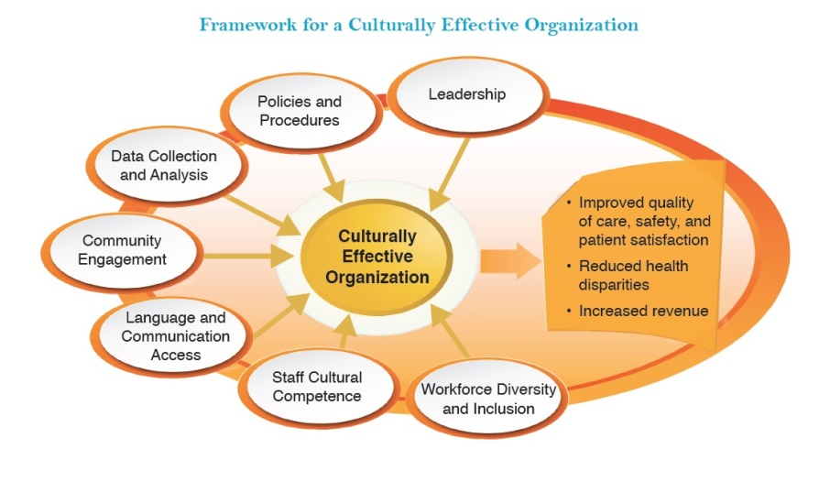

How Can You Do it?
There are multiple opportunities for further engagement with the Health & Equity Partnership by getting involved in the NH HEP committees and working with other partners on these three priorities areas.
Environments Where We Live, Learn, Work, and Play
Access to Care
Workforce Diversity
Cultural Effectiveness of Organizations
Access to Care
REaL Data – Collection and Use

Slide 24
Become a Partner
Google Group: EquityNH
Monthly e-newsletter
website: www.equitynh.org
Facebook: www.facebook.com/equitynh/
Nathalie Ahyi, Director of NH HEP
Email: nahyi@healthynh.com

Slide 25


www.agefriendly.community
Increasing the collective impact of aging in place initiatives through shared learning.

Slide 26






Funders

Slide 27
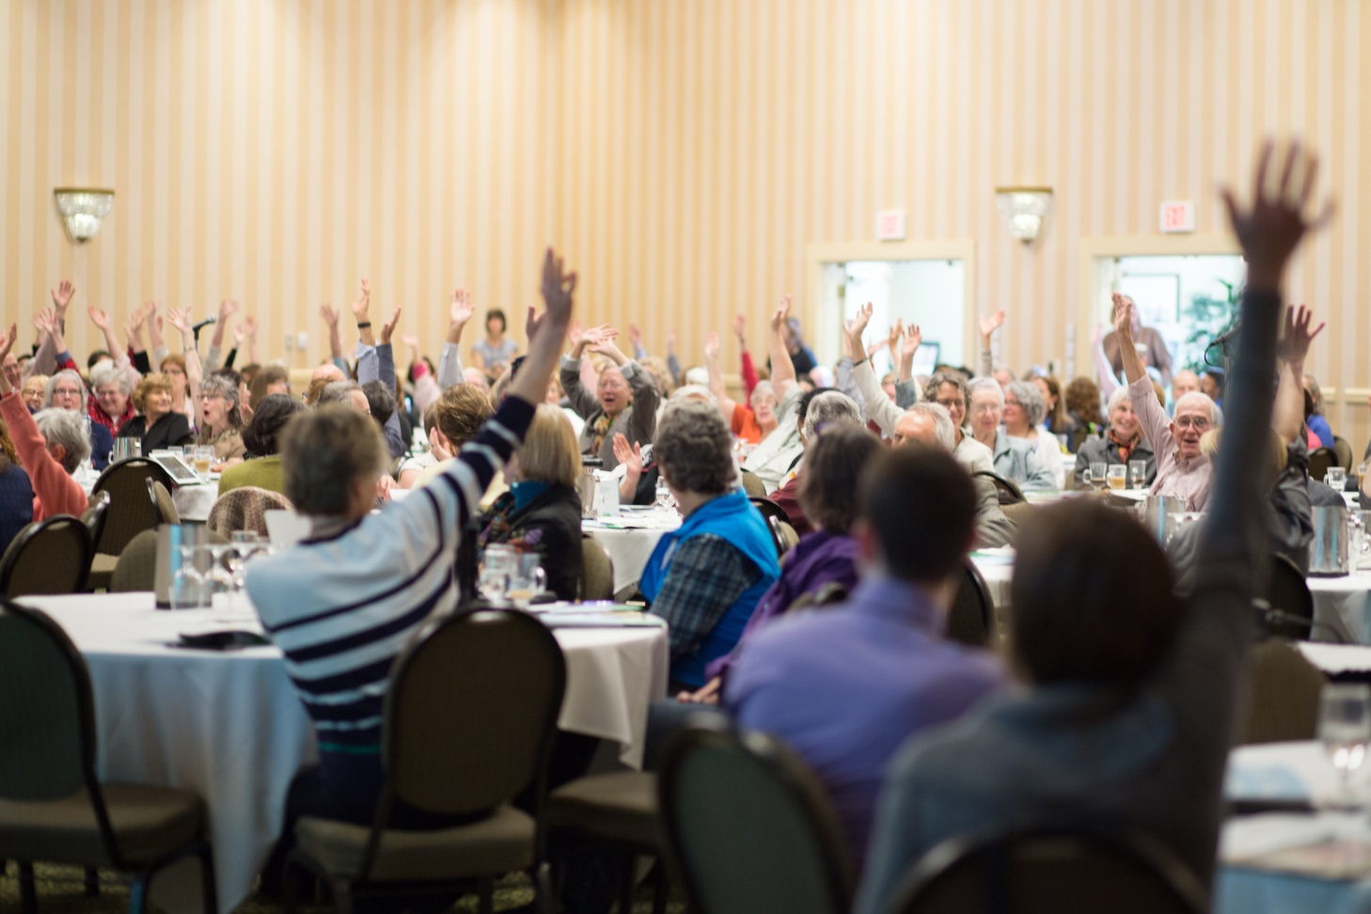
Shared Learning
Monthly Webinar Series
Community Leaders Forum
Semi-annual Events

Slide 28
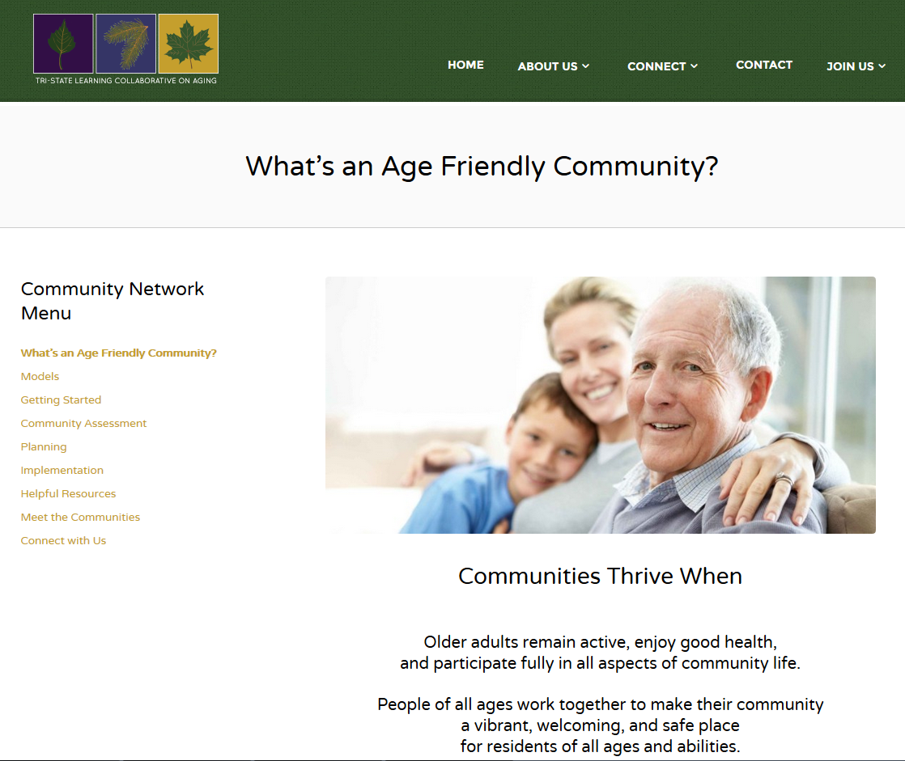
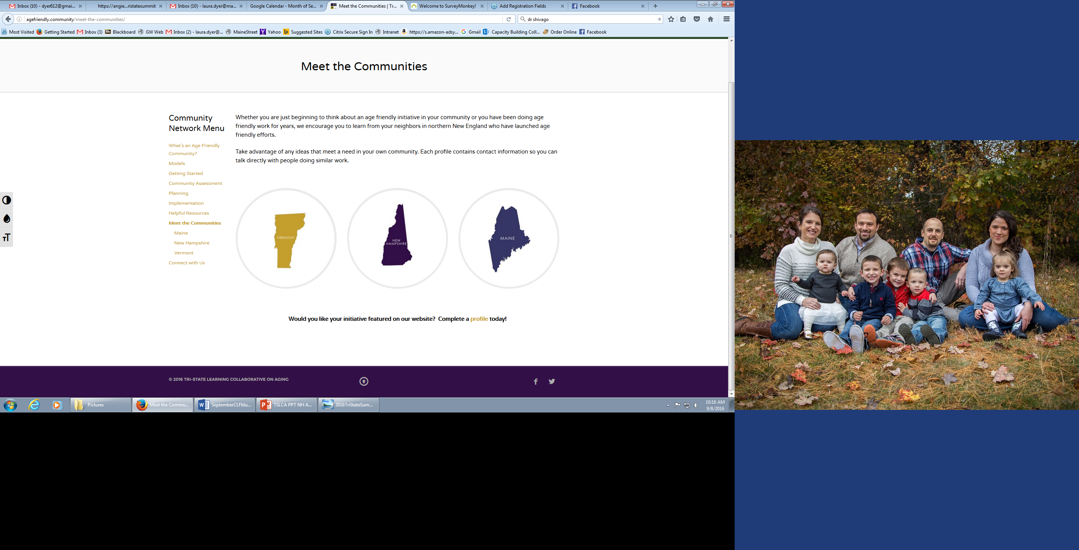
TSLCA Community Network

Slide 29

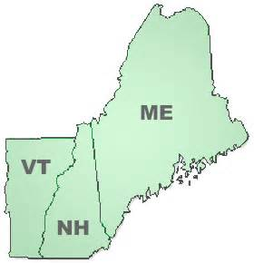
Save the Dates!
November 4th - Frank Jones Center, Portsmouth NH November 15th - Hotel Coolidge, White River Junction, VT November 17th - Sunday River (Grand Summit) in Bethel, ME
Come to one event – or come to all! We’re better when we share, learn and grow together as a region.
Informal family caregiving from a multifaceted point of view.

Slide 30

Target Audience & Objectives
Caregivers of older adults
Leaders of age friendly community/aging in place initiatives
Town/City managers/administrators/planners
HR directors/Business leaders
Community providers of family caregiver supports and services
Advocates and policy leaders
Health care providers/care managers
Higher education partners
Participants will:
Broadly understand the challenges of caregiving
Learn what resources, models and laws, support caregivers across multiple settings
Connect to tools and ideas that will help them increase supports and services to caregivers in their organizations and communities
Contribute their wisdom and vision to guide development of future work in this area

Slide 31


About the Process
Contribute
Connect
Listen
These events will help build a roadmap for collective action to address the many challenges care partners face.

Slide 32
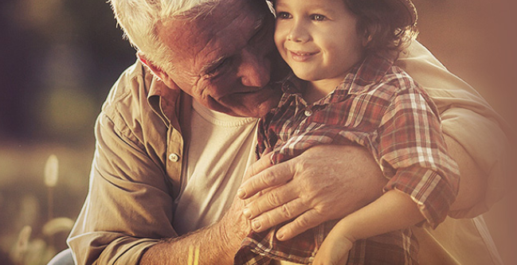
Connect
Registration for the Cross-border Conversations on Caregiving opens in October!
Community Leaders Forum: Formal Fundraising Efforts
September 27th 12:00 – 1:30 via webinar
Preventing Elder Abuse & Exploitation
September 29th 12:00 – 1:30 via webinar
Register for webinars and events at www.agefriendly.community

Slide 33
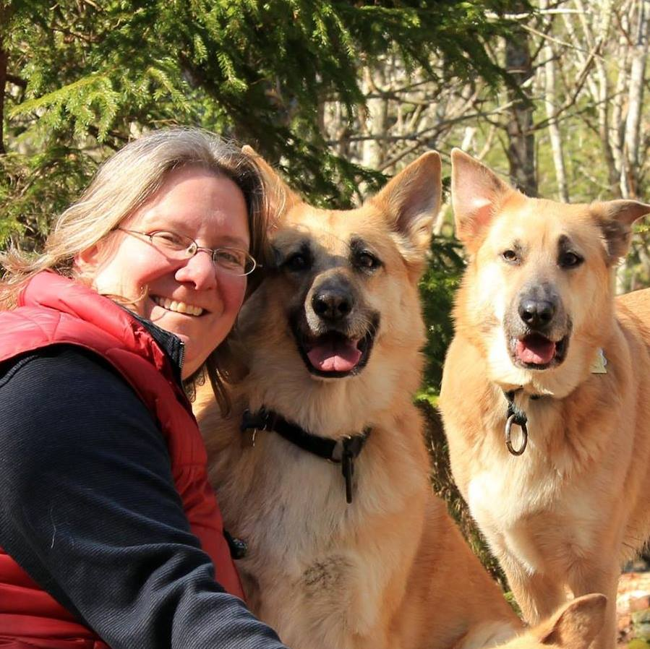
Contact
Jessica L. Maurer, Esq.
Executive Director, Maine Association of Area Agencies on Aging Project Manager, Tri-State Learning Collaborative on Aging Co-Chair, Maine Council on Aging
207-592-9972
jmaurer@maine4a.org
www.agefriendly.community

Slide 34
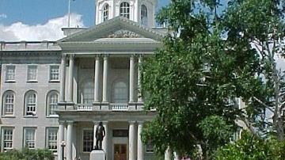
Planning for the Upcoming Legislative Year

Slide 35


Slide 36

Update from the Work Groups
Transportation
Zoning
Workforce
Cross Disciplinary – Policy
Care Coordination - Practice
Caregivers
Advocacy
Information Coordination

Slide 37
Group | 1st Meeting Time | 2nd Meeting Time
Transportation | June 13 | July 18
Zoning | July 14 | TBD
Cross Disciplinary- Policy | June 21 | August 11
Workforce | June 29 | August 5
Information Coordination | June 29 | August 10
Caregiving | June 24 | July 27
Care Coordination -Practice | June 13 | July 26
Advocacy | June 28 | July 28
Workgroup Calendar

Slide 38
Caregiver Group Update
Meeting June 24th
Focusing the Caregiving Group on
Utilizing the previous action plan as a springboard
Informal/unpaid caregivers

Slide 39
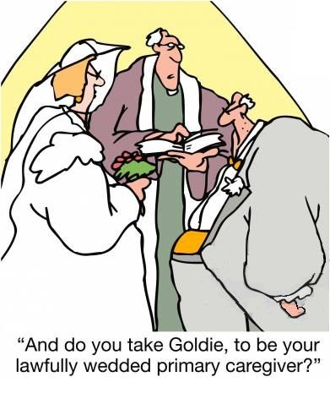
Informal Caregiver

Slide 40
Caregiver Group Update
Meeting July 27th
Identification of 2 strategies:
Employer case model of best practices
Five Questions to be developed and used to help caregivers self identify

Slide 41
Caregiver Group Update
Meeting July 27th
Developing a case model for employers:
Identifying and reaching out to NH businesses that have supportive employment models to
Learn from them
Gain their support to help us involve more businesses.

Slide 42
Caregivers
Meeting July 27th
Tools for employed caregivers– to discuss their rights and accessible resources.
The value of securing assistance
caregivers don’t feel comfortable reaching out to ask for help
.
.

Slide 43
Caregiver Group Update
Meeting July 27th
Informal caregivers have a difficult time identifying that they are caregivers
Spouses, Children, Parents
Five Questions to be developed/identified to help caregivers grasp that they are informal caregivers and get help
Example: one local ServiceLink is trying to identify caregivers by having them answer a brief survey and then targeting those folks for powerful tools for caregivers.

Slide 44

Thank you for participating!
For questions, or more information contact: jennifer.rabalais@unh.edu

