Slide 1

Creating a Collective Approach to Address an Aging NH
September 24, 2015
Notes:
I want to thank you for inviting me here today to talk about the work that the Endowment for Health has been undertaking to create a collective approach to address the changing and aging of NH.
My name is Kelly Laflamme.
I am a Program Director with the Endowment. In that role I am responsible for the implementation of two of our targeted initiatives: Ensuring the Health and Dignity of Elders and Advancing Health Equity for Racial, Ethnic and Language Minorities in NH.
I have been with the Endowment since 2006.

Slide 2
Today’s Agenda
Welcome
Round the Room Introductions
Presentation on the Economic Impact of Aging in NH by Steve Norton of NH CPPS
Update on the Collective Impact Process
Update on the Action Planning Workgroups
Breakout into Workgroups

Slide 3
Rapid Introductions
Tell us your NAME
Tell us what TOWN you live in
Tell us ONE HAT that you are wearing today

Slide 4
The Economic Impact of Aging in NH

Slide 5
Endowment for Health’s Ongoing Activities to Support the Elder Health Coalition
Quarterly Coalition Meetings Workgroup meetings in the 6 domains
Research by NH Center for Public Policy Studies on Economics of Aging
Advisory Committee on Research
Tri-State Learning Collaborative Participant Committee
Creating a Collective Impact Approach to Advance Healthy Aging in NH
Environmental Scan of Resources for Older Adults Done by CACL - UNH
Steering Committee
Core Advisors for Coalition
Support of Frameworks “Reframing Aging” project
June, 2015
Notes:
So over the past several months, we have been making investments of our grantmaking dollars and staff time for these activities. These investments are helping to create the conditions for successful collective impact.
In addition to the things I have already talked about … the research, the coalition, the steering committee, and the workgroups…this chart also shows our support of the Tri-State Learning Collaborative on Aging.
Which is convening its advisory council for the first time next week. The Tri-State Collaborative will be rich source of knowledge, ideas and collaboration across ME, NH and VT.
It also shows our grant support for the national work to Reframe Aging which has been commissioned by 8 leading aging organizations and funded by national and regional funders.
This work is being undertaken by the FrameWorks Institute and our grant support will ensure we get boots on the ground in NH during their research and message testing phase.

Slide 6
Steps to Launch Collective Impact
Created Shared Vision 2014
Identify priorities & measures for 2 to 3 year Action Plan – Summer & Fall 2015
Establish a leadership structure Fall 2015
Launch a Statewide Coalition and Steering Committee early 2016
Identify partners to lead strategies and engage additional members 2016
Transition to a permanent Backbone 2017
Notes:
So how will we do this?
We have contracted with the Center on Aging and Community Living to lead us all through an action planning process. Over the next several months, under the facilitation of staff from CACL – we will convene workgroups to co-create an action plan for the next 2-3 years. This will set targets and shared measures that are doable with a stretch over this time frame and recognize that there are longer term goals and targets that we’ll focus on in the future.
Developing leadership, a Steering Committee, to guide this plan and monitor the implementation of the plan once it is created, is an important step for the next several months. We’ll start by working with those who served in a core advisory capacity to the Endowment’s work thus far, to help create the guiding principles and role description for steering committee members.
Our vision is that the Steering Committee won’t just lead the planning, it will launch and lead a Statewide Coalition…focused on a collective impact approach to advance healthy aging and age-friendly communities in NH.
It will take more than the Steering Committee – we will need to identify partners to lead the strategies selected in the planning process and to engage more members to support this work.
The EH is committed to providing the backbone support to undergird this effort during this formative time – like an incubator for the coalition – with the intention of it being a free-standing coalition in the future.

Slide 7
Creating a Collective Approach to Address an Aging NH:
A Shared
Vision for
Our Future
We envision communities where New Hampshire’s culture, policies and services support our elders and their families, providing a wide range of choices that advance health, independence and dignity.
Coordination Communication Technology Information
A broad range of living arrangements are available
Fundamental needs are met
• Food
• Safety
• Info about Services
• Shelter/Warmth
• Transportation
• Planning & zoning
• Resources available to support living at home
• Affordable
• Home modification options
Equity
Independence
Dignity
Person-Centered
Respect
Choice
Support
provided to caregivers and families
Advocates for elder issues are effective
• Access to info on services and supports
• Caregiver education and training programs
• Flexible funding to meet the unique needs of caregivers
• More consistent pay for formal, paid caregivers
• Respite care
• Cultural view of elders is positive/realistic
• Laws are elder friendly
• Aging issues are a community wide priority
Elder Friendly Community
Quality physical and mental wellbeing supports are in place
Social and civic engagement options are plentiful
• Meaningful connections with family, friends and neighbors
• Paid and volunteer work opportunities
• Active engagement in social life
• Cultural, religious activities plentiful
• Access to preventative care
• Access to medical, mental health and palliative care
• Planning for end of life care
Supported by
Revised 4/2015
Notes:
And that is what our vision is all about.
It was created during 2014 with the input of more than 40 stakeholders, the input of more than 100 elders who participated in focus groups across the state, and with interviews of 10 cross sector business leaders in NH.
This wheel was used to capture the key themes that we heard in our planning conversations, our focus groups and interviews.
This vision recognizes that the health and well-being of our elders requires a comprehensive approach..
Fundamental Needs of food, shelter, and safety need to be met.
A broad range of living options are needed to support us at every stage of the aging process
Our families and caregivers need support in order to support us through our aging and dying processes
Social and civic engagement options need to be plentiful and appropriate for being of all stages of aging and all cultures
Quality physical and mental wellbeing supports need to be in place – to promote healthy aging and prevent decline, to address health issues that occur as we age and to support elders and their families through the end of life.
And finally – we need a strong and effective capacity to advocate on behalf of elders and their families.
Those of you familiar with AARP’s work to create Age Friendly Communities or the World Health Organization’s work or other age friendly communities work will notice that this vision is very similar to their models. For example, the World Health Organization breaks their model out into 8 areas – but we combined some of their domains and added a special emphasis on both advocacy and caregiving.
You might be surprised that NH’s largest health foundation is supporting and leading such a broad and comprehensive vision and that what you might traditionally think of the EH’s work is only the green wedge – but the Endowment for Health has a comprehensive and inclusive view of health.
Realizing this vision isn’t going to be easy. And that is why a collective impact approach is what we think is the best way to work.

Slide 8
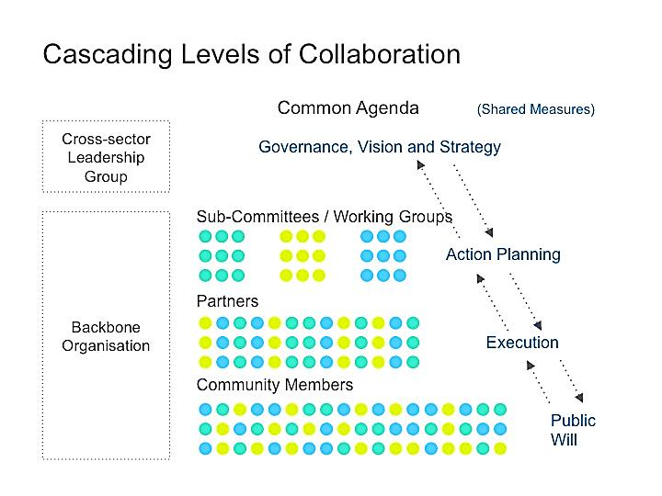
Source: http://www.collaborationforimpact.com/wp-content/uploads/2014/02/Cascading-collaboration.jpg
Notes:
This is a visual of what the collective impact approach will look like as it develops…it isn’t linear…notice the arrows going up and down the levels of collaboration.
Right now we have our Vision and we’re working with partners to turn the vision into a common agenda with strategy and measures.
We are working to establish the cross-sector leadership group.
We’ve convened working groups and launched the action planning phase.
And the Endowment has volunteered to provide backbone support until we identify or create a separate backbone organization in the future.

Slide 9
Action Planning Process
Vision Strategic Destination Summer 2015
Identify Strategies
September 2015
Prioritize and Set Objectives November 2015
Select Measures December 2015

Slide 10
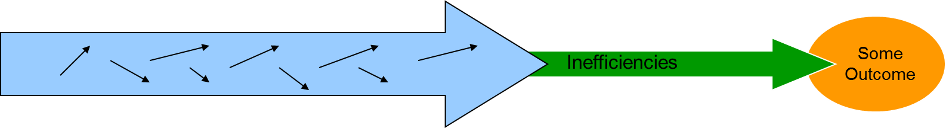
Creating Alignment
Working in isolation = Isolated Impact
Working together = Collective Impact
Policy Environment
Academic
Providers Non-profits Media Civic Groups
Enhanced Outcomes for Elders
Government Businesses Public Health Faith-based
Adapted from : Paul Epstein, Results that Matter Team
Notes:
But let’s be honest, working together in unison isn’t easy. And it isn’t the normal way of doing things.
When we try to create social change and create better outcomes for people we care about without the intentionality of a collective impact approach, it looks like the first arrow…we sort of all aiming in the same direction – but a lot gets lost along the way through inefficiencies and missed targets.
But when we align our efforts – recognize that we all have an important and differentiated role – we have an integrated system – with mutually reinforcing activities which leads to a greater chance of hitting the targets and enhancing outcomes for elders. Put another way – it’s not about giving up our work or even our turf – but it’s about being clear in what our work accomplishes and acknowledging that we can’t do it alone.

Slide 11

Notes:
This is what I think Collective Impact looks like.

Slide 12

Free membership for service providers, local officials, advocates, caregivers and older adults from Maine, New Hampshire and Vermont.
Simply go online to register:
http://agefriendly.community/
Notes:
You are all eligible to participate for free in a Tri-State Learning Collaborative on Aging.
The Learning Collaborative is offering free webinars, peer to peer learning opportunities and an annual conference.

Slide 13

Upcoming Webinars
Supporting Community Health
Wednesday, September 23rd from 12-1:30 PM
Age Friendly Community Model: Villages
Wednesday, October 21st from 12-1:30 PM
Notes:
There are two upcoming webinars planned – you can register now.
And others will be planned at least monthly, if not more.

Slide 14
Don’t Miss the Boat!
Participate in a Work Group
Join the TSLCA
Sign up for the Webinars
Register and mark your calendar for December 10th

Slide 15


Questions?

Slide 16
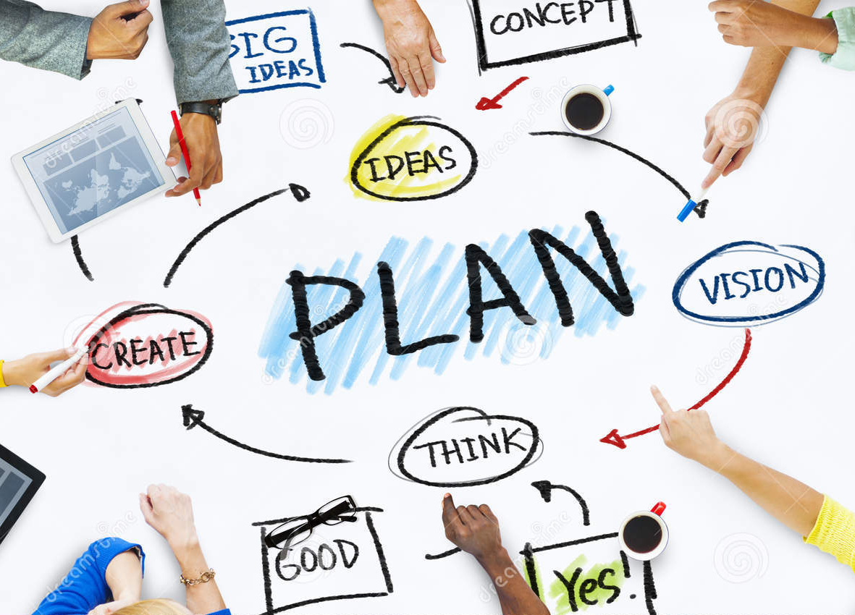
Update from the Work Groups
Social and Civic Engagement
Fundamental Needs
Broad Range
of Living Arrangements
Quality Physical and Mental Wellbeing
Support to Caregivers and Families
Advocates are Effective

Slide 17
Priority Area: Fundamental Needs
Definition: Fundamental needs are defined as food, safety, information about services, shelter and warmth, and transportation. ­­­­­­­­­­­­­­­­­­­­­­­­
Strategic Destinations
FROM | TO
Access to food for Elders remains a priority Access to information about nutrition is inconsistent. Cultural perceptions held by Elders in NH may limit program participation | Consistent, high quality information about and access to nutrition for Elders in NH The reduction of stigma regarding accessing assistance in various forms will need to be addressed
Various agencies currently assess the safety of older adults; however there is little consistency in how this is accomplished. Currently, there are few programs that Elders can access broadly that provide flexible funding for assistive technology, equipment, and other tools to promote aging in place. | A universal understanding of safety and consistent methods to measure safety will be important. Elders need access to flexible spending dollars for assistive technology and equipment to promote safety
High staff turnover, inconsistent knowledge transfer from staff member to staff member, high client volume and low staff volume make access to hi quality, accurate, consistent information challenging. | Universal, state-wide standards for programmatic information delivery will be key Consistent training, technical assistance, and education for all staff is necessary
Currently, Senior housing options are inadequate in number. Many emergency or temporary shelters are not elder-friendly or easily accessible. While some towns in NH support Elders by creating Elder-friendly communities, stigma, tension with town officials, and town economics present challenges. | NH needs more options for Elders wishing to remain in the community NH needs to embrace community-based, Elder-friendly communities in order to fully support its aging population
Transportation across NH is limited, and does not always meet the needs of Elders. There are not enough volunteers to supplement need Inconsistent funding makes sustainability difficult. Insurance costs make sustainability difficult. | Consistent funding, travel training, a strong volunteer transportation network, and discussions regarding vehicle insurance costs for drivers and organizations will all need to be explored.

Slide 18
Priority Area: A Broad Range of Living Arrangements is Available
Definition: Planning and zoning; resources available to support living at home; affordable [homes], and home modifications options ­­­­­­­­­­­­­­­­­­­­­­­­
Strategic Destinations
FROM | TO
NEIGHBORHOOD AND COMMUNITY LEVEL: Communities not designed to support aging in place. Facilities for people who cannot stay at home are often segregated, unappealing | Communities recognize changing needs of citizens, workers and visitors and adapt/adopt zoning and regulations to support visions and plans that address them, including various types of homes as well as retirement complexes, assisted living, etc. having walkable access to daily needs, easy transportation choices, proximity to green gathering spaces, more.
HOME LEVEL: current thinking reflects way of life that is in the past (e.g., subdivisions, rules about who can live in a home, no thought about changing needs when homes designed…) | Planners, designers and developers as well as municipal leaders recognize importance of a variety of choices in home design, location, affordability and who may live there– and their importance to healthy living (including physical, social and economic health)
INDIVIDUAL LEVEL: Currently a hodge-podge of services to support living at home – services that vary by quality, accessibility, affordability. Coordination of services and information about them sporadic and most who need this assistance don’t know where to start looking or what to ask. | Available resources (including resources themselves and information about them) are coordinated. Information about both is plentiful and disseminated through various channels.

Slide 19
Priority Area: Support is Provided to Caregivers and Families
Definition: Access to information on services and supports; caregiver education and training programs; flexible funding to meet the unique needs of caregivers; more consistent pay for formal paid caregivers and respite care. ­­­­­­­­­­­­­­­­­­­­­­­­
Strategic Destinations
FROM | TO
Outreach and Education: Lack of knowledge by the public sector on caregiving issues and fragmented access to information and services. Flexible employment policies to accommodate employees providing care are not prevalent among employers. | Outreach and Education: Public generally aware and understand definition of caregiver, value of caregiving is understood. Coordinated system provides easier access to information and services. Strong models for employers on flexible workplace strategies to accommodate caregivers with these practices becoming the norm rather than the exception.
Service Development: Limited services for caregivers that provide only temporary assistance. Services don’t address the specific needs of all populations (linguistic and ethnic minorities, older caregivers). Caregiver needs tend to be separated out from the needs of the care recipient. | Service Development: Increased service options including greater use of non traditional strategies (mentoring, care networks, intergenerational care options). Whole person assessments include an emphasis on caregiver needs and service connection for these needs.
Service Integration: Long term care segmented between nursing home/hospital care and community based care. | Service Integration: Coordination of services between nursing home/hospitals and community based care options; resulting in more fluid transitions and greater utilization of all resources.
Advocacy/Planning: Advocacy for caregiving issues is provided by a small number of organizations and not coordinated across the state. Minimal training opportunities to teach caregivers how to be strong advocates for themselves and care recipients. Planning efforts are reactive and not proactive. | Advocacy/Planning: Robust caregiving advocacy network that includes champions outside the provider system and within top leadership across the state (employers, legislators, state government). Programs available to supports and foster strong advocates. Statewide proactive planning efforts to prepare for the state population’s caregiving needs.

Slide 20
Priority Area: Social and Civic Engagement Options are Plentiful
Definition: Meaningful connections with family, friends and neighbors; paid and volunteer work opportunities; active engagement in social life; and cultural and religious activities are plentiful. ­­­­­­­­­­­­­­­­­­­­­­­­
Strategic Destinations
FROM | TO
Existing programs lack diversity and accessibility. | Senior Centers, adult day programs, and other community programs will provide a rich array of culturally appropriate activities that engage people across all generations.
Transportation to engage in community activities continues to be a challenge in many NH communities. | Transportation will be well coordinated and available throughout the state to provide access to a wide range of opportunities for older adults.
The skills and talents of older adults are underutilized in both paid and volunteer work opportunities. | Partnerships will be built at the community level to include faith based groups, volunteer associations and organizations, community service providers and business leaders to support informal and formal connections to community, work, and volunteer opportunities.
There are not a lot of opportunities to engage people across generations and across cultures. | Partnerships will be built at the community level to include faith based groups, volunteer associations and organizations, community service providers and business leaders to create opportunities to bring people of different backgrounds and ages together.
We continue to promote a negative image of aging, perpetuating the stigma around aging. | Aging will be viewed positively as an opportunity. The gifts, skills, talents, and wisdom of older adults will be recognized and well utilized.

Slide 21
Priority Area: Physical & Wellbeing Workgroup Definition: Ensure that quality physical and mental wellbeing supports are in place, including: (a) Access to preventive care; (b) Access to medical, mental health and palliative care, and; (c) Planning for end of life care ­­­­­­­­­­­­­­­­­­­­­­­­
Strategic Destinations
FROM | TO
Workforce GWEP (Dartmouth Centers for Health & Aging) Needs of the workforce | More informed legislature Better link between public/private sectors – legislators, businesses, providers, general public.
Prevention Wellness visits- Medicare (GWEP to promote) Falls Oral Care “Predictable events” | ”Business Approach” Cost effectiveness of good care “Return on Investment” Saving $ = effectiveness and helping people
Dementia Care Multiple current supports Caregiver burnout/aging | Educate general public about aging/opportunities Quality of life, not necessarily quantity Choices Health literacy
Culturally effective care Stigma/ageism Whole person approach/ “Slow Medicine Physical and language | System changes Providers have more direct time with people Accountable care organizations – reimburse prevention & “slow medicine” Integrated care team approach medical/social/psych
Mental Health Services – Integrated care “Backward slide” – not enough GP specialists REAP and VNAs providing brief care “Whole person” approach – integrated care | Technology Reduce office visits with technology monitoring Technology to improve care coordination and integration Reimburse technology use Tech tools

Slide 22
Priority Area: Physical & Wellbeing Workgroup (continued) ­­­­­­­­­­­­­­­­­­­­­­­­
Strategic Destinations
FROM | TO
Medication management Multiple prescriptions Medication adherence Misuse | Proud and appropriately compensated workforce Pay and benefits Take advantage of ACA -> pay CHWs Promote workforce – pride Improve workforce availability “Gatekeepers”
Transportation Non-urgent transportation needed | Reverse “backward slide” of mental health services Shift funding priorities Gero-psych specialists Substance use resources
Technology Electronic medical records Need to include community/non-medical care | Reduce medication misuse Involve pharmacies Resources for med management
Advanced Care Planning Palliative care | Encourage consistent/early use of palliative care Education – public/client/provider/patient Consistent approach
End-of-life care | End-of-life Care Advanced directives – increase percentage Educate all – healthy adults Respect choices
 | Sexuality of older adults Overcome social stigma Increase awareness of issues

Slide 23
Priority Area: Advocates for elder issues are effective
Definition: Cultural view of elders is positive/realistic; Laws are elder friendly; Aging issues are a community wide priority ­­­­­­­­­­­­­­­­­­­­­­­­
Strategic Destinations
FROM | TO
Governmental system components are fragmented and lack power. Example: State Committee on Aging lacks power as originally intended. | All levels of state government are leading and coordinating on aging issues Example: Establish a Commission on Aging
Lacking a consumer advocacy infrastructure Example: Lack of education/support for advocacy on aging and providers are often the advocates. | Create stable infrastructure for advocacy Example: Education mechanisms in place for sharing information and developing leaders
Lack of public awareness regarding why aging issues are important Example: Negative frame of aging | Culture shift to a positive and realistic frame of aging Example: Public call-to-action campaign
Lack of engagement and underutilization of the broad stakeholder community Example: Business sector does not see the problem or why it matters. | New partners engaged, educated, and activated on aging issues. Example: Bolster a stronger partnership with Home Health Association (Nursing Facilitates).

Slide 24
Work Group Breakouts
Caregivers: PSNH Room
Living Arrangements: PSNH Room
Physical and Mental Well-being: PSNH Room
Fundamental Needs: Fireplace Room
Advocates: Fireplace Room
Social and Civic Engagement: Classroom

